Slide 1
THE MBA REPORTER
Empowering Business Leaders: MBA in Action

Slide 2
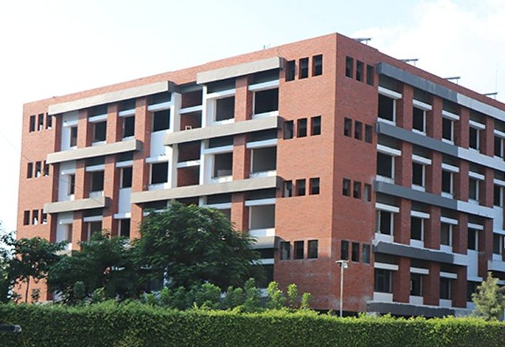

Slide 3
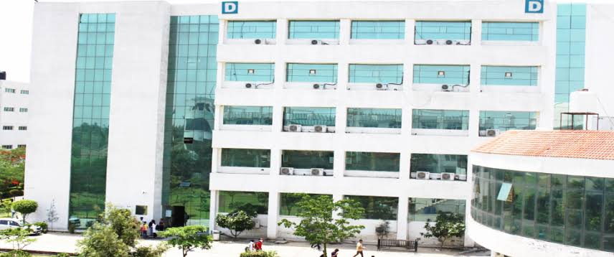
Vision
To develop responsible and globally competent professionals with managerial and leadership abilities to create positive difference in the society.

Slide 4
Mission
M1: To teach, the students, applications of core business principles and develop their abilities in quantitative and qualitative reasoning, business analysis and decision making.
M2: To utilize advanced technology and resources to create leaders who can apply their skills to solve complex business problems.
M3: To create and support a learning framework that integrates business ethics, sustainability, and globalization to produce graduates with creative, innovative and entrepreneurial mindset.
M4: To foster academic and corporate collaborations developing a strong understanding of the dynamics of national and the global business environment.

Slide 5
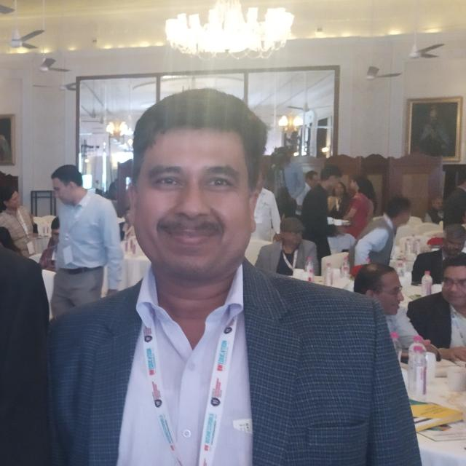
Prof. Akhilesh Mishra (HoD, DMS PIET)
The Department of Management Studies is excited to announce the release of the Eighteenth Issue of our e-newsletter, "The MBA Reporter". This newsletter provides an excellent opportunity to showcase the academic and extracurricular achievements of our MBA students.
Our Department strives to merge exceptional education with top-notch service to the industry. Our ultimate goal is to be acknowledged as a pioneering and prominent management Department. We aspire to offer our students a well-rounded educational experience that balances intellectual and practical skills to equip them to meet various societal needs.
To all our students, we wish you the best of luck in your future endeavors!

Slide 6
DMS - Fraternity
PROFESSORS
Prof. Himanshu Jain
Dr. Saurabh Garg
Dr. Dalbir
Dr. Ankur Sabharwal
Dr. Suman Dahiya
Dr. Anju Kumari
ASSOCIATE PROFESSORS

Slide 7
Dr. Sandeep Kumar
Dr. Mohan Thakral
Dr. Vikas Tyagi
Dr. Sonu Kumari
Dr. Navita
Dr. Preeti Gugnani
Mr. Parikshit Vaid
Mr. Manish Gulyani
Mr. Amit Singla
Mr. Ravi Koul
Ms. Manju Rani
Mr. Vikas Nain
Ms. Ridhi Kochar
ASSISTANT PROFESSORS

Slide 8
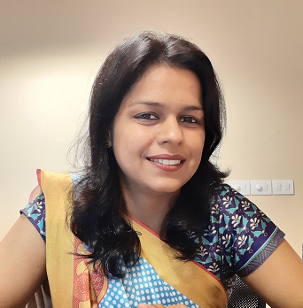
From Editor’s Desk
Faith is the compass that guides us through life's storms, leading us towards hope, love, and greater purpose.
Dr. Suman Dahiya

Slide 9
GUEST LECTURES
Guest lectures in colleges provide students with exposure to diverse perspectives, ideas and experiences beyond the curriculum, enabling them to develop a more well-rounded understanding of the subject matter and real-world applications.

Slide 10
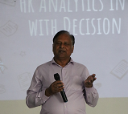
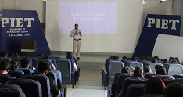
Guest Lecture on “People Analytics and Automation”
An expert lecture was organized on the topic People Analytics and Automation by Mr. Samar Mahapatra, CHRO at Shigan Quantum Technologies Ltd., Gurgaon on
March 2, 2023.

Slide 11
Guest Lecture on “Workshop on Wholesome Banking Experience”
A workshop was organized on the topic of Wholesome Banking Experience on
March 9, 2023, by the Department of Management Studies in Panipat Institute
of Engineering and Technology. The department was honored to welcome Mr.
Shwetanshu (Manager), Mr. Himanshu (SBI Life Insurance) – State Bank of
India as the key resource persons.

Slide 12
Guest Lecture on “Green Marketing and Use of Artificial Intelligence in Marketing”
Expert lecture was organized on the topic Green Marketing and Use of Artificial Intelligence in Marketing by Mr. Himanshu Singla, CEO and Founder – Cyberoism and
Online Trouble Shooters and Director Marketing – Matyaj, Gurgaon. on
March 14, 2023.

Slide 13
Guest Lecture on Agile and
Lean for Modern Management
On April 24, 2023, the Department of Management Studies hosted a guest lecture focused on Agile and
Lean for Modern Management. The esteemed guest speaker was Mr. Manish
Kumar, Manager of the Agile Centre of Excellence at Bain Company. Mr
Kumar is a Certified Agile Coach, Certified Scrum Master, Certified Product
Owner, Certified Kanban Practitioner and Certified SAFE Agilist.

Slide 14
INDUSTRIAL VISITS
Industrial visits to companies allow students to gain practical knowledge about the functioning of different industries, technologies and processes, which cannot be acquired through textbooks or classroom teaching. This helps them to bridge the gap between theoretical knowledge and practical application, and prepares them for real-world challenges and opportunities.

Slide 15
Industrial Visit to Mother Dairy
Industrial visit to Mother Dairy Fruits and Vegetables Pvt. Ltd., Patparganj, New Delhi was organised on 29th November 2022 and 3rd December 2022 for the students to explore the various Milk products produced and distributed by the company across the country.

Slide 16
Industrial Visit to Haier
Industrial visit to Haier was organised on 30th November 2022 for the students to explore the electronic goods manufactured by Haier.

Slide 17
Industrial Visit to Yakult Danone India Pvt. Ltd.
An industrial visit to Yakult Danone India Pvt. Ltd. was arranged for the students of MBA 1st year and 2nd year on 23rd March, 2023.

Slide 18
Conferences / FDPs / Conclave / Fest / Workshops
Organizing conferences, faculty development programs, conclave and fests provide a platform for knowledge sharing, networking, and collaboration among professionals, academics, and students. This fosters innovation, creativity, and learning, and helps to keep the participants updated with the latest developments in their fields, ultimately contributing to personal and professional growth.

Slide 19
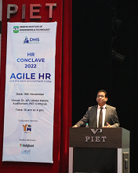
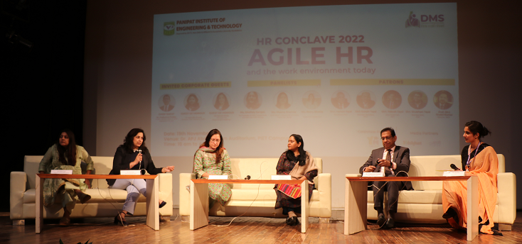
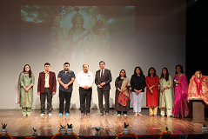
HR Conclave
The HR Conclave on the theme “Agile HR and the work environment today” was organized on 19th November 2022 in collaboration with the corporate partner – Yungminds and the media partners Dailyhunt and Aap ki Khabar.

Slide 20
Workshop on Self Love 360 Degree
A workshop was organized by Dr. Preeti Gugnani and Dr. Navita on 14 February 2023, Valentines Day to encourage individuals to
love, care and respect themselves.

Slide 21
WORKSHOP ON CAMPUS TO CORPORATE
(FUN FILLED MANAGEMENT GAMES)
A workshop on Campus to Corporate was organized for the first and final year students of MBA on 28th March 2023. The speaker for the session was Dr. Ambika Rathi, a Certified Corporate Trainer and Career Coach.

Slide 22
PRABANDHAN MANIA 2022
Department of Management Studies (DMS) of Panipat Institute of Engineering & Technology (PIET), Samalkha, Haryana organized two days online National Management Fest, PRABANDHAN MANIA – 2023 on 21st and 22nd April 2023. The event consisted of three major events – Business Plan Competition, Case Study Analysis, and Elevator Pitch.

Slide 23
See you with 19th Edition…………..

