Slide 1
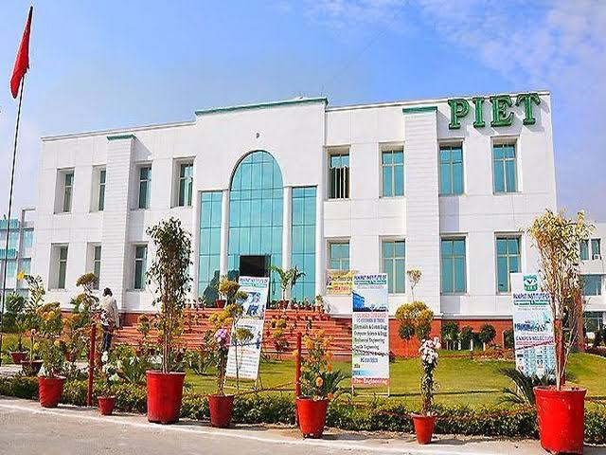
DEPARTMENT OF BUSINESS STUDIES
NEWSLETTER AUGUST 2020

Slide 2
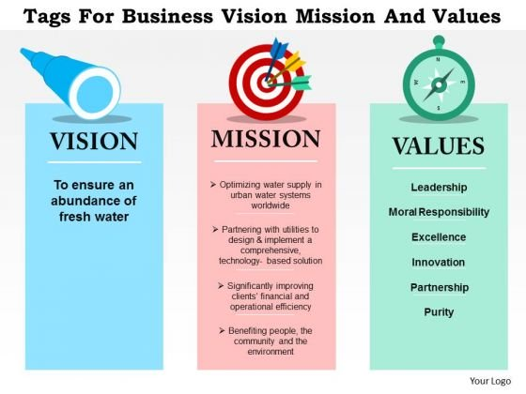
“To be a world leader in business education, research and engagement, helping to create a better knowledge society.”
To teach basic knowledge, skills and aptitude regarding business activities for running the business. and to provide an opportunity of higher education in the field of business administration.
: Systematic academic support and mentoring
: Inter department collaborations
:Start up ecosystem

Slide 3
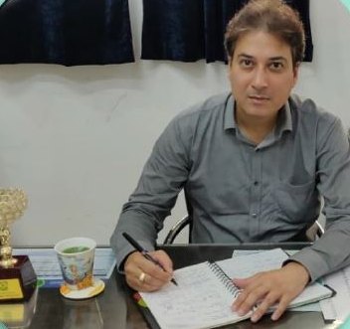
HOD’S MESSAGE
The purpose of education is to teach budding managers to think and develop a capacity to reason our facts. Learners should keep in mind the importance of planning and prioritizing their time and the effective use of it which are essential to achieve success. Learner’s should always think and review, discover the cause and effect of every event, in which they are involved. Do not surrender or become a salve to youthful fancies and indulgences. Be steady in your studies.
MR. ATUL GAUTAM
“ WE CANNOT ALWAYS BUILD THE FUTURE FOR OUR YOUTH, BUT WE CAN BUILD OUR YOUTH FOR THE FUTURE”. REMEMBER“ THE REWARD OF EVERY GOOD ACTION WILL BE GOOD ONLY”.
“Learn to enjoy hard work particularly your studies”.

Slide 4
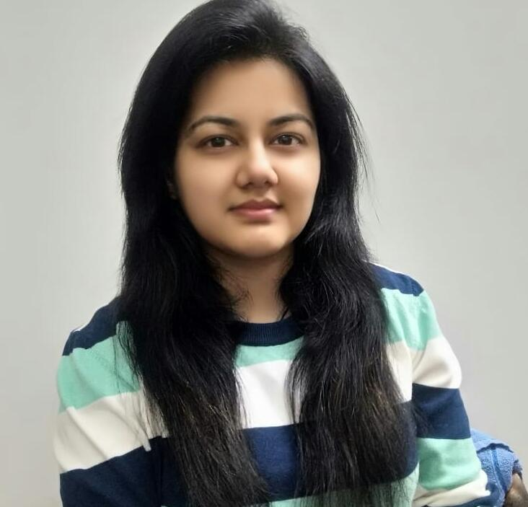
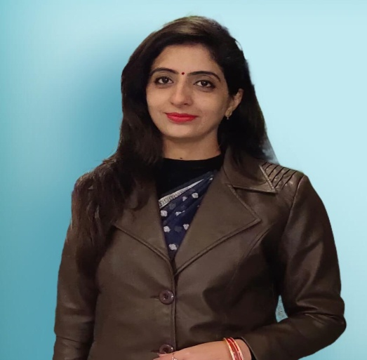
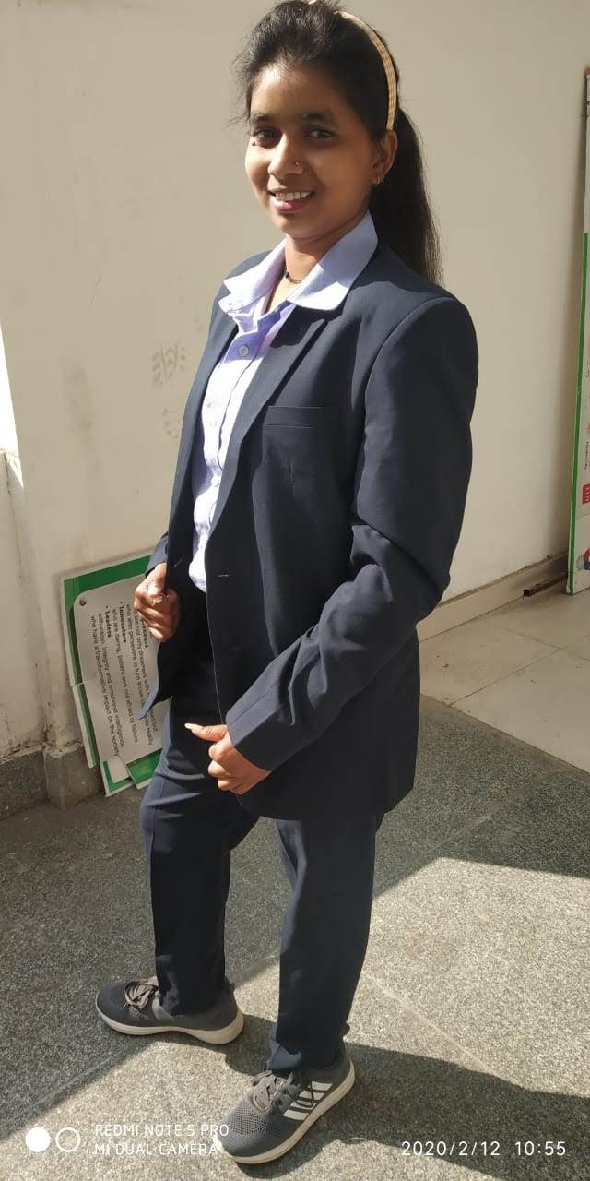
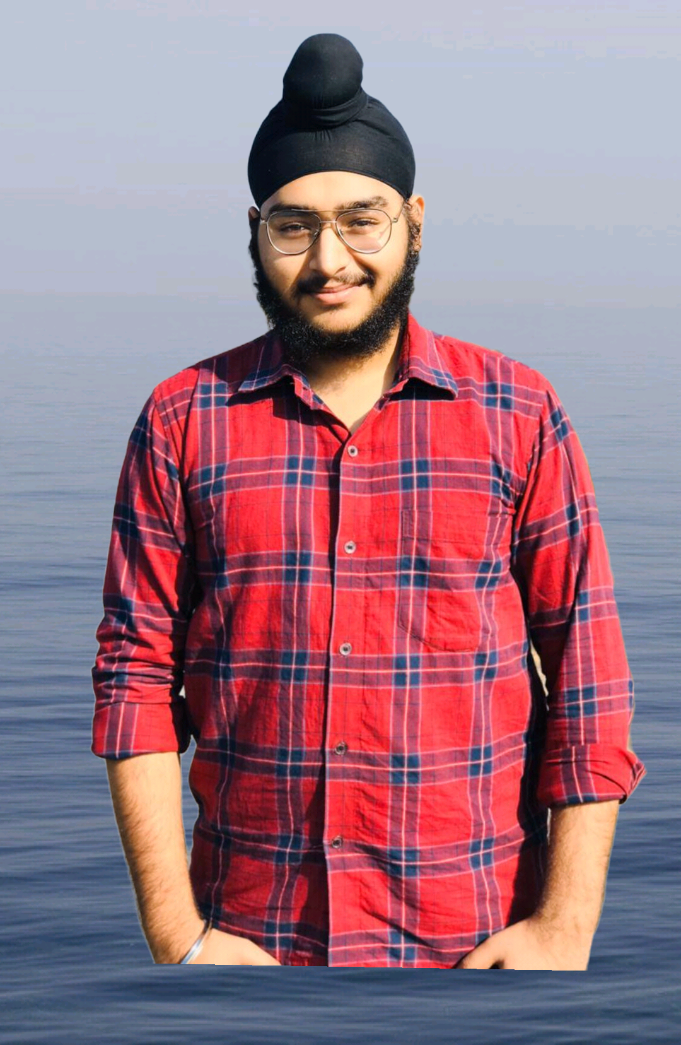
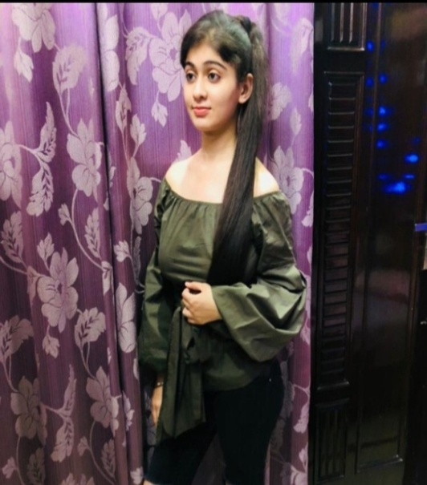
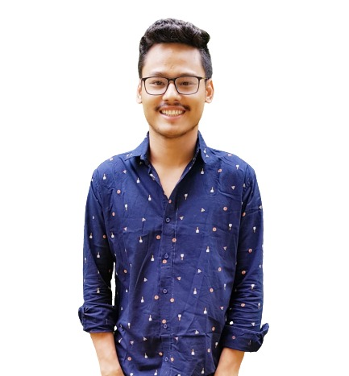
From Editor’s Desk
MS. SAHIBA SHARMA
DR. NANCY ARORA
Radha
BBA 2nd year
Jasjeet
BBA 2nd year
Aarushi
BBA 3rd year
Sanjul
BBA 3rd year

Slide 5
LEARNING
NEVER
STOPS !!!
ONLINE
EDUCATION
EDUCATION IS THE MOMENT FROM DARKNESS TO LIGHT.

Slide 6
COMPREHENSIVE VIVA
Its quite difficult to conduct exams for the first year and second year students in this Lockdown period. So, P.I.E.T College had decided to conduct comprehensive viva for them with the purpose that they can be promoted to next level of education.

Slide 7
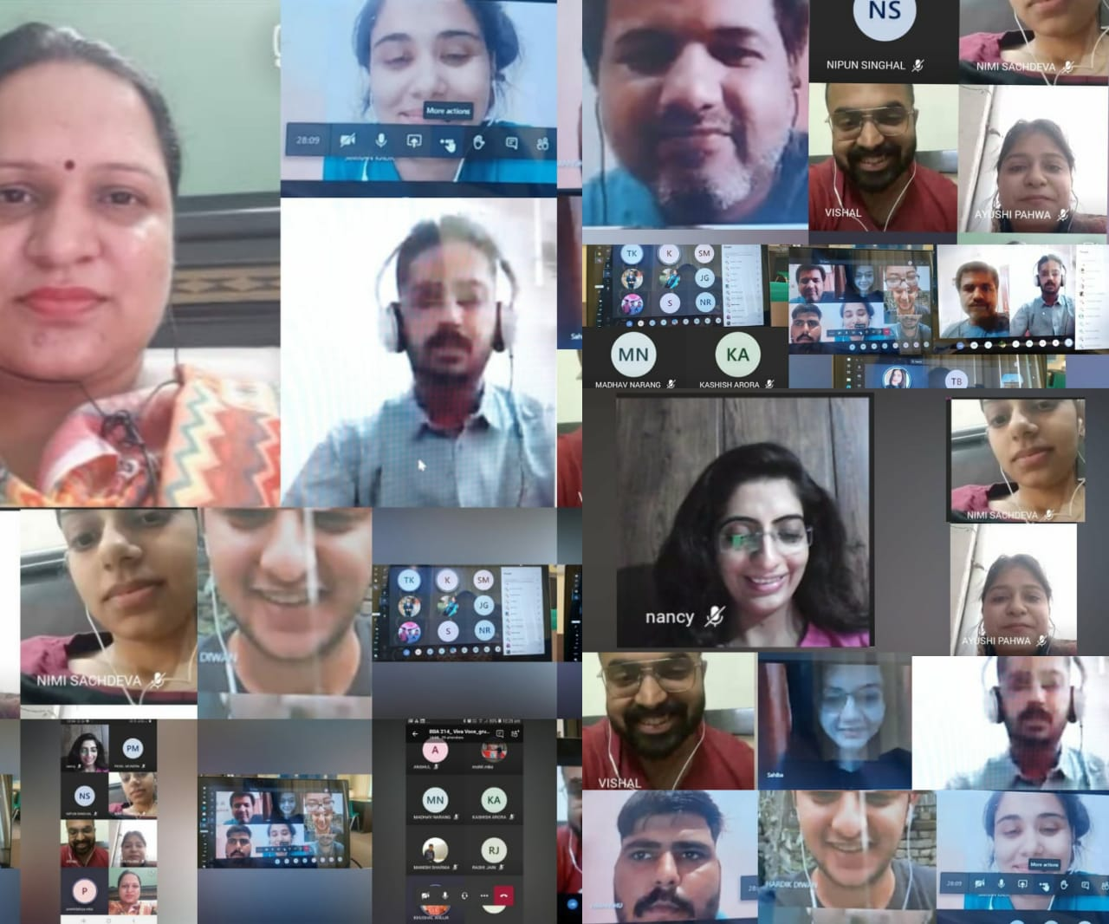
SOME GLIMPSE OF COMPREHENSIVE VIVA

Slide 8
KURUSHETRA University has decided to conduct final year exams in September, so for the preparation of these exams
classes have been started by
P.I.E.T COLLEGE FOR FINAL YEAR STUDENTS.

Slide 9
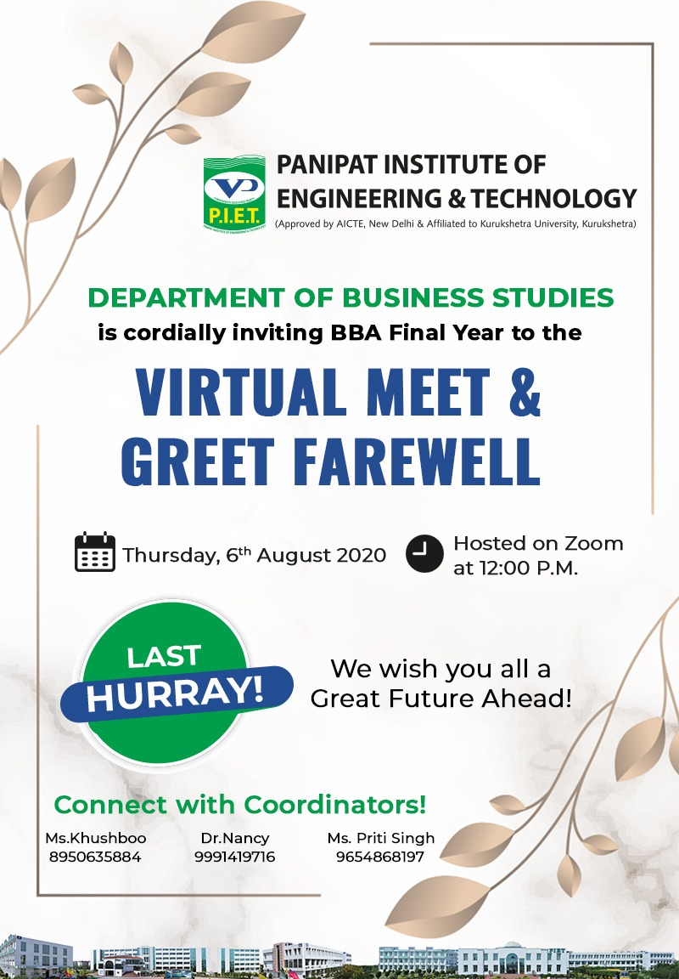
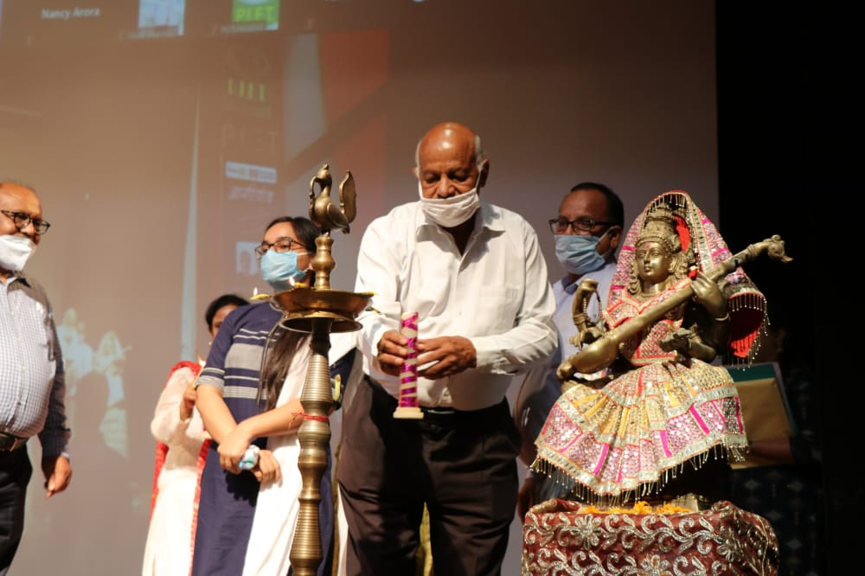
2017 -2020 batch

Slide 10
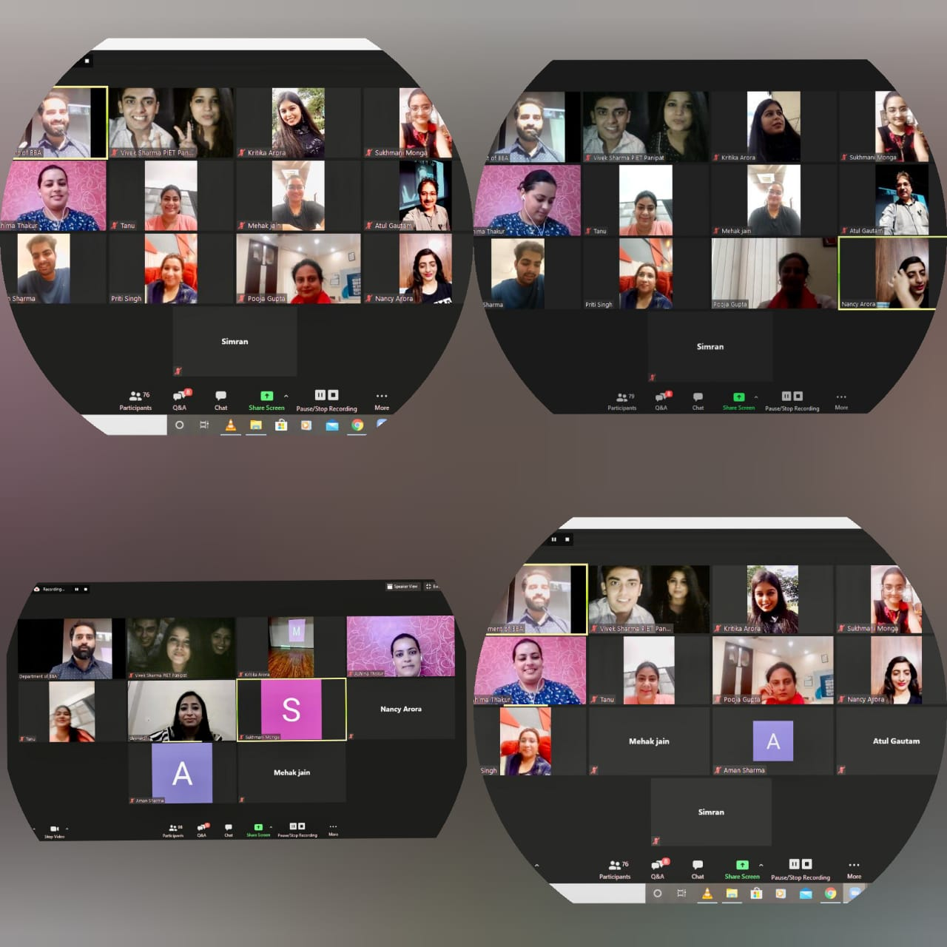

Slide 12
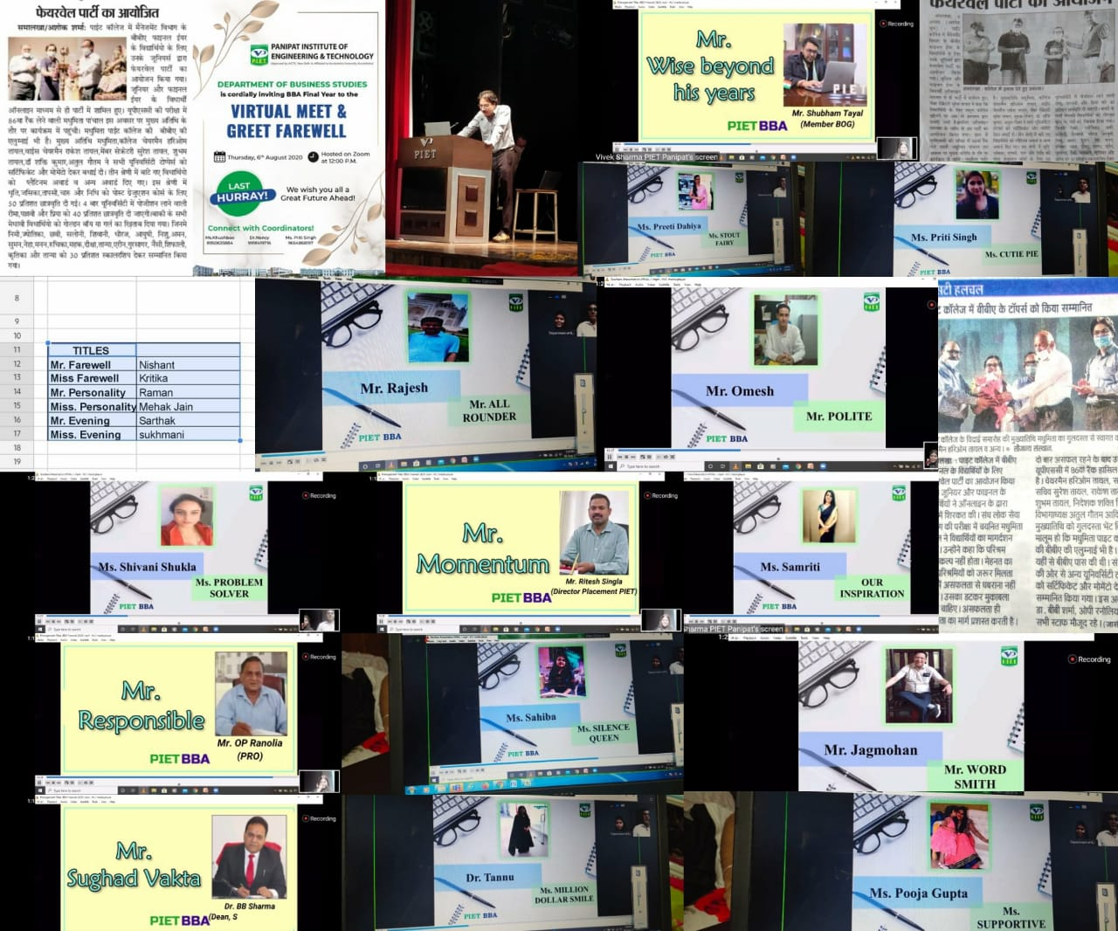

Slide 13
Mr. Farewell- Nishant Miss Farewell- Kritika Mr. Personality- Raman Miss Personality- Mehak Jain Mr. Evening- Sarthak Miss Evening- Sukhmani

Slide 14
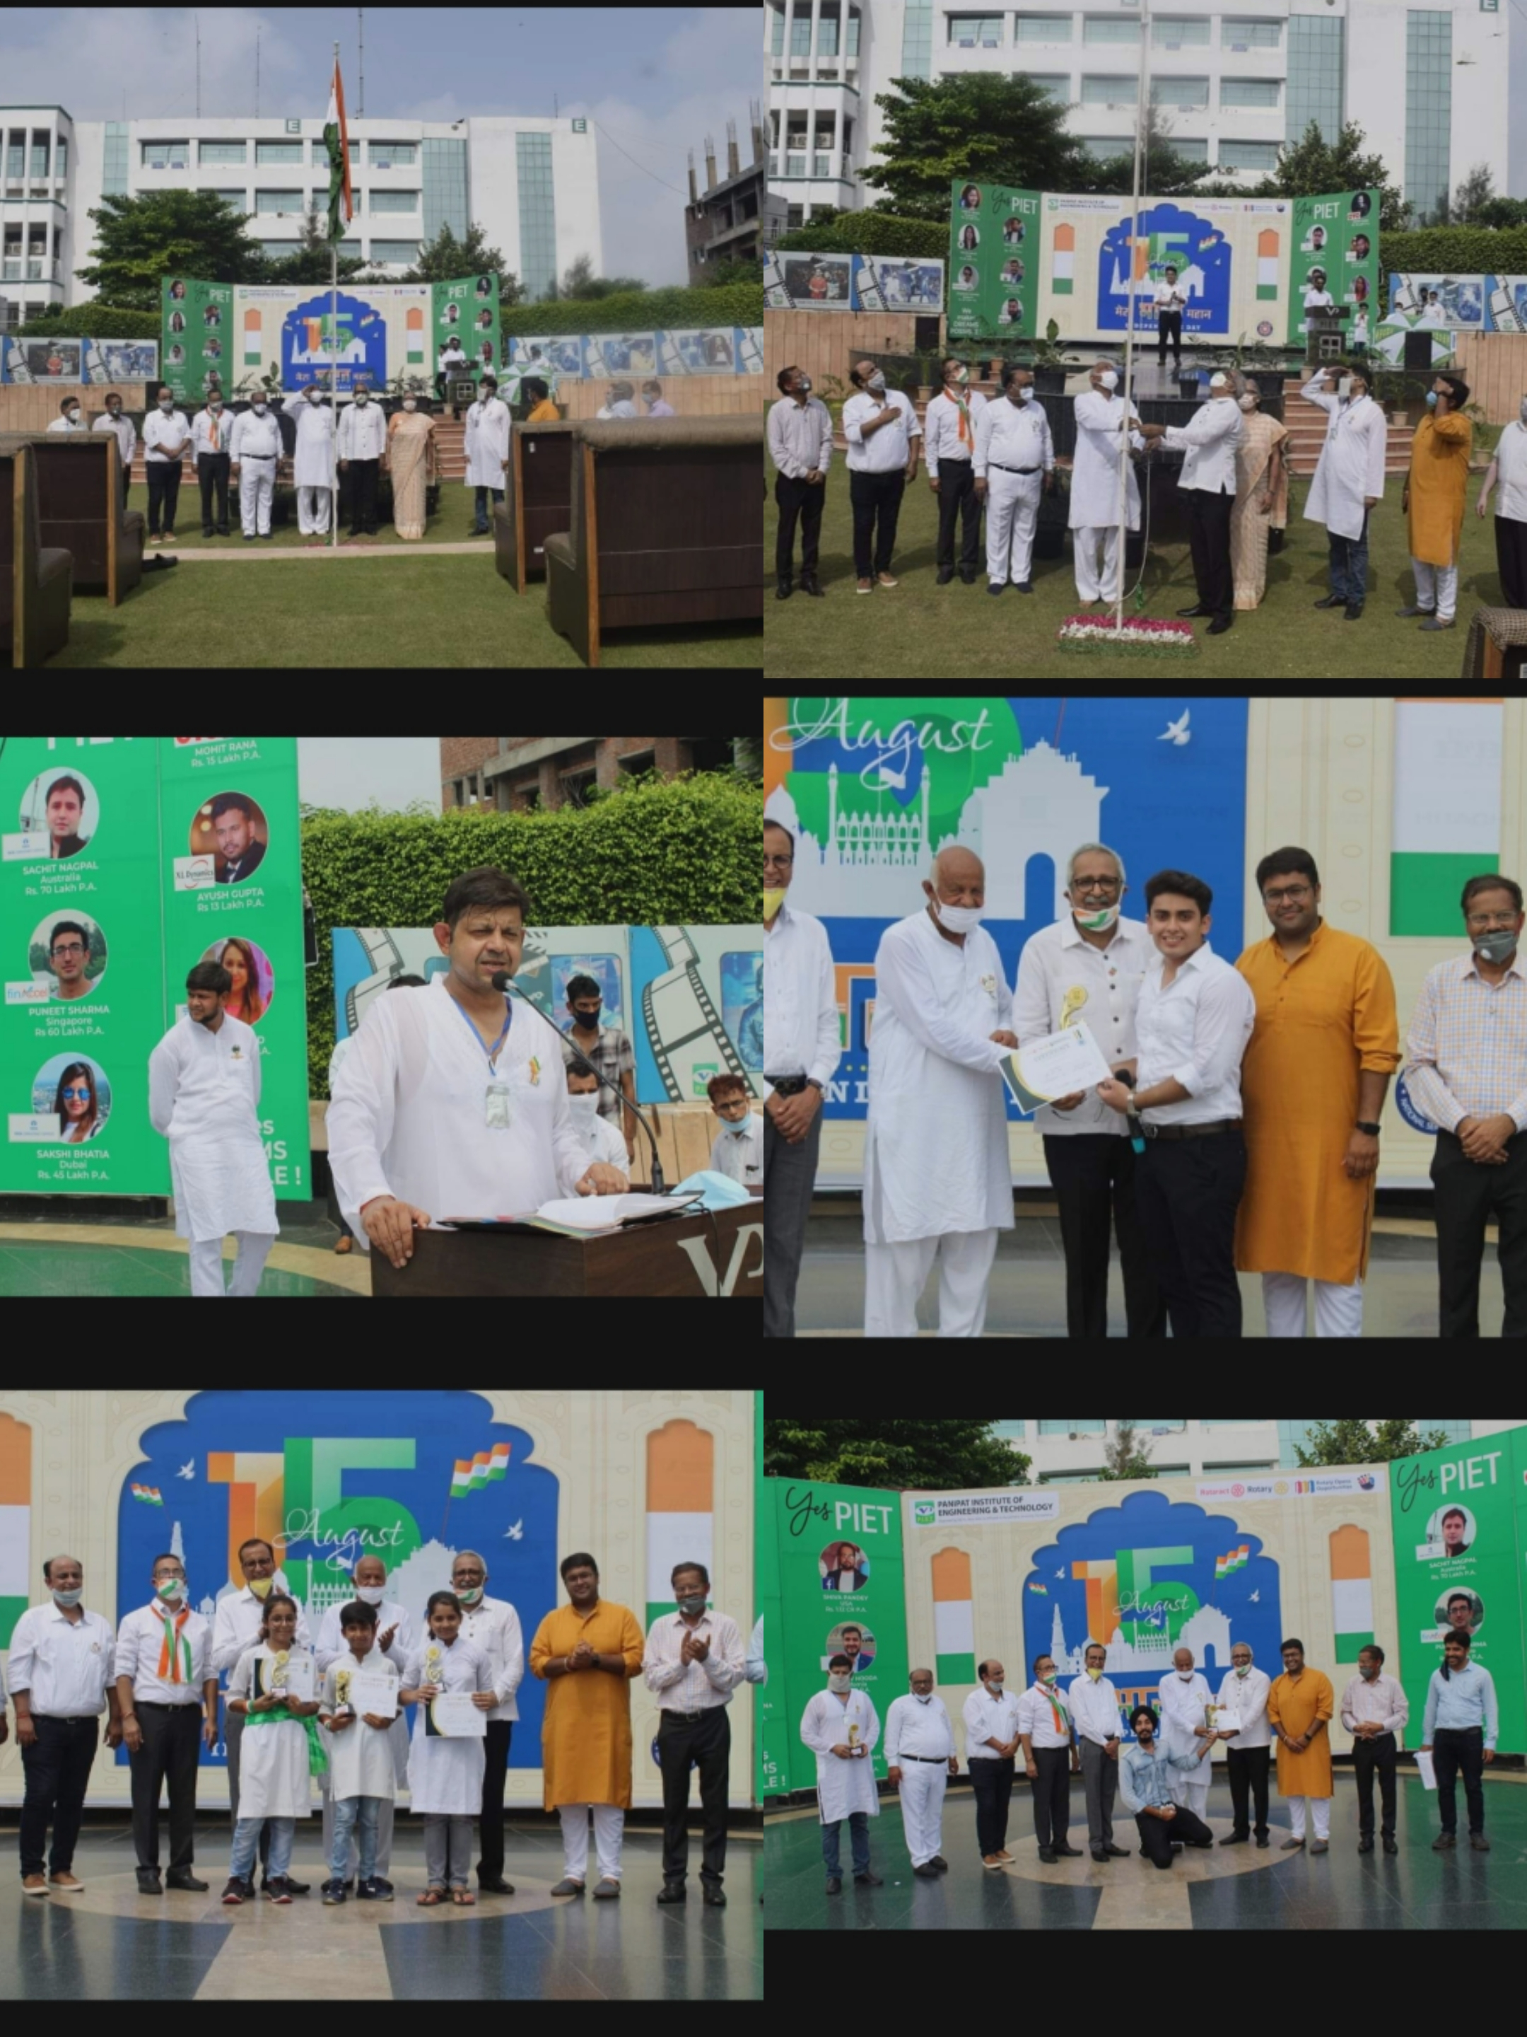
INDEPENDENCE DAY CELEBRATIONS

Slide 15
4th semester
University positions
Sonam Doon
(1st position)
Gaurav
(3rd position)
Shivi Gupta
(4th position)
Narayan Grover
(1st position)
Simran Chhabra
(4th position)
Riya Chanana
(4th position)
Tanya
(1st position)
Smily Bansal
(4th position)
Deepali Garg
(4th position)
Chhavi Anand
(1st position)
Sakshi Goel
(4th position)
Aarushi
(4th position)

Slide 16
Shruti
(6th position)
Abhishek Garg
(9th position)
kashish
(9th position)
Maneet Kalra
(6th position)
Lavisha
(9th position)
Abhinash Jha
(9th position)
Nikita Garg
(6th position)
Diksha
(9th position)
Sanjul
(9th position)

Slide 17
Education is the key to unlock the GOLDEN door of FREEDOM

