Slide 1
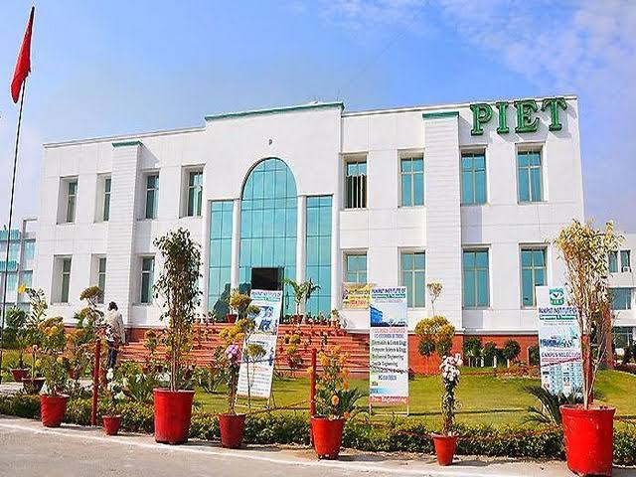

Slide 2
VISION
To provide business and administration knowledge to individuals so as they learn to handle and manage the operations of business in competitive environment.
MISSION
To teach basic knowledge, skills and aptitude regarding business activities for running the business.
To provide an opportunity of higher education in the field of business administration.
To sharpen their operational skills by workshops.

Slide 3
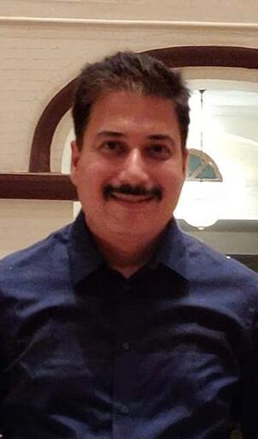
HOD’s MESSAGE
The purpose of education is to teach budding managers to think and develop a capacity to reason our facts. Learners should keep in mind the importance of planning and prioritizing their time and the effective use of it which are essential to achieve success. Learner’s should always think and review, discover the cause and effect of every event, in which they are involved. Do not surrender or become a salve to youthful fancies and indulgences. Be steady in your studies. Learn to enjoy hard work particularly your studies.
MR. ATUL GAUTAM
“ WE CANNOT ALWAYS BUILD THE FUTURE FOR OUR YOUTH, BUT WE CAN BUILD OUR YOUTH FOR THE FUTURE”. Remember “ THE REWARD OF EVERY GOOD ACTION WILL BE GOOD ONLY”.

Slide 4
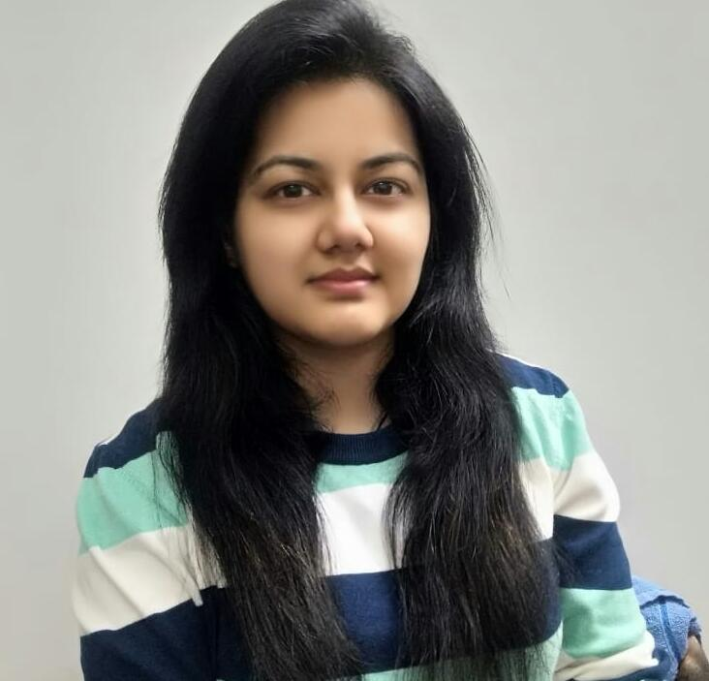
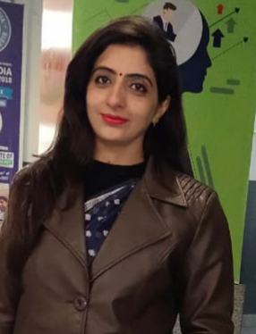
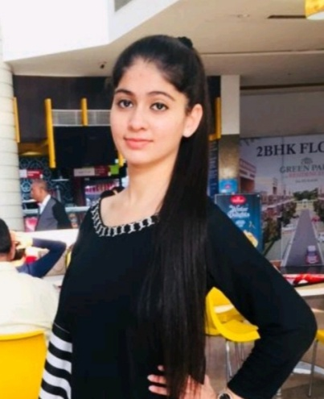
From Editor’s Desk
Ms. SAHIBA SHARMA
Dr. NANCY ARORA
AARUSHI
BBA 2ND YEAR

Slide 5
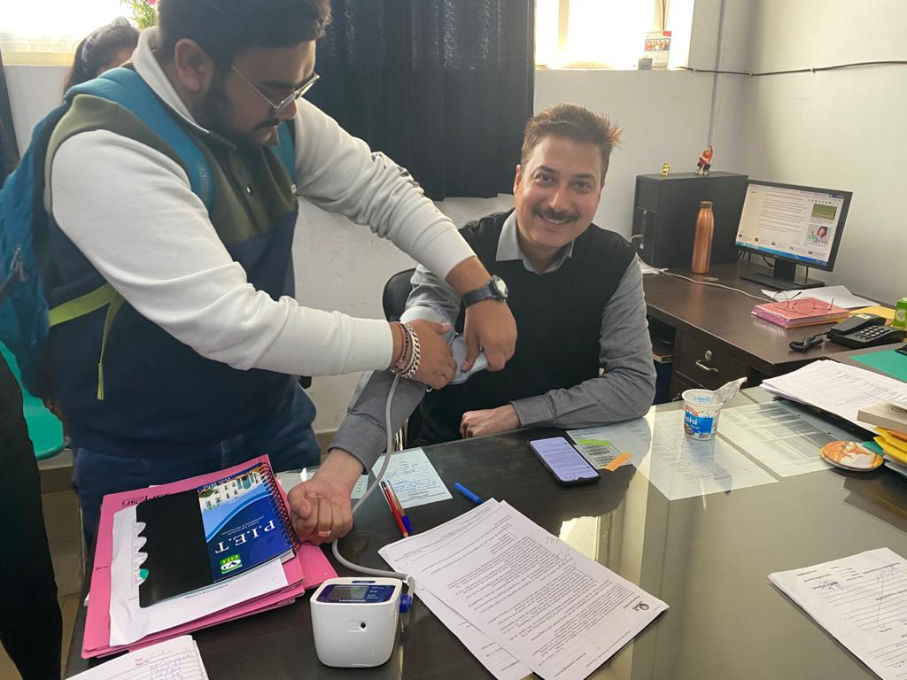
EXPERIENTIAL LEARNING
ACTIVITY (ELA)
To make student practically aware about the variation in one variable with another variable either in the same direction or reverse direction, an activity entitled “Correlation between age and blood pressure of person. Data range 30 –50 age” conducted successfully in BBA Department.

Slide 6
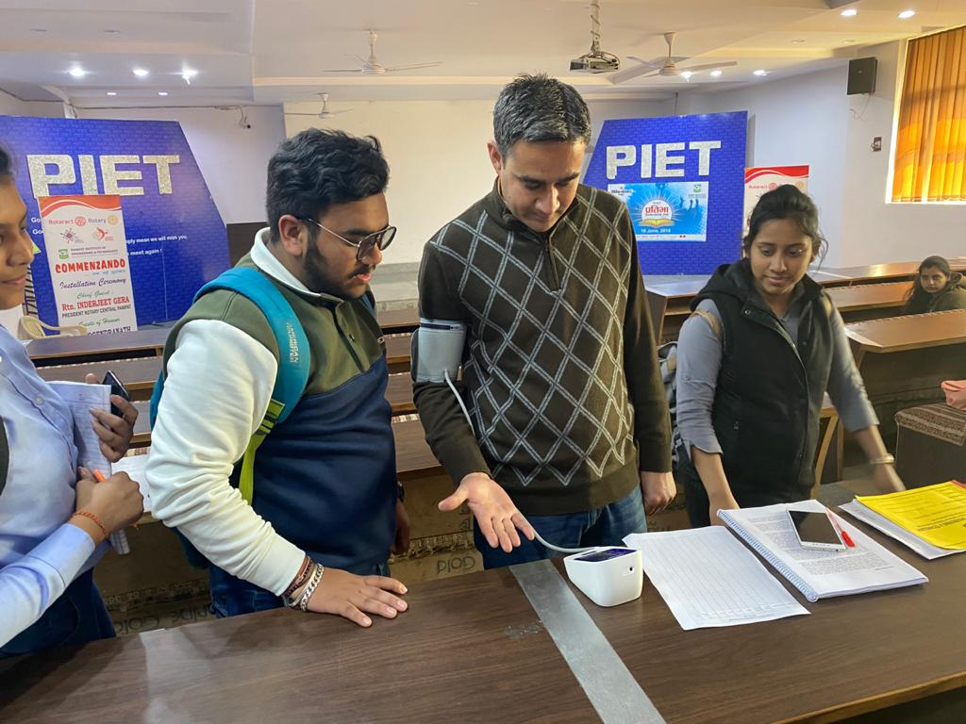
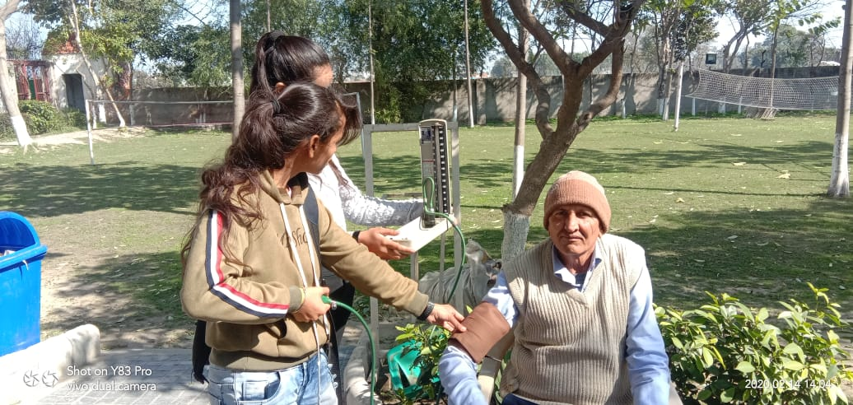
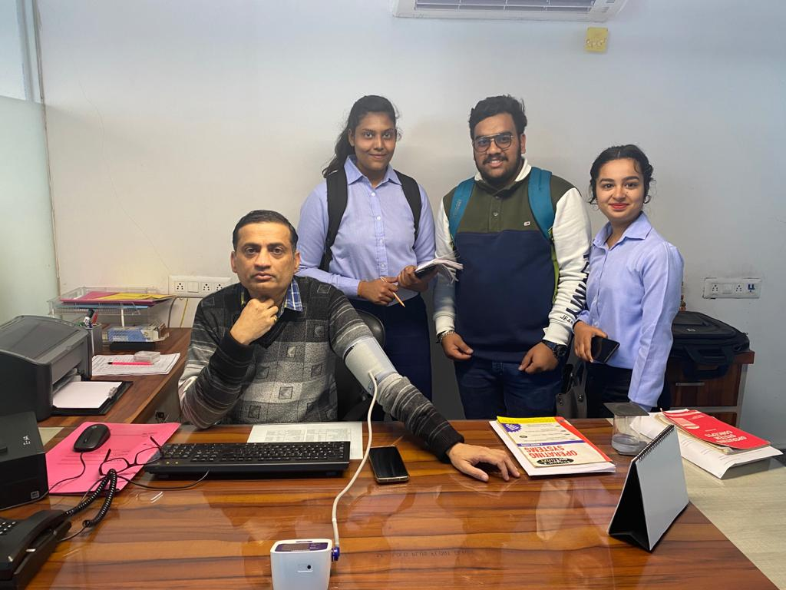
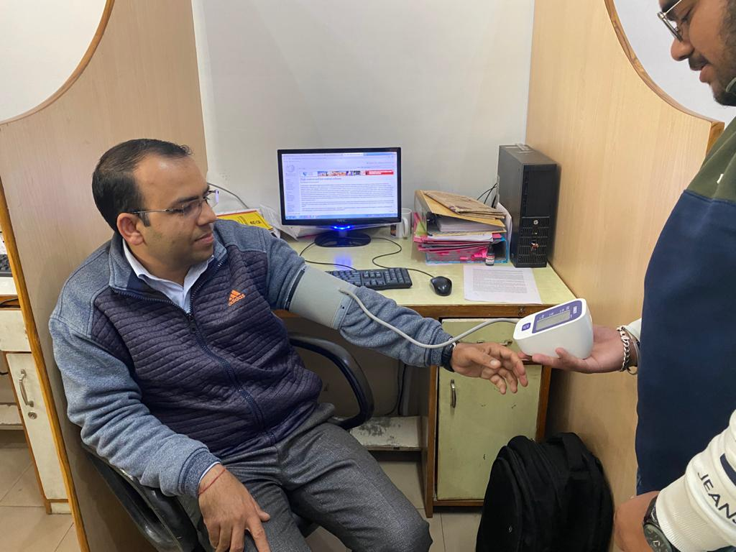
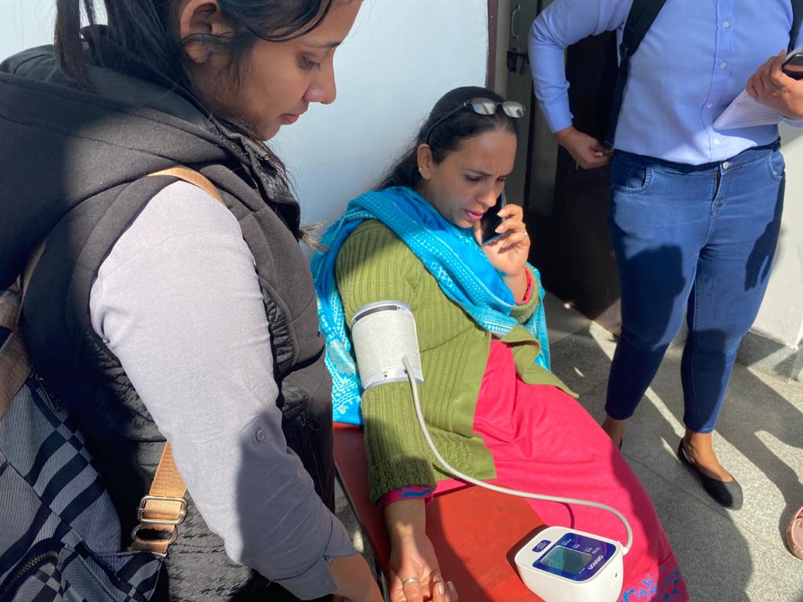
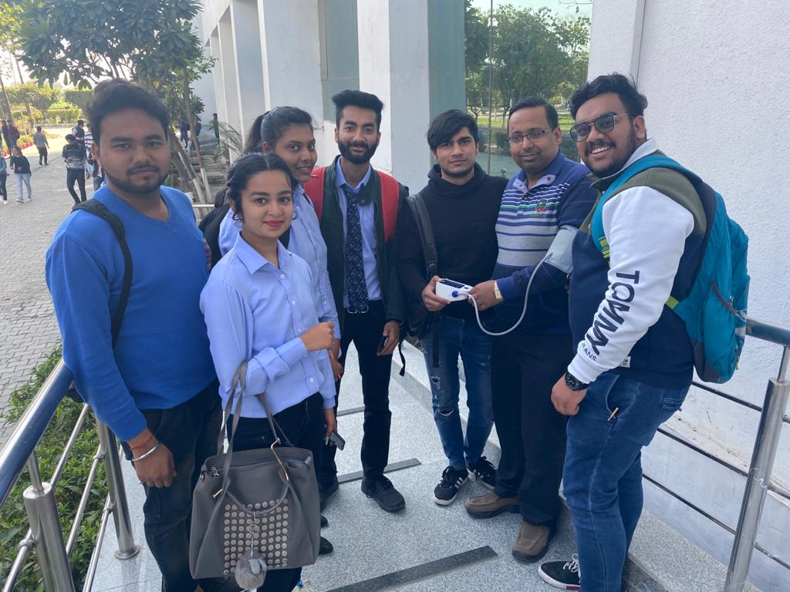
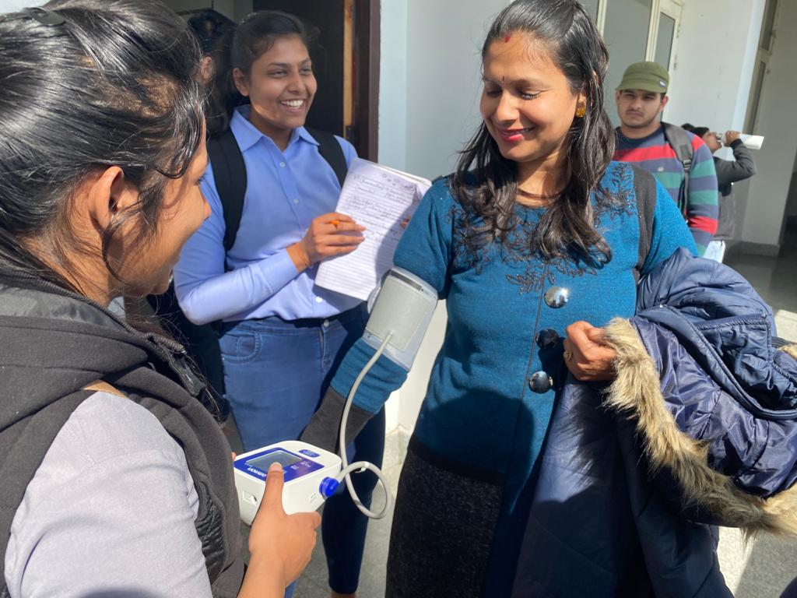
After this activity students were able to make future forecast with the help of one variable and predict the uncertainty in a rational manner.

Slide 7
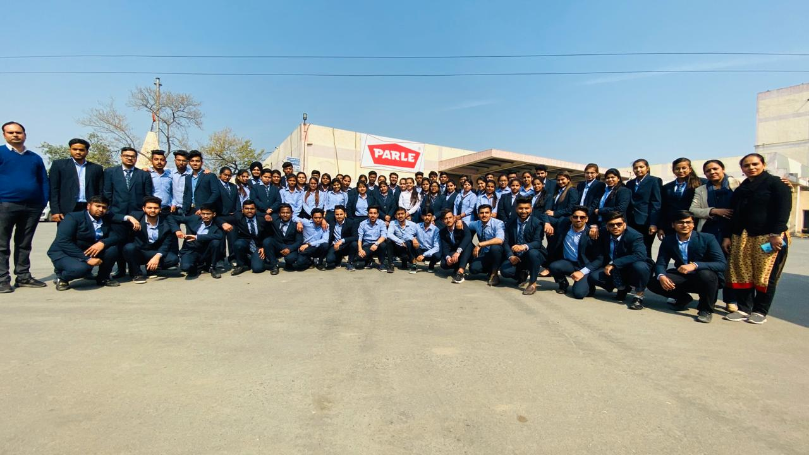
PARLE

Slide 8
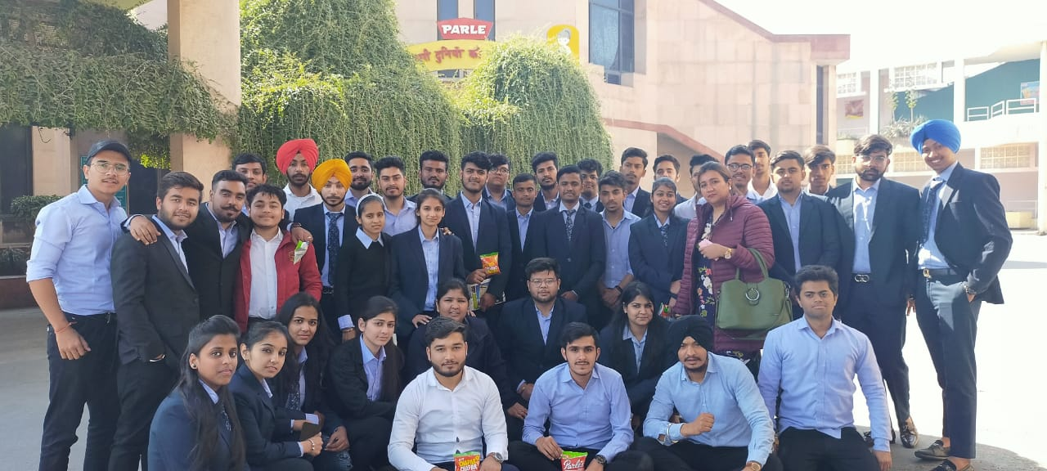
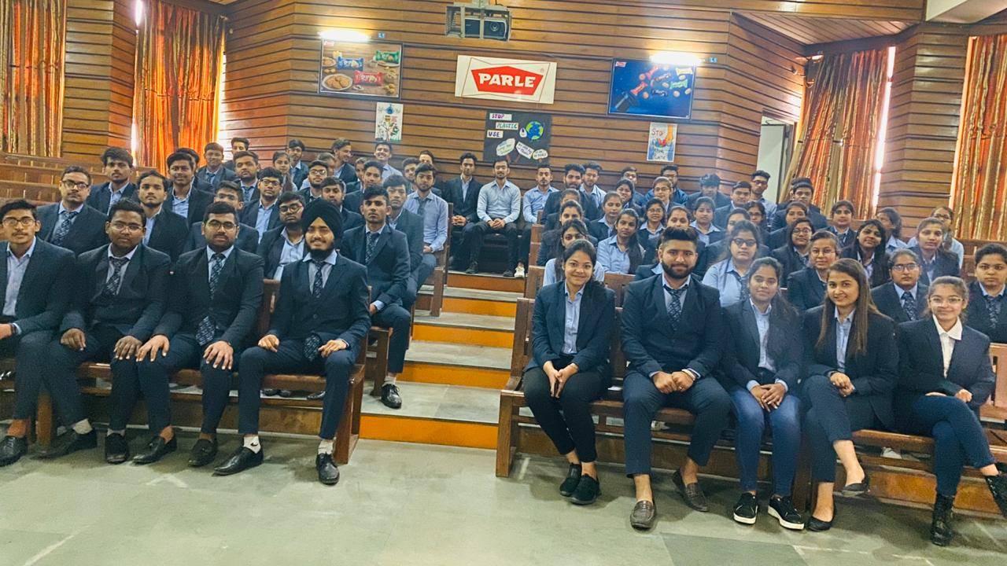
: Enhance professional skills.
: Helps to gain practical experience of how industry work proceeds and executed.
: It fills the gap between theoretical and practical learning in real – life environment.

Slide 9
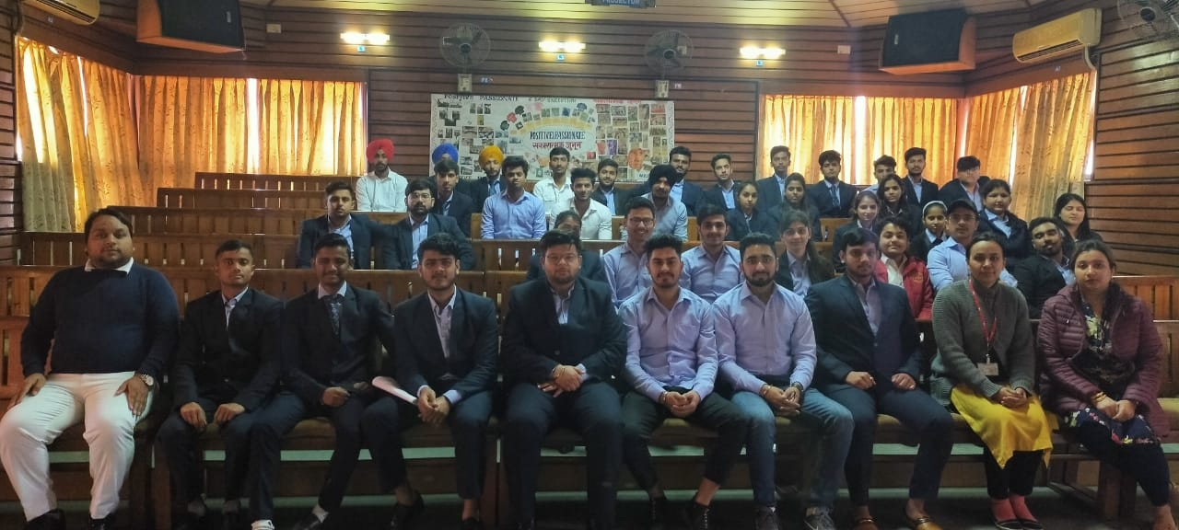
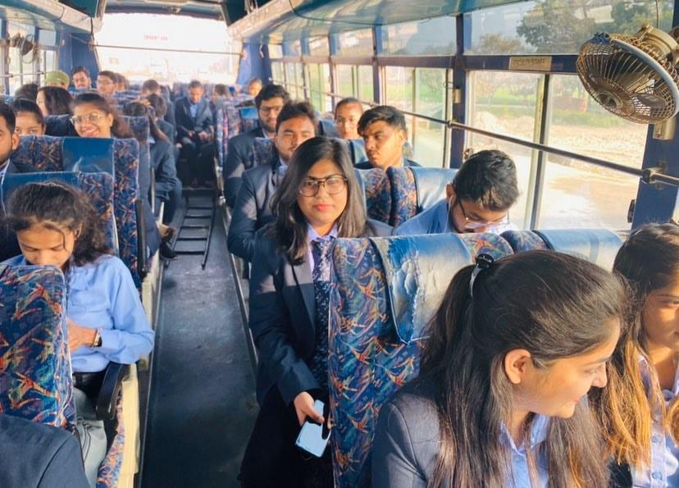

Slide 10
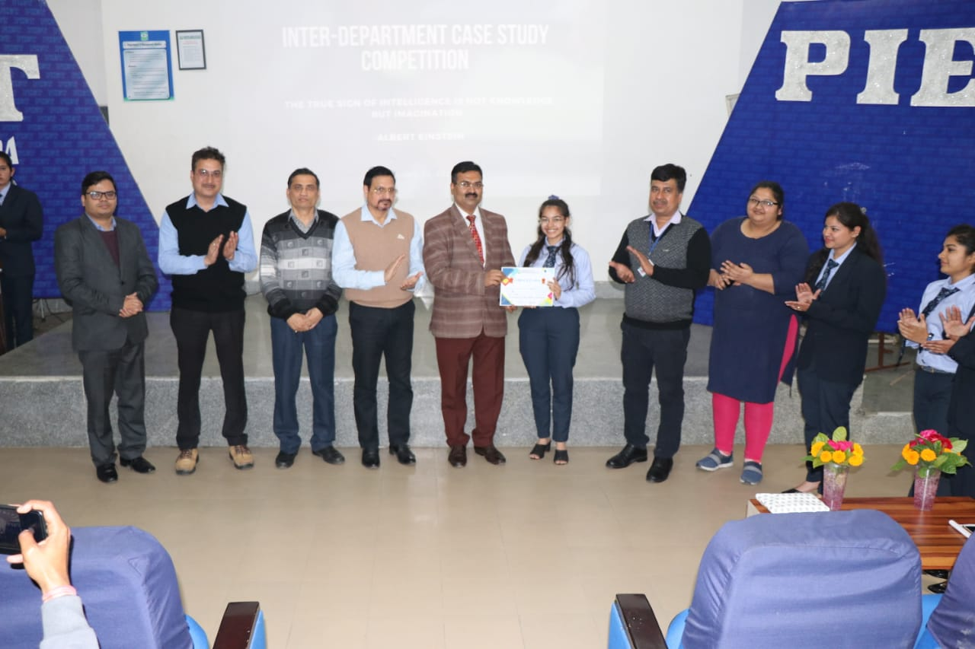
INTER DEPARTMENTAL
CASE STUDY COMPETITION
Simran BBA 2nd year won the Interdepartmental case study competition
KEY
KNOWLEDGE
CRITERIA
ANALYZING
DATA
RESEARCH

Slide 11
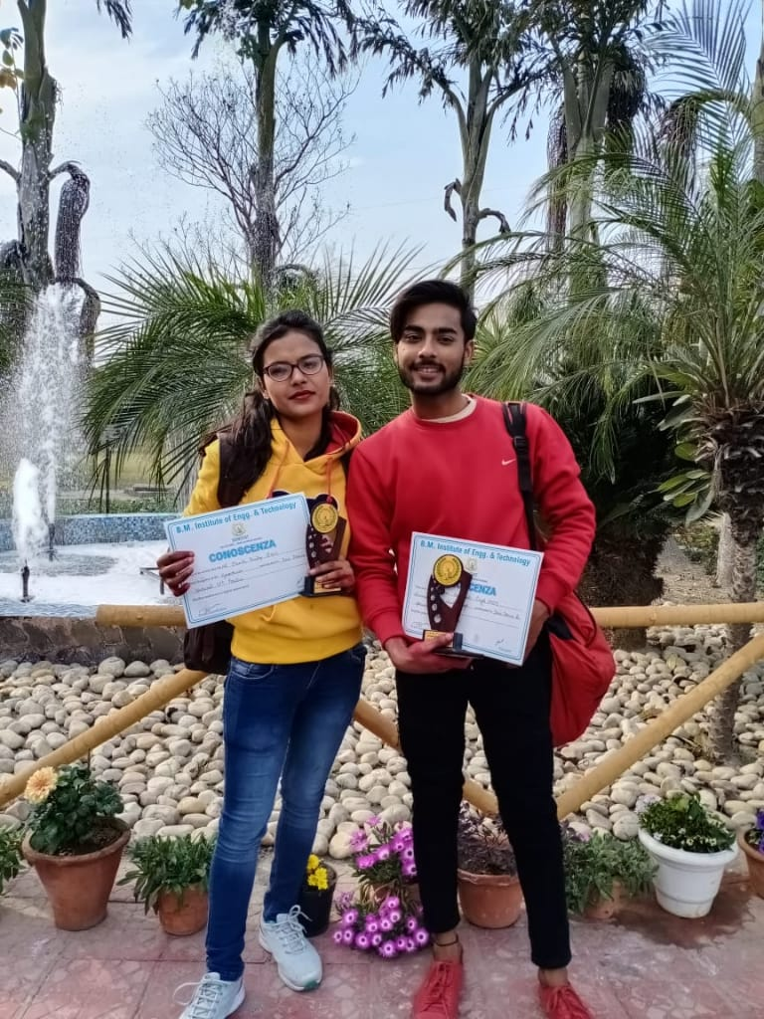
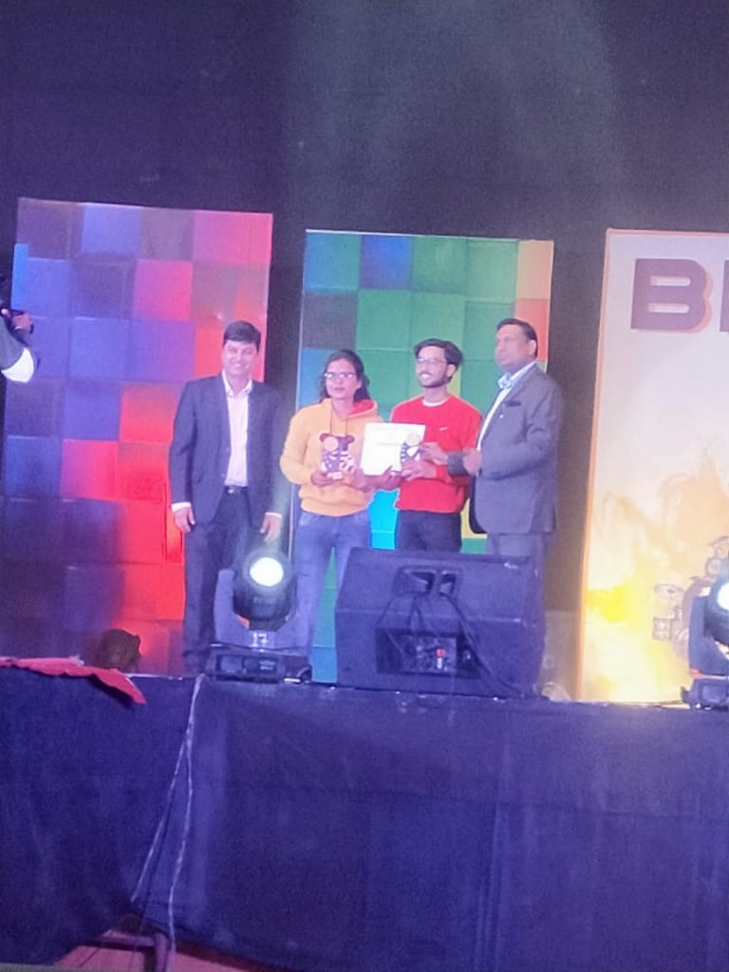
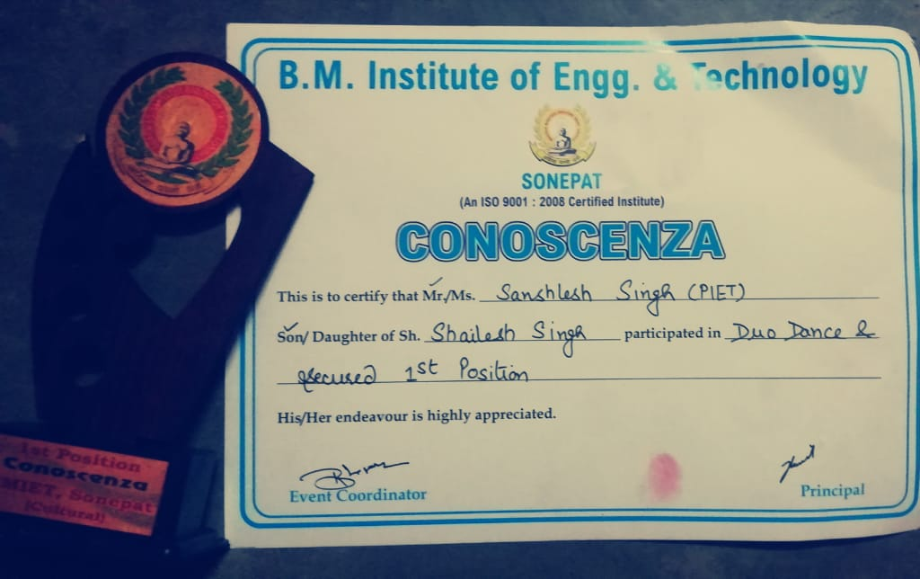
INTER COLLEGE DANCE COMPETITION
DANCE IS THE JOY OF MOMENT
AND THE HEART OF LIFE.
Our student, Sanshlesh Singh secured 1st position in Duo Dance competition held at B M Institute (BMIET) on 19 Feb 2020

Slide 12
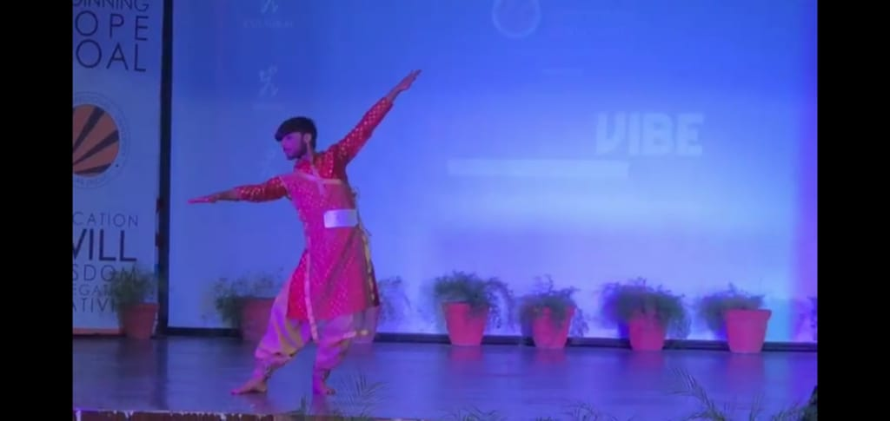
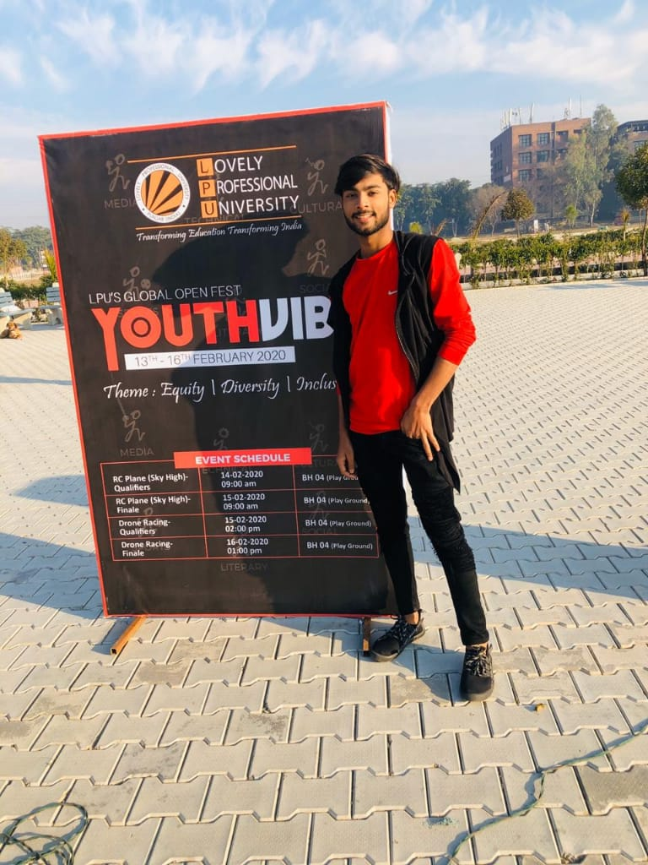
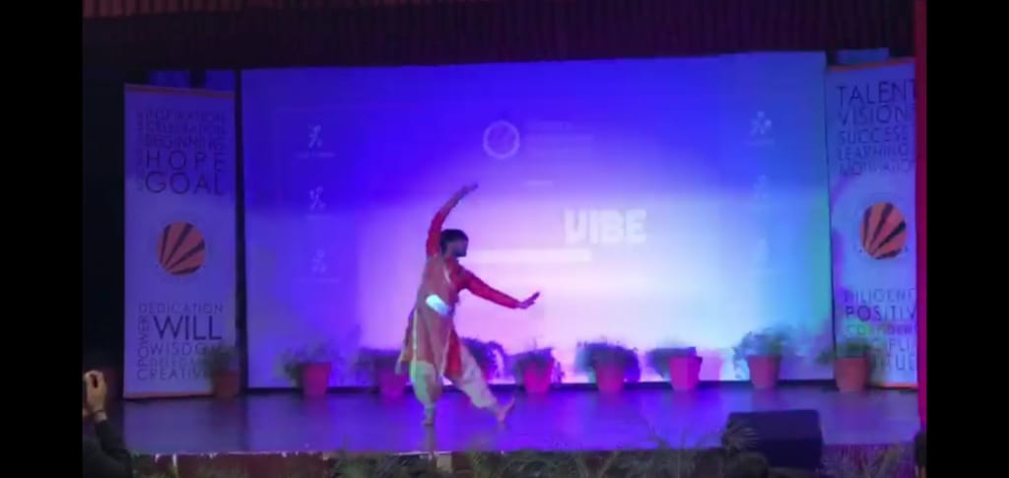
PROUD MOMENT
Sanshlesh Singh secured first position in Dance competition held at LPU on 13-17 Feb. 2020

Slide 13
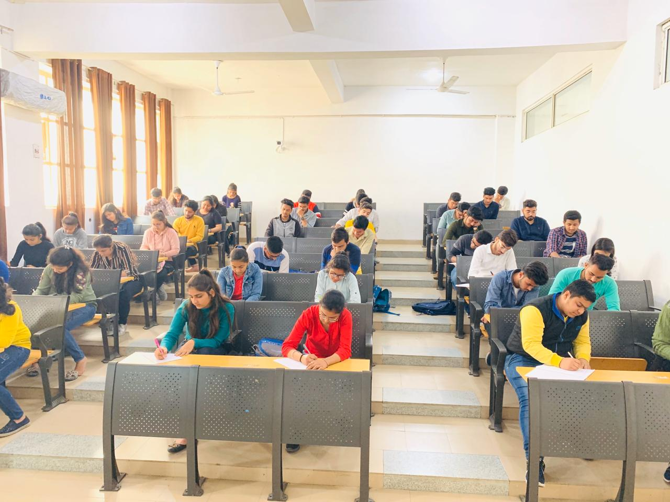
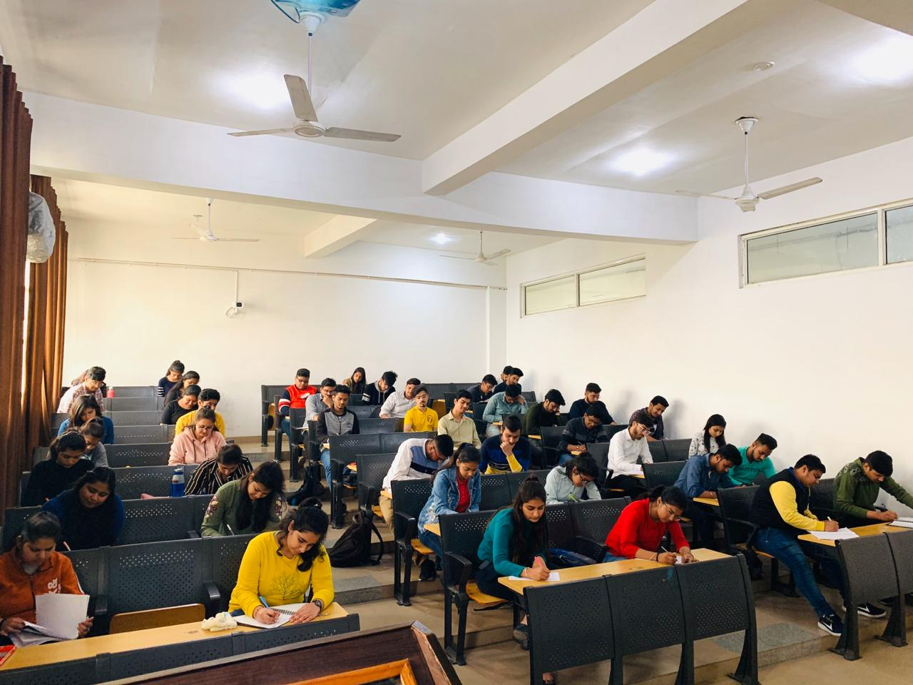
SESSIONALS
First Sessionals Examinations in BBA
EDUCATION IS THE MOST POWERFUL WEAPON WHICH YOU CAN USE TO CHANGE THE WORLD.

Slide 14
FEBRUARY 2020

