Slide 1
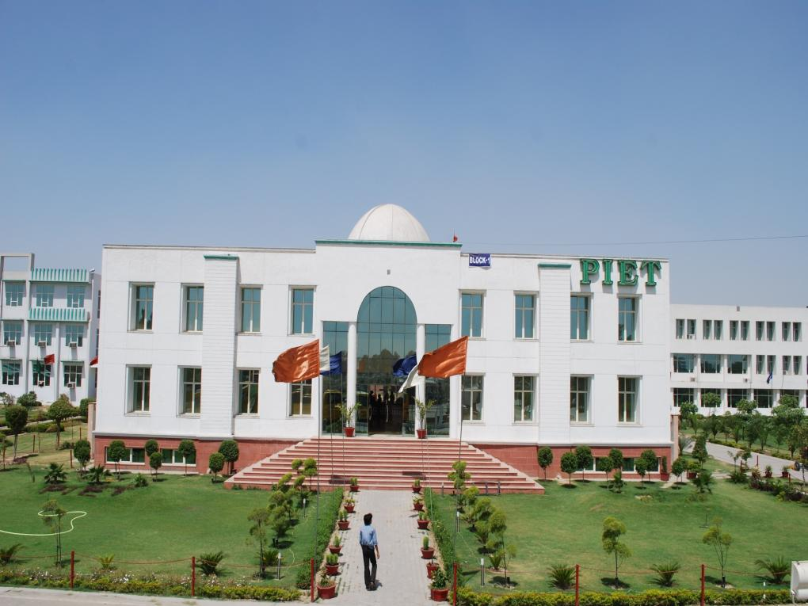

Slide 5
Welcoming New Year is not just a custom, nor just a wish but rather it is like taking an oath afresh to do things with more vigor, more focused and with better results.
Thanks Time for granting us another year.

Slide 6
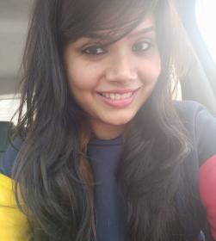
While we talk about the start of the New Year, we are talking about the end of the immediate past year, in this case 2017. The start of January is generally in no way enthusiastic except for the first day, which is the celebration of the year just set in. Why this is so? The month of January is named after the Roman god ‘Janus’, which is a two faced god whose one face is looking forward and the other backward. That is the reason we feel more energized in the beginning of the year. The obvious reflection of this effect we have seen in the very first week of January with students coming to the classes bubbling with vigor and participating in classes from the very first day of New Year.
FROM THE EDITOR’S DESK

Slide 7
As you fall into the ‘FABULOUS’ February, you must start with clear goals and targets with a perfect planning to achieve what you aspire. This will be first E-magazine of BBA for the current year and on a happy note we have additions to the editorial team with Ms. Simranjeet & Ms. Simran Verma joining the existing team. We can all expect a lot new things because young minds always come with newer ideas. Let us wait and watch for exciting moments in times to come.
Happy New Year 2018
Chief Editor
Jagmohan Malhotra

Slide 8
Dr. Yoginder Singh Kataria, HOD, BBA

Slide 9
Having walked away a few steps from 2017 I find this to be a great time of reflection on the events of the year gone by. It has finished with many accomplishments and surprises and may be a few disappointments too. It's easy to just be done at this point and begin the New Year revelry. You might find yourself tempted just to coast to the end thinking, "I'll just save my mental energy and start fresh in the New Year”. Nothing in the world can take the place of persistence. Talent will not, nothing is more common than unsuccessful men with talent. Genius will not; unrewarded genius is almost a proverb. Education will not; the world is full of educated derelicts. Persistence and determination alone are omnipotent. Nothing builds self-esteem and self-confidence like accomplishment. Small steps add up to complete big journeys. Don't tell me how hard you work. Tell me how much you get done. Whenever you have taken up work in hand, you must see it to the finish. That is the ultimate secret of success. Never, never, never give up! Remember the last quarter, like the last few miles of a race, is a great time to dig deep and aim to excel. Much can be accomplished in a few short weeks. After all, while everyone else is pulling up, the winner is often the one who finds the strength for one more burst of speed.
WELCOME 2018

Slide 10
Forgetting the missed opportunities, unplanned happenings and the sense of remorse, sadness, regret, guilt or disappointment you must focus on accomplishments and achievements which came your way. It could even be a lesson worth learning from an experience. There are no deadlines for your dreams and goals. Always be open to change plans and not the goals.
Remember the exercise I accomplished with you in your very first classes, the filling of the virtual bucket with clearing things not needed anymore and overcoming self limiting beliefs vis-à-vis making amends in
relationships.
So start the year by creating a virtual ‘SUCCESS JAR’ for yourself with all the colored chits, chits that contain your plans, goals and targets. This will fill you with enthusiasm and boost your courage whenever you open a chit out of it.
Dr. Yoginder Kataria HOD, BBA

Slide 12
As we bid ‘Good Bye’ to 2017 and wave welcome flags to 2018, we are probably telling ourselves ‘let by gone, be by gone’ and thinking in our minds to set sight on newer heights. With the beginning of the ‘even’ semester there are even new names in the faculty team of BBA with 3 new faces.
Dr. Annu Dahiya
Ms. Simranjeet
Ms. Simran Verma

Slide 13
15-Jan-2018

Slide 14
A seminar on Career interaction was held for BBA 2nd year students which was headed by Prof. K K Paliwal, Director PIET along with Dr. Nidhi Singhal, Director, Corporate and International affairs and Dr. Yoginder Singh Kataria, HOD, BBA

Slide 15
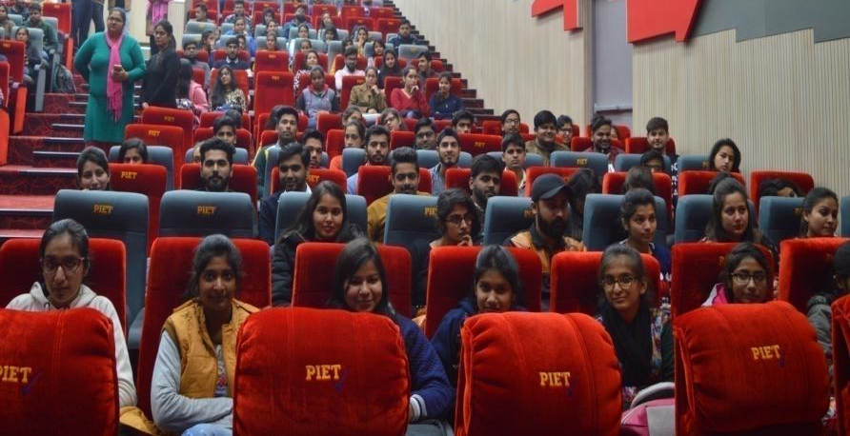
A view of the audience for Career Interaction

Slide 16
18-19 January 2018

Slide 17
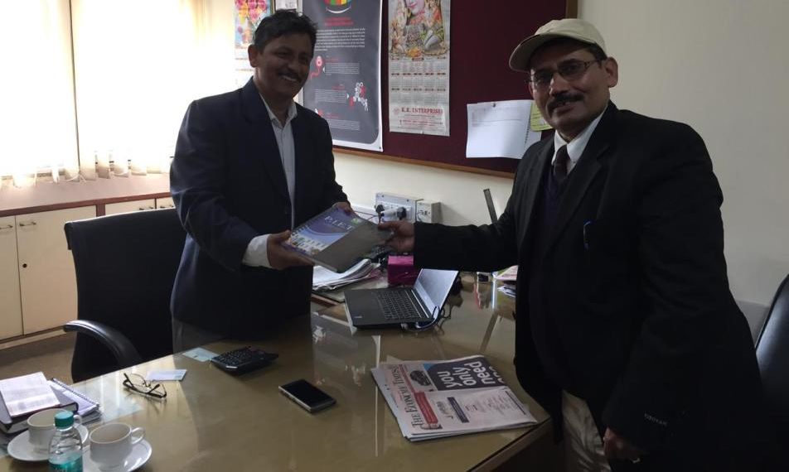
HOD Sir Presenting Momento to Mr Deepak Singh,
GM-HR at Safal.

Slide 18
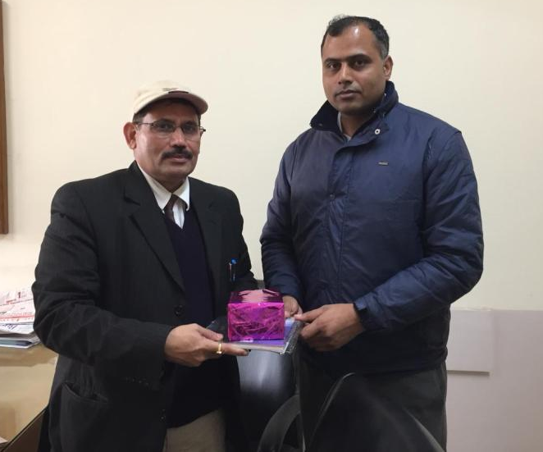
HOD Sir Presenting Momento to Mr. Vikram Singh, Assistant Manager HR at Safal .

Slide 19
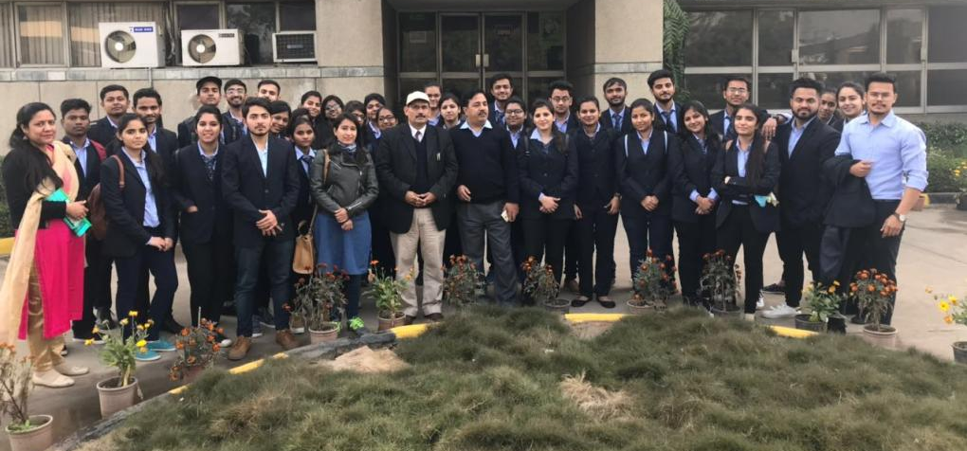
Group Photograph of BBA 1st Year with HOD Sir, Ms. Shilpa & Ms. Preeti at Safal and Mr Sanjeev (Representative at Safal)

Slide 20
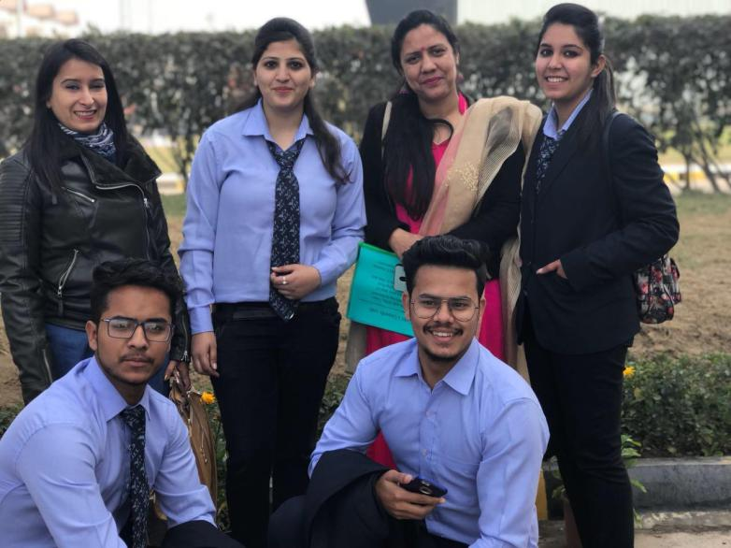
Kanika, Mohita, Sahil, Vishal (Students of BBA 1st Year) along with Ms. Shilpa Sardana and Ms. Preeti Dahiya At Safal enjoying their visit with cheerful smiling faces.

Slide 21
Industrial Visit To Safal
MOTHER DAIRY FRUITS AND VEGETABLES PVT. LTD.
Students of BBA went for an Industrial trip to Safal Mother Dairy fruits & vegetables pvt ltd in Mangolpuri , Delhi on 18 Jan ,2018
As an industrial visit provides an interface between educational and organizational fronts, it is considered as one of the most tactical methods of teaching. Visiting a company gives students a practical perspective on the world of work. It gives then exposure to current work practices in support of theoretical knowledge being taught at the institution.
With this opinion of sharpening the understanding of students, Department of Business Studies, organized an industrial visit to ‘Mother Daily, MANGOLPUR New Delhi’ plant on 18th of January, 2018 for BBA students.

Slide 22
Industrial visit started with the brief introduction about the Company .
The Manager of mother dairy gave a presentation related to the history of Mother Dairy Plant .
Mother Daily Fruit Vegetable Pvt Ltd is an Indian company that manufactures, markets and sells milk, milk products and other edible products. Its milk products include cultured products, ice areas, paneer and ghee under the Mother Daily brand. The company also sells edible oils, fresh fruits and vegetables, broken vegetables, and processed food like fruit juices, jams, pickles etc.
Mother Daily was started in 1988 by the ministry of agriculture. Mother dairy is basically known for its best quality product and service to the entire satisfaction of the customer .
Mother dairy operates in the Note business of 59. It is a type of horticulture business in which the main unit is in Mangolpuri , Delhi and also have a unit in the Uttarakhand , Bangalore.
Ambient products Value added
Fresh fruits. • Frozen pea
Fresh vegetables. • Frozen kebab
Pea processing. • Aloo Tikki
Packed fruits • Juice ARTS
Drinks
Vegetables item

Slide 23
Mother dairy focus on the Improving the quality of life of the farmers & producers and to create Better & meaningful life for the society.
Provides training to the farmers for producing grading at farm level . It also helps in motivating the farmers and tells them what ,when , and how much to grow . So in this way they guides the farmer.
There is a special team for consumer grievances in an efficient way.
It is spread across the 22 acres, 15022000 ; 2005. Located in 16 states , 8000 farmers are joined with Safal , 126813 MT and works under FSSAI.
There are fixed term casual employees . Under food safety management , there are frozen product like peas, sweet corns , baby potatoes . Under this products are stored in the temperature -16°c in a freezed room for the long life of the products.
INFRASTRUCTURE OF MOTHER DAIRY
12 chambers. 9000 MT
5 chambers. 1OOOMT
7 chambers. 175MT
Average sale is 315 MT per day in which 6500 of vegetables
Supply their product in :-
Government - Tihar jail, Railways, vidhan sabha ,NCC .
Hospitals - AIIMS , Railway hospital
Hotels- Taj, Oberois ,lalit , litebite
102 institution , 250 unique supply products

Slide 24
The booths are spread across all over the nation and their is booth in Rashtrapati bhawan also.
They not only deal in domestic market but also in foreign market as they have exported 5OOO MT products to western Europe ,Russia ,USA , Honkong , Japan etc .
Mother Dairy has its own electricity generating solar plant so electricity is available for 24x7 hrs , own bio gas plant through which gas is supplied to the canteen to make foods.
Mother dairy also have its water treatment plant in which Purification of water is done .
Product distribution system Backward linkage (farmer connect )
Central distribution facility ( factory connect ) Forward linkage ( customer connect)
At the operational hall, after taking out the peas from its shells on large scale. The peas are further processed and shells are used to feed the cattle .
Now peas are boiled technically through new technological machines and then stored in a freezed room ( -16° temperature) and after that peas which are bad in size or color are rejected and this work is done manually by the women labour.
Packaging :now peas are packed in the Safal packets of 200 gm .
Transportation:- peas are transported in a freezed temperature only after checking out the standards and specifications because mother dairy is only known for its best quality product.
They also monitors all the activities through CCTV camera to keep a check on all the activities and after all that now Safal peas packets are ready to dispatch from the Safal unit.
The students had over all a good experience with an in-depth learning.

Slide 25
BBA 1st year students at ‘Safal’ venture of Mother Dairy under guidance of Dr. Saurabh Garg and Ms. Monica Sawhney.

Slide 26
Mr Sanjeev giving presentation to BBA student / teacher team at Mother Dairy conference hall

Slide 27
24-25 Jan 2018

Slide 28
BBA March Past Team in PIET ANNUAL ATHLETIC MEET.

Slide 29
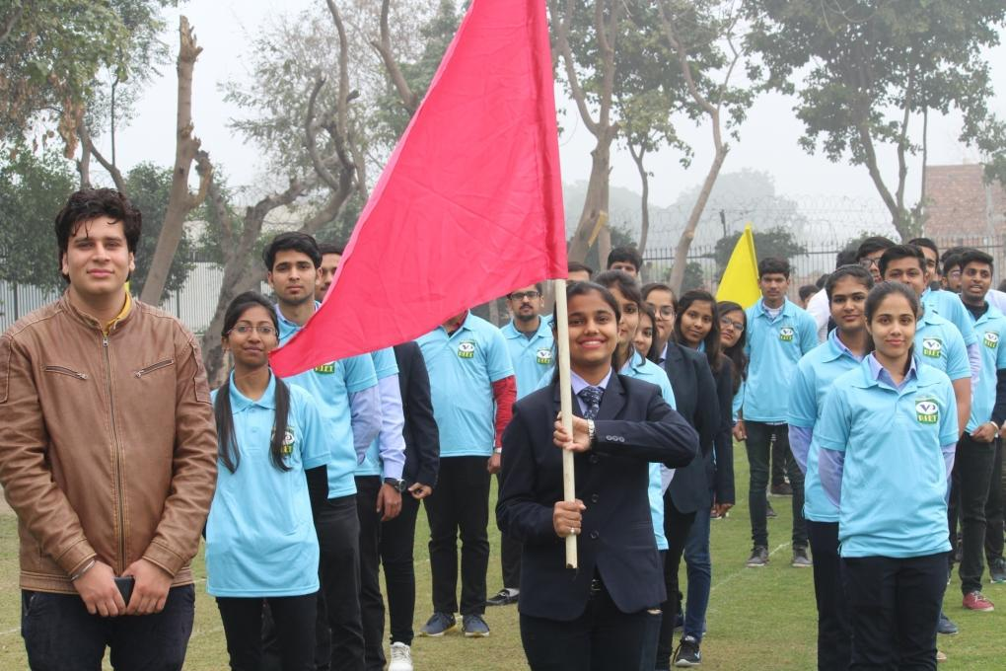
BBA March Past Team in PIET ANNUAL ATHLETIC MEET held on 24 March 2018.

Slide 30
BBA Team during March Past.

Slide 31
SSh S.K. Khanna ji, Prof.(Dr.) K.K. Paliwal, Dr B B Sharma, Dr S.C. Gupta Attending Athletic Meet 2k18

Slide 32
Dr. Yoginder Singh Kataria , HOD ,BBA Attending Athletic Meet 2k18 along with other HOD’S.

Slide 33
Sakshi Rana, BBA-2nd Year won 3rd Position in
400m race.
BBA Team In Tug Of War won 2nd Position

Slide 34
Kirti Jain, BBA-2nd Year won 1st prize in
Relay race.
BBA Girls Team In Tug Of War got 2nd position

Slide 35
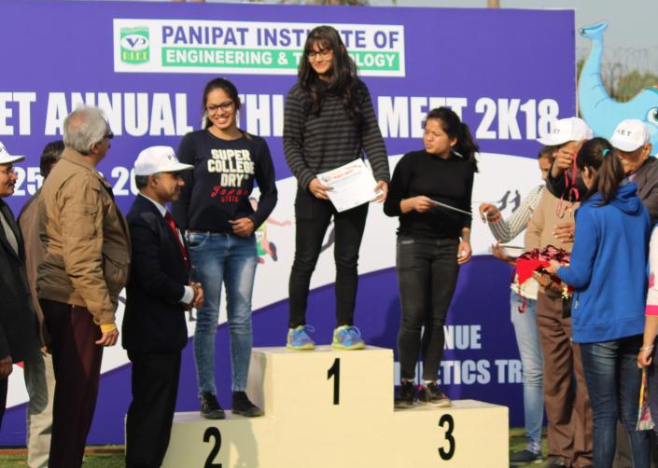
Priya (2nd Rank) & Neha (3rd Rank) receiving Medals

Slide 36
Kirti(2nd position) and Sakshi (3rd position) Receiving Prizes and Certificates from Sh Hari Om Tayal Ji, Sh S k Khanna Ji, Prof (Dr) K K Paliwal and Dr BB Sharma.
Meenakshi, BBA-3rd Year got 2nd Position in 400m race

Slide 37
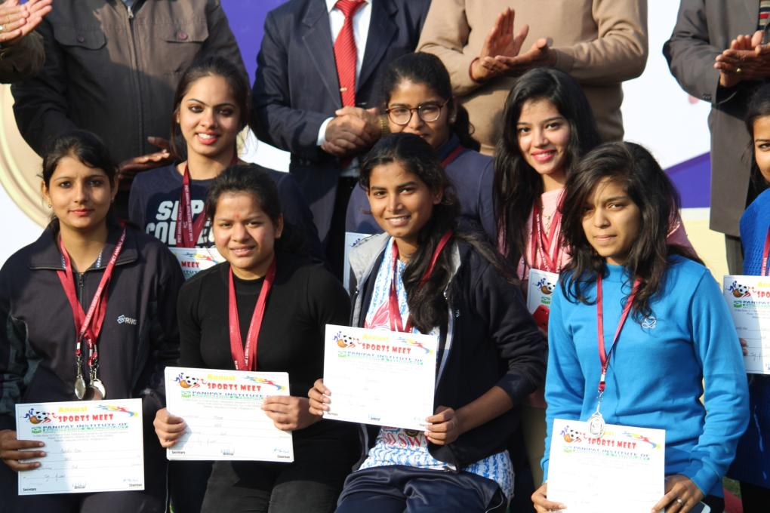
Happy Faces of BBA Students while receiving Prizes

Slide 38
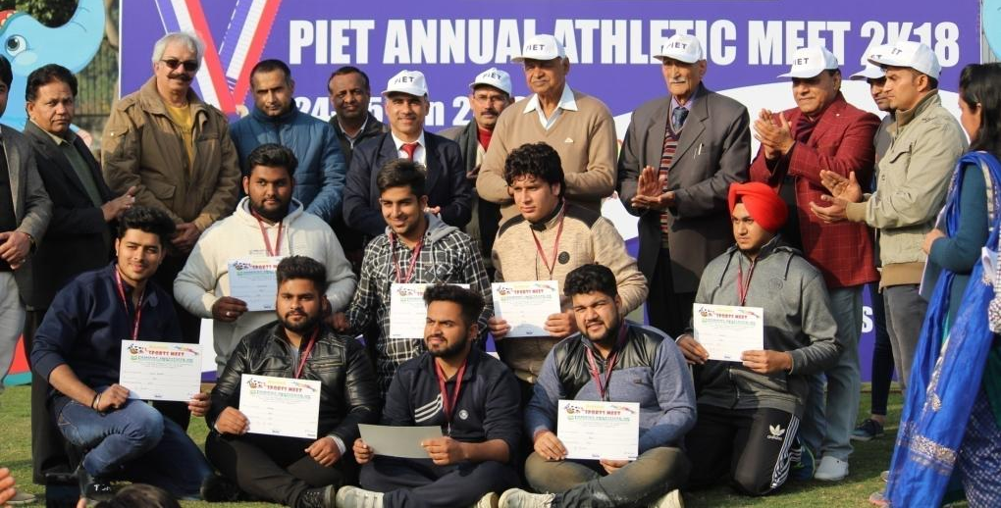
Sports being a part of the student education program, this year the sports day was organised with a difference. The events were declared open with the march past parade of students from all streams of the college. It was a grand presentation which was highly appreciated by the management.

Slide 39
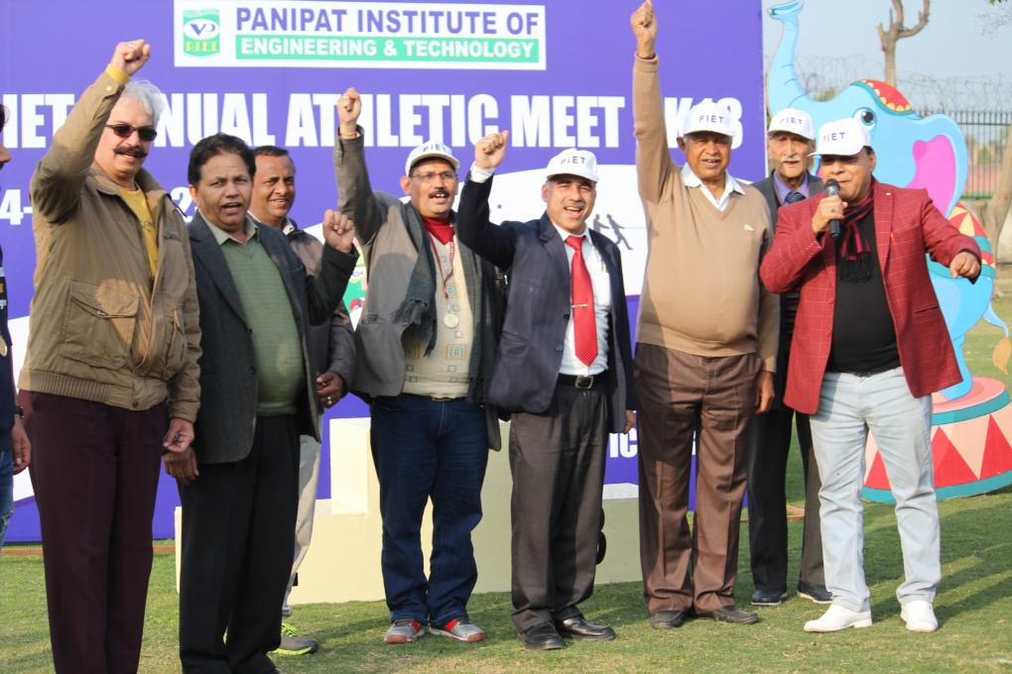
YES PIET !! Cheers for the successful Sports Meet 2k18

Slide 41
Sh S K Khanna Ji and Shri Hari Om Tayal Ji sharing their valuable words on Republic Day

Slide 42
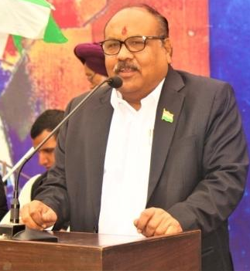
Mr Rakesh Tayal , Mr Suresh Tayal and Prof (Dr) K K Paliwal sharing their views on importance of Republic day.

Slide 43
The Republic Day Celebration was marked by the presence of Chief Guest Mr. Vikas along with his spouse Mrs. Sushma. They both are known for their achievement of the Everest climbing. Their presence was quite motivating for all.

Slide 44
Kritika and Nishant, BBA 1st year
Kritika BBA 1st year
Komal Goel from BBA 3rd Year

Slide 45
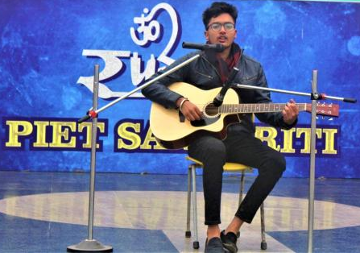
BBA Students Participating in Various Events

Slide 46
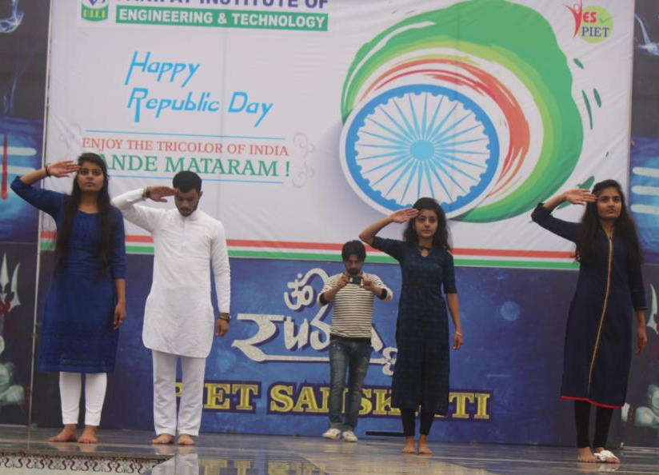
Sakshi Bhutra and group presenting their dance performance on O ri chiraiya, kehte hain humko pyar se India wale.

Slide 47
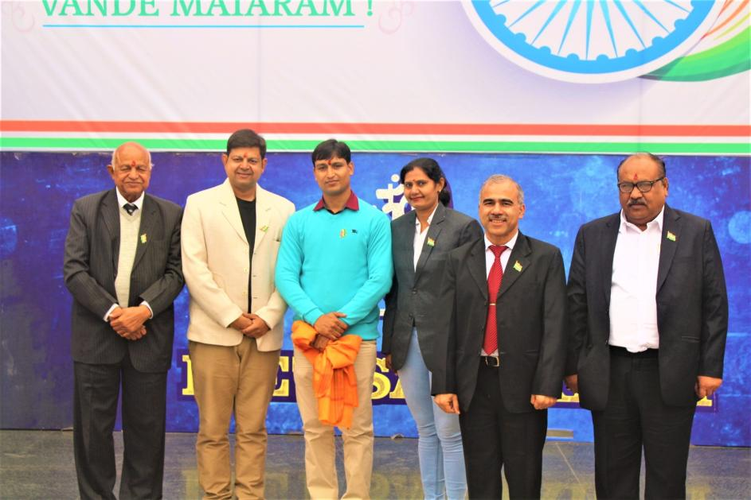
YES PIET !! Vande Matram!!
Mr. Vikas along with his spouse Mrs. Sushma and our worthy Management of PIET

Slide 48
28/01/2k18

Slide 49
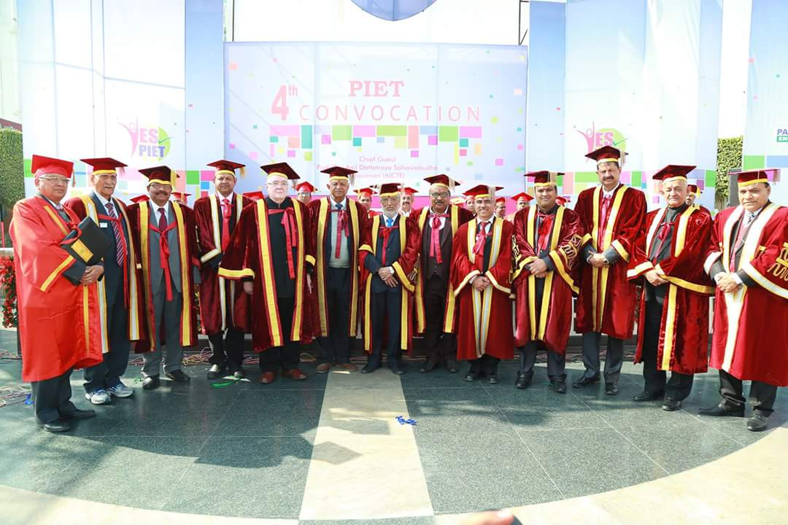
PIET Dignitaries with Chief Guest

Slide 50
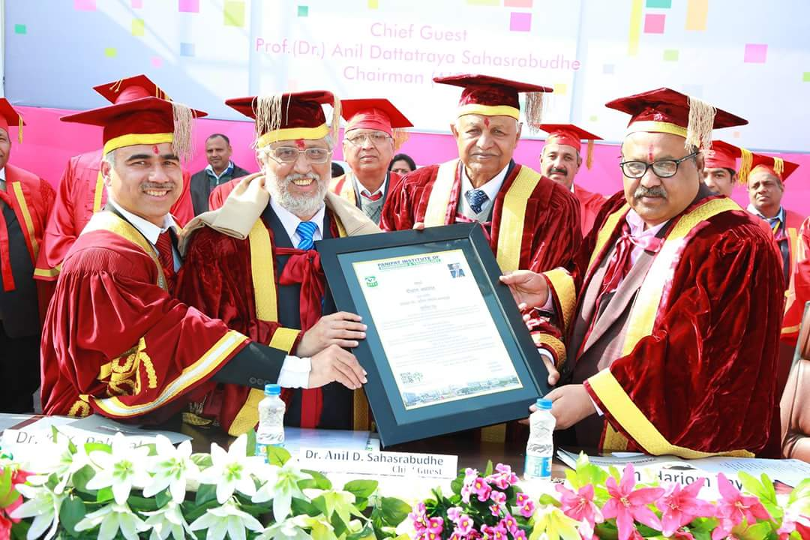
Chief Guest Prof.(Dr.) Anil Dattatraya Sahasrabudhe

Slide 51
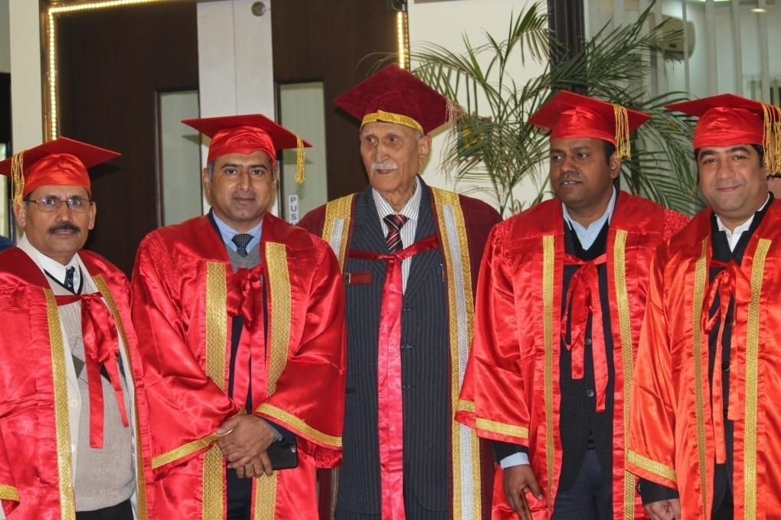
HOD sir along with other HOD’s and Respected Khanna Sir in Convocation 2k18.

Slide 52
4TH CONVOCATION 2K18
The 4th convocation was held at PIET on 28th January wherein 1072 degrees were awarded. Dr. Yoginder Singh Kataria, HOD, BBA was stage secretary for this red letter day which had a smooth flow all through and a successful ending to the entire satisfaction of the management.

Slide 53
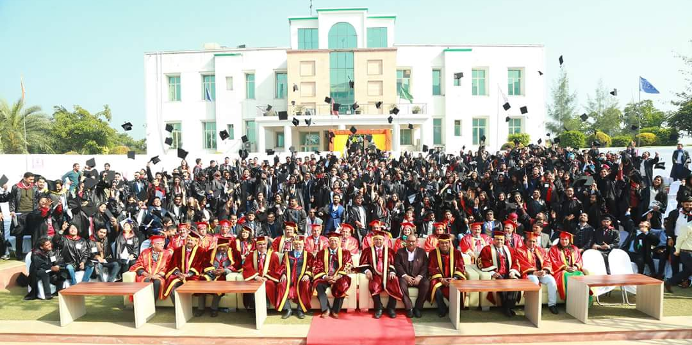
28th January was another red letter day in the history of PIET when the 4th Convocation was held wherein 1072 Graduates were awarded Degrees. Of course this was a day of festival for all theses young aspirants who were officially declared qualified by Kurukshetra University. The even was followed by an Alumni Evening. BBA students took part in the show which was full of fun and frolic.

Slide 54
Ms. Namita BBA Department won the title of Miss Personality after facing two rounds i.e Ramp Walk and Questioning .

Slide 55
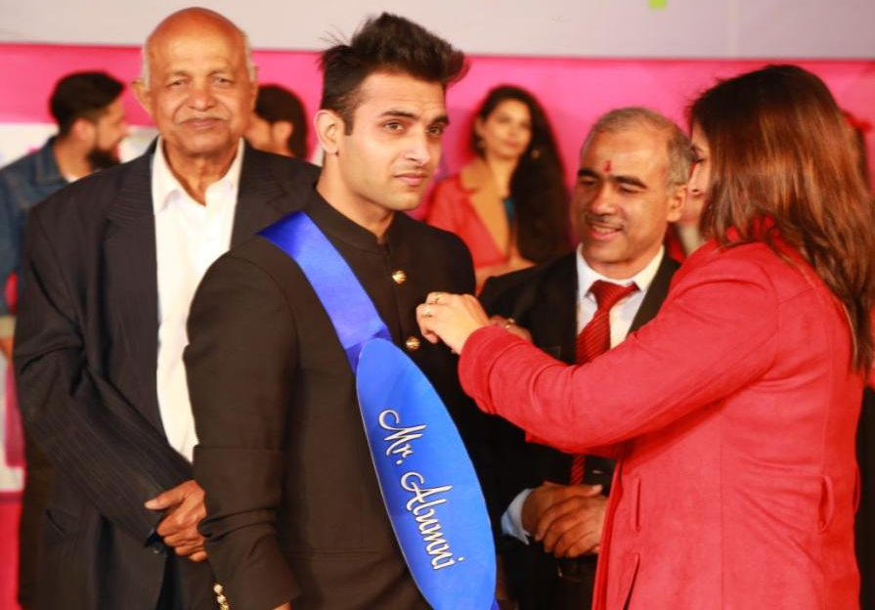
Nishchay Nagpal (Batch 2014-17) BBA Department won the title of Mr Alumni after facing a competition in two rounds i.e Ramp Walk and Questioning .

Slide 56
I am Nishchay Nagpal (ex-PIETian) of BBA 2014-17 batch. I migrated here in 2nd Year of my BBA and at that time I was a common student but Thanks to PIET Family who Polished and Enhanced my potential to express myself and explore new possibilities by showing me the light of guidance and motivation. PIET have given me the major exposure of life through which i stepped on the track of achievements.
Earlier i was shy and least interest taking student but Now i am self motivated and confident enough to leave behind my footprints of achievements. By all these i was awarded with the title- Mr. BBA on our farewell which means a lot to me and now this Mr. Alumni, I am speechless. I felt these are the result of my hard work and dedication which brings me here. These memories will never ever get fade by time in fact it boosts me up and motivates me to achieve more in life.
At last all i can say is that my college life was fantastic and full of experiences which now helps me in my life.
Thanks PIET

Slide 57
List of Medal Holders on Convocation
BBA 2012-2015 Batch
NAME | PERCENTAGE | POSITION
MADHUMITA | 83.15 | 1ST
RISHABH AGGARWAL | 80.23 | 2ND
MANKIRAN | 77.25 | 3RD

Slide 58
List of Medal Holders on Convocation
BBA 2013-2016 Batch
NAME | PERCENTAGE | POSITION
VEDANT | 79.90 | 1ST
NISHA | 77.15 | 2ND
GAZAL | 76.83 | 3RD

Slide 59
31 January 2k18 1-2 February 2k18

Slide 62
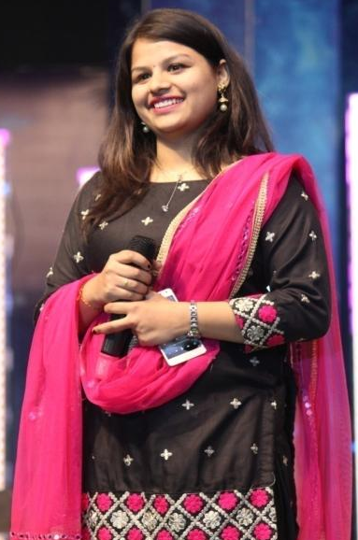
Jigyasa , BBA-2nd Year, Anchor for Day-1
She is also President of Rotaract Club and a very active student in all activities

Slide 63
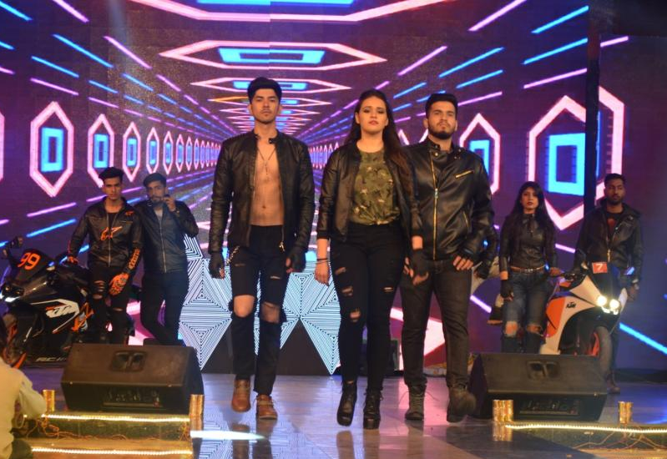
Tanya , Gagan in Most Fascinating event RAMP WALK (Bikers theme)

Slide 64
BBA Students in RAMP WALK (Lakhnavi theme)

Slide 65
EDM Set Up !!

Slide 66
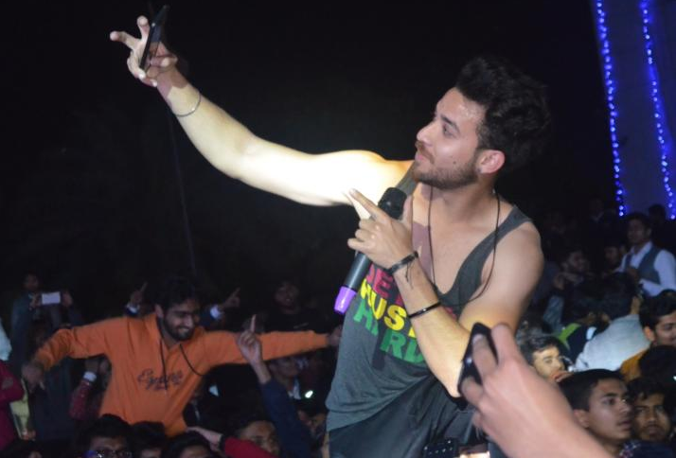
MYRIS , The EDM Sensation at PIET

Slide 67
PIETians enjoying EDM night !!

Slide 71
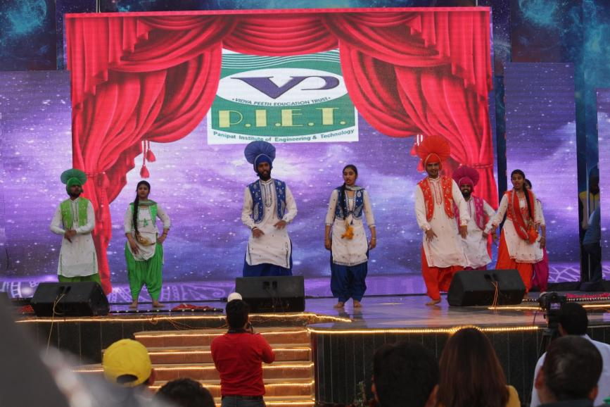
Bhangra Team from PIET participated in Maestros 2K18 in which Prince, Chetna students of BBA Department also participated and presented an enthusiastic performance.

Slide 72
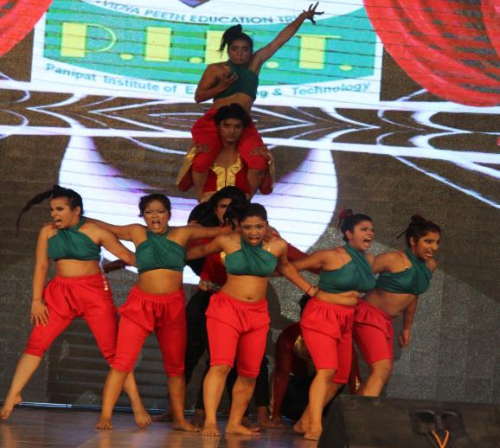
Day-2 was all about cultural activities in which many good colleges from Delhi, Sonipat, Karnal and Panipat participated in group dance, play, and singing.

Slide 74
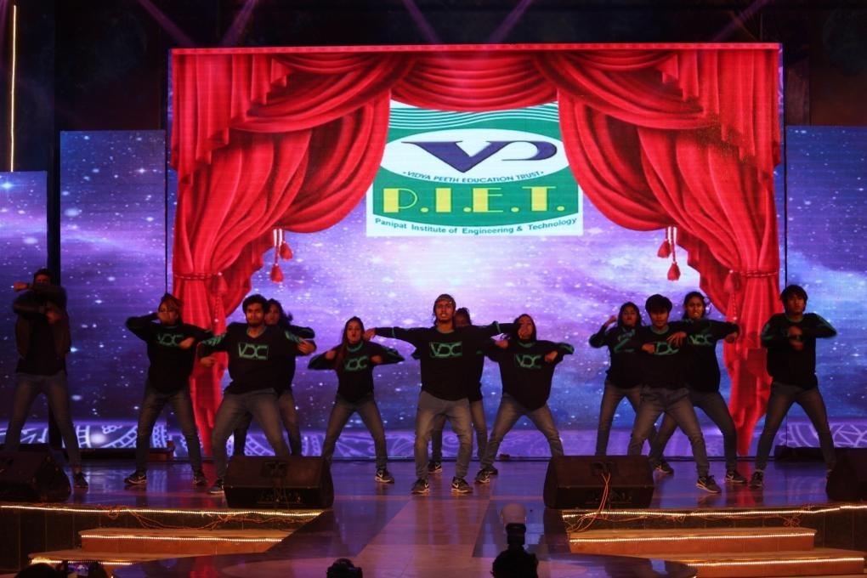

Slide 77
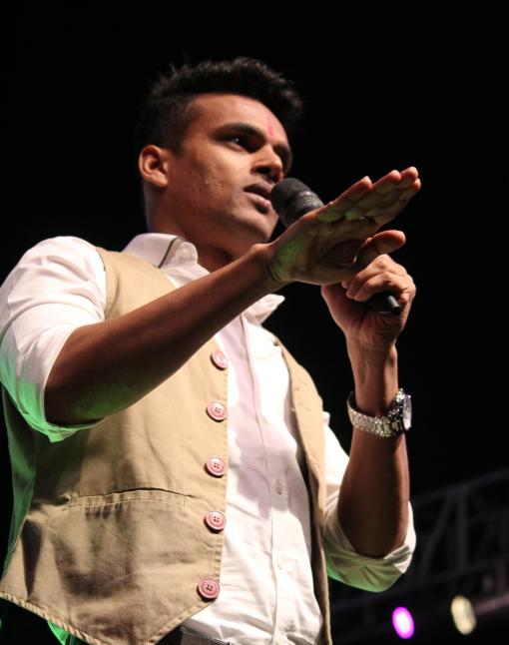
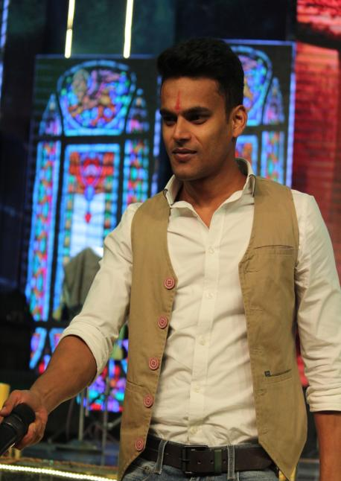
Jayvijay Sachan at PIET

Slide 78
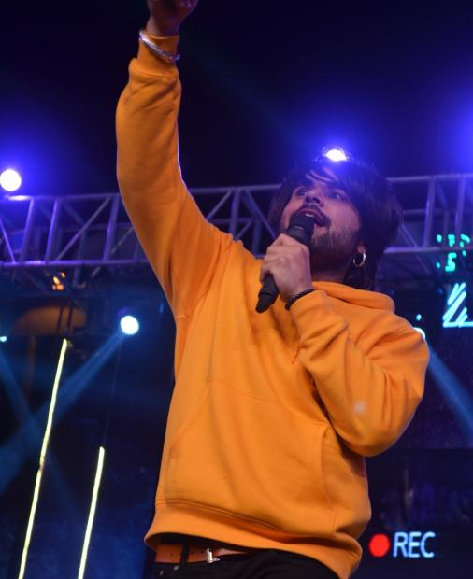
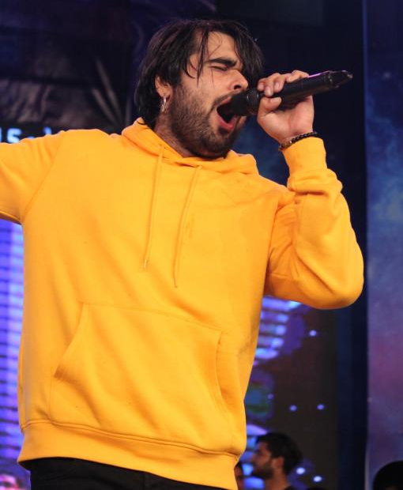
NINJA at PIET

Slide 79
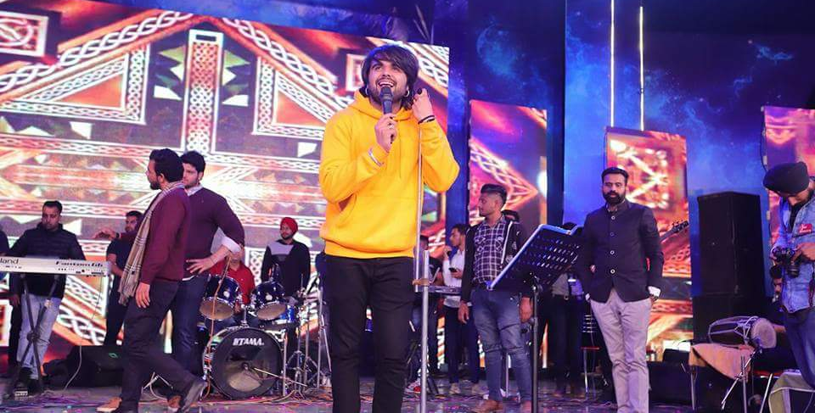
NINJA (A very famous Punjabi singer) Performing on STAR NIGHT Of Maestros Xtreme 2k18

Slide 80
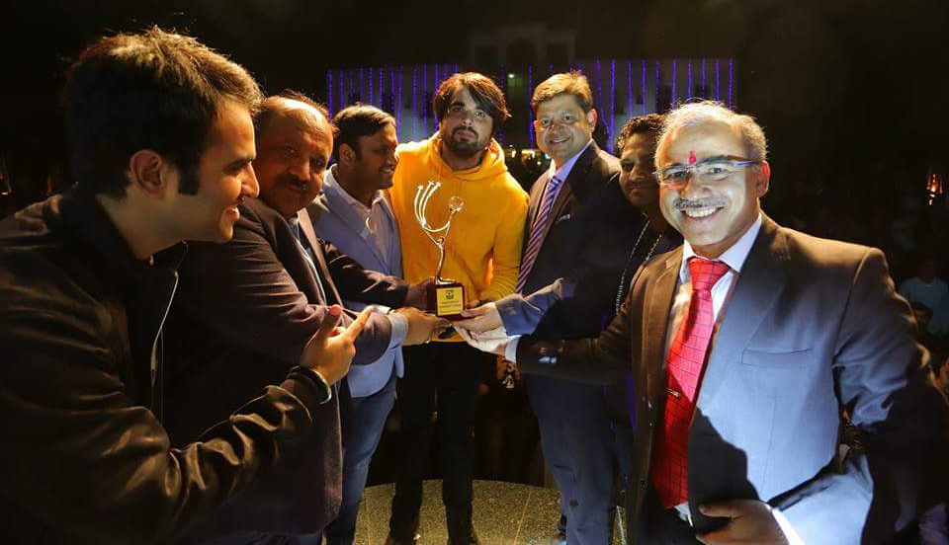
Momento presentation to Star NINJA by PIET Dignitaries

Slide 81
Marketing team Maestros Xtreme 2k18 was headed by Dr. Yoginder Singh Kataria, HOD, BBA, PIET along with Dr. Sandeep, students from various streams but maximum were from BBA Department.
The work done by Marketing team was worth appreciating. And it lead to success of the Maestros.
All thanks to BBA HOD Dr. Yoginder Singh Kataria, for proper guidance to the students which helped them a lot during this.

Slide 82
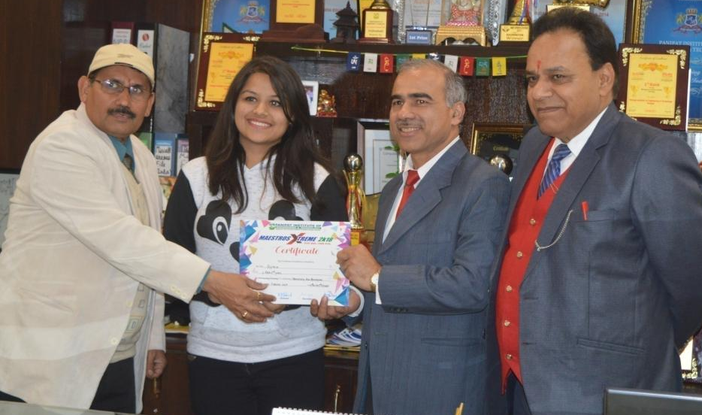
Jigyasa Khurana, BBA-2nd Year

Slide 83
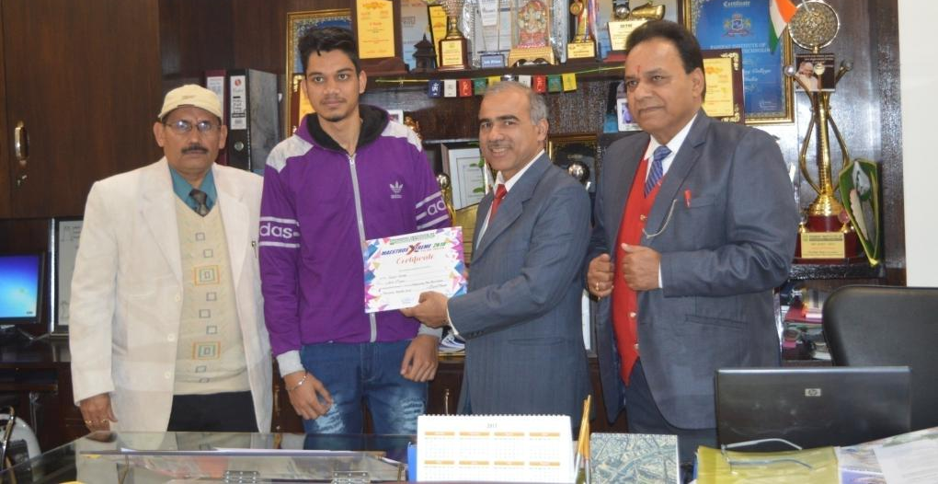
Rohit Kumar, BBA 2nd Year

Slide 84
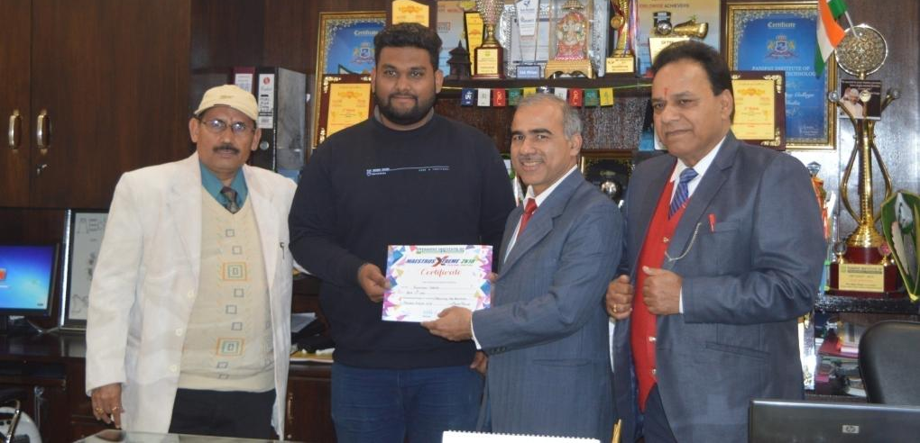
Anshuman Sharma, BBA 1st Year

Slide 85
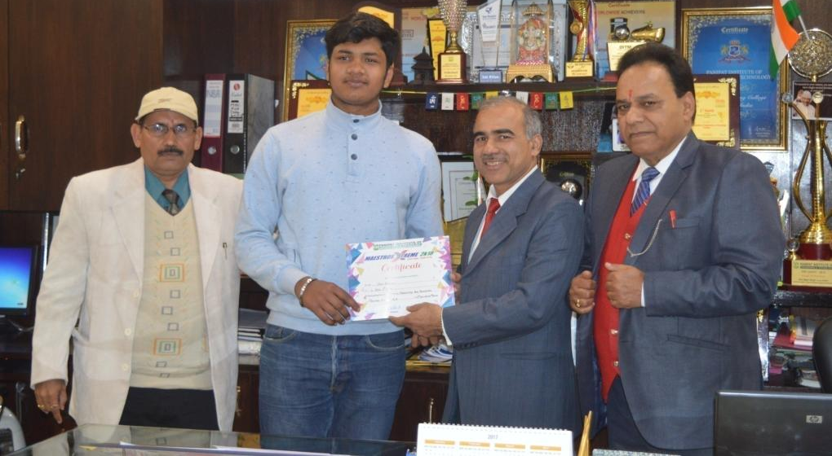
Vasu Bansal, BBA 1st Year

Slide 86
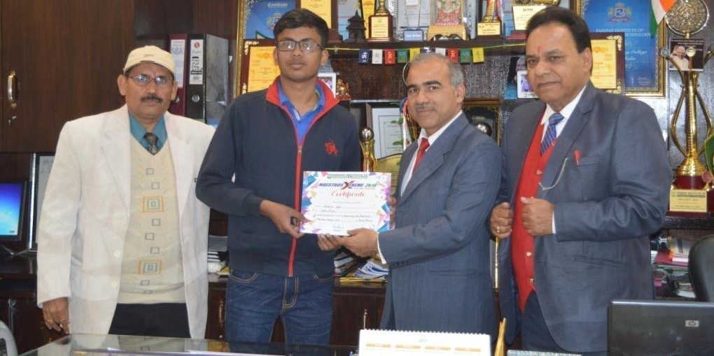
Anubhav Garg, BBA 1st Year

Slide 87
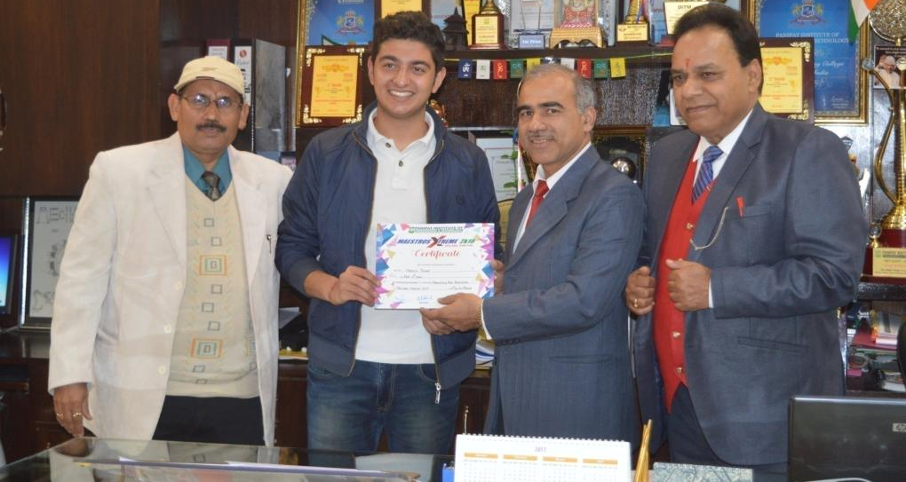
Hardik Diwan, BBA 1st Year

Slide 88
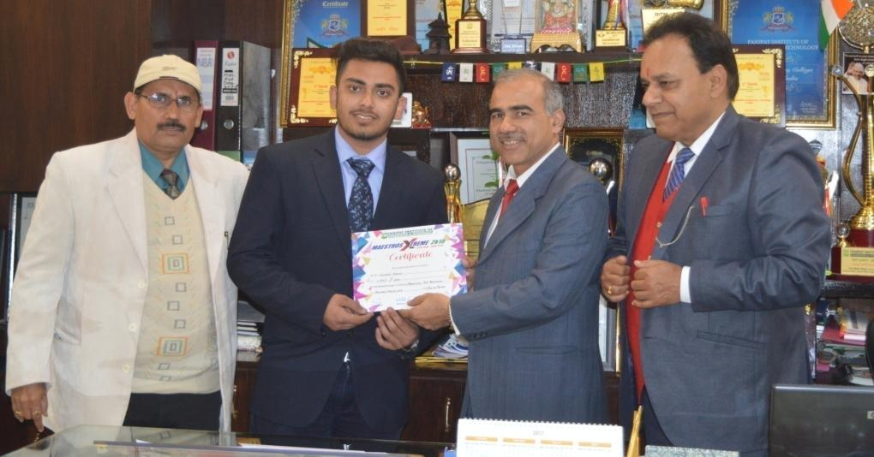
Nishant Bareja, BBA 1st Year

Slide 89
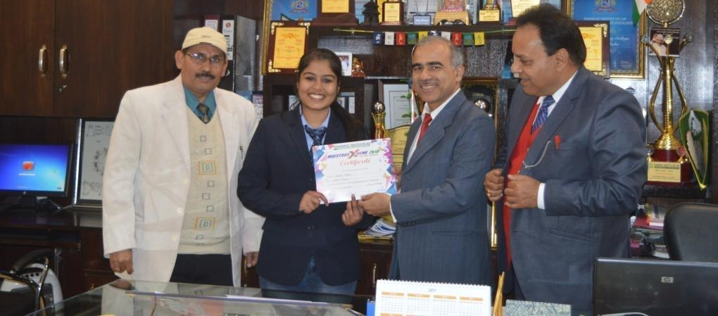
Kritika Arora, BBA 1st Year

Slide 90
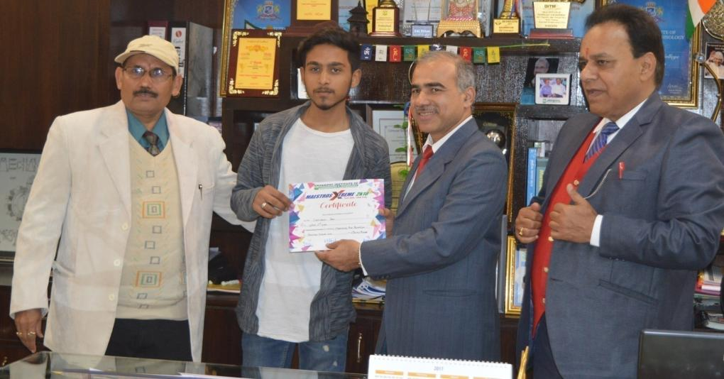
Shriyansh, BBA 2nd Year

Slide 91
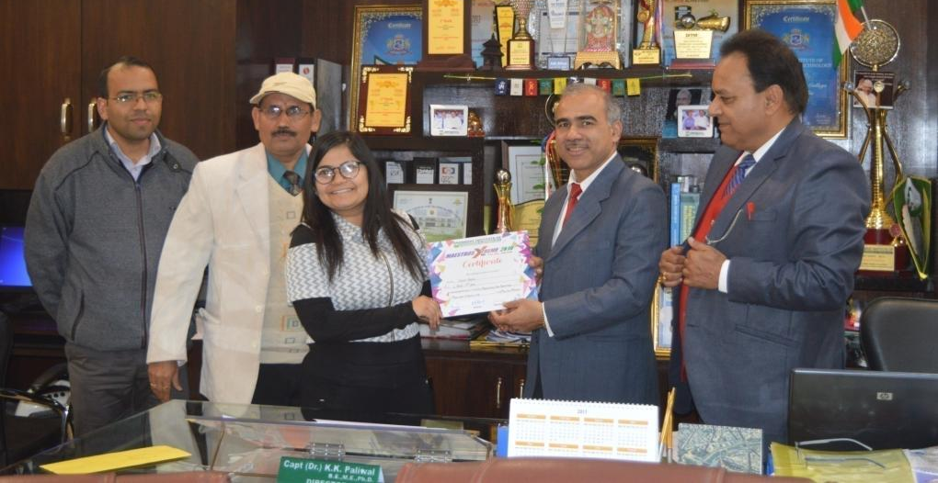
Vidhi Arora, BBA 2nd Year

Slide 92
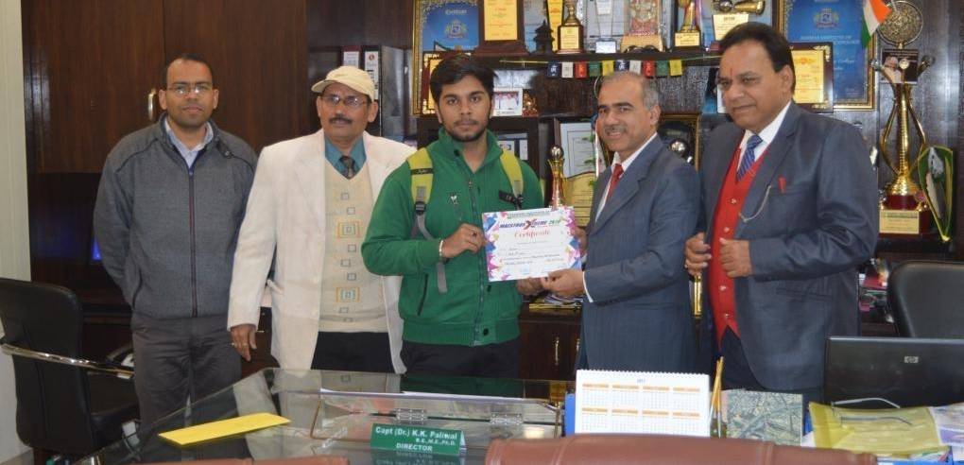
Kunal , BBA 1st Year

Slide 93
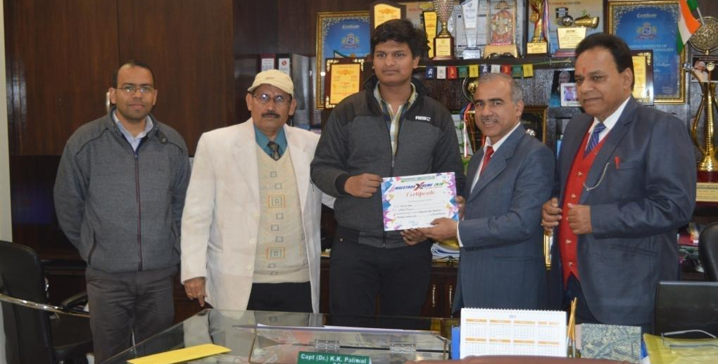
Akshit Garg, BBA 2nd Year

Slide 94
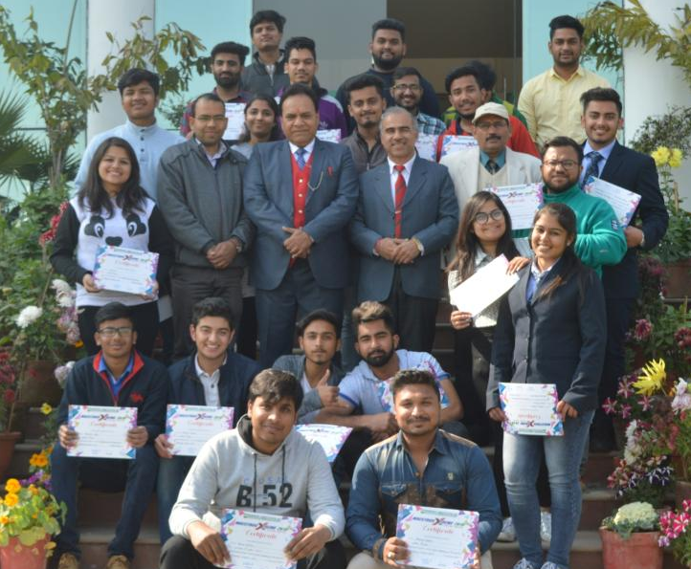
Group Photo Of Team Marketing, PIET Maestros Xtreme 2k18

Slide 96
MAESTROS 2K18
INFORMAL EVENTS (31st Jan 2018)
S. No. | Event | Ist Position / (College Name) | 2nd position / (College Name) | 3rd Position / (College Name)
1 | Fastest Finger 1st |  | Sahil Raheja ,PIET(BBA)
2 | Nail Art | Harsimran Kaur,PIET(BBA)

Slide 97
MAESTROS 2K18
INFORMAL EVENTS (1st Feb 2K18)
S. No. | Event | Ist Position / (College Name) | 2nd position / (College Name) | 3rd Position / (College Name)
1 | Roadies | Mamta,PIET(BBA)
2 | Face Painting |  | Mansi &Vasu,PIET(BBA)
3 | Photography |  |  | Aman Goel, PIET(BBA)
4 | Food Carnival | Mansi &Vasu,PIET(BBA) | Saloni &Tanya,PIET(BBA)

Slide 99
Time to Say Goodbye to Performance Management and Welcome Performance Motivation?
Ms. Simranjeet Kaur, Assistant Professor, BBA, PIET

Slide 100
I came across an interesting write up and found it to be very relevant in today's fast changing hyper - competitive environment.
Time to Say Goodbye to Performance Management and Welcome Performance Motivation?
Many of us talked about performance management till the other day but that worked great in the 1980s, Now , in the changed scenario it’s really time for us to upgrade our systems to performance motivation.
Performance motivation is awesome and important because it creates intrinsic motivation. In fact, job descriptions and related stuff should cease from immediate effect. Job descriptions are boring and stupid and they don’t add value.
Instead focus should be on impact descriptions.

Slide 101
With impact descriptions, you take the old job descriptions, dust them off, and add just a few things to it such as who we are as a company, who you are to succeed in this role, how this role matters, how this role makes a dent in the universe, and who your ultimate customers are.
Let’s not forget Daniel Pink in his famous book The Drive talks of three Principal elements of Motivation namely: autonomy , mastery & purpose. So, We’re actually painting the picture of experience of safety, belonging, and mattering.
So it’s time to take stock, reflect and move forward with new thinking!

Slide 102
BBA, HOD
(Dr. Yoginder Singh Kataria)
BBA, E-Committee
(Mr. Jagmohan Malhotra)
(Ms. Sakshi Garg)
(Ms. Simranjeet Kaur)
(Ms. Simran Verma)

