Slide 1
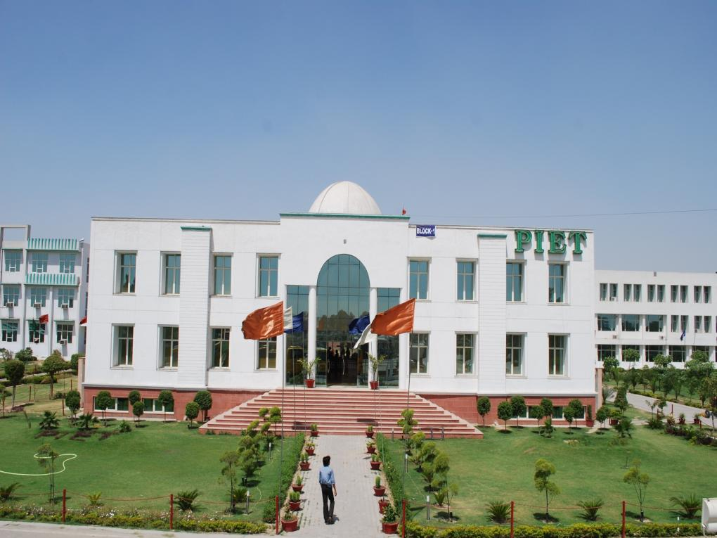
-+*

Slide 4
The month with least number of days (only 28) represents the transition from winter to summer via spring. The word FEBRUARE (Roman) also means ‘purify’ and hence in this month the environment is a bit more glorious, shining, fresh and colorful with flowers tossing their heads in their beds and blessing all life around with their sweet fragrance.
For the collegians it is the month of SOTs, Sessionals, Academics and Placements, a peculation process of learning they have gone through all these days.
This month is also all the more crucial as the count down starts for the end of another semester leading to ‘University Exams’.

Slide 5
"We cannot always build the future for our youth, but we can build our youth for the future.” -Franklin D. Roosevelt These words by Franklin D. Roosevelt perfectly describe our aim at BBA Panipat Institute of Engineering and Technology. Beyond providing a sound education, we wish to provide our students a holistic learning experience for life. Our aim is to teach students to LEARN, not just STUDY. Hence, we strive to travel beyond the boundaries of mere books. We have realized that the future is virtual, abstract and unknown but the youth in our hands are real, lively and enthusiastic and can be molded. Dear students, "You are the nation-builders. You are the movers of technology. You are the agents of change." It is our fervent hope that the years that you spend in PIET would enable you to equip with leadership and managerial skills. The knowledge that you will gain, the fine qualities that you will imbibe and the technical skills that you will learn to apply will be your major contribution to your parents, to society, and to the nation.
Mr. Jagmohan
Ms. Sakshi

Slide 6
We invest our trust on you. You are our safe source and we bank all our efforts on you. We create not the future instead we craft you for the future. There are strong challenges to great efforts but, always remember, great effort bears the sweet fruit of success. We want you to taste the fruit of success once and for the rest of your life, you will never rest.
"You don't have to be great to start, but you have to start to be great.” With best wishes from editorial team for the coming up challenges.
Jagmohan Malhotra Chief Editor
Ms. Simranjeet
Ms. Simran

Slide 7
Dr. Yoginder Singh Kataria, HOD, BBA, PIET

Slide 8
FROM HOD’s DESK
It is said that the college magazine is a mirror which reflects the image of a college. This statement is quite true because a magazine carries the contributions reflecting ethos and aspirations of the students, faculty and other team members of an institution.
They amply demonstrate the communication skills, poetic prowess, imagination and creativity, humor and humanism, technical competence, and patriotism of the contributors. The pride of every student and staff would be in his/her college.
A college may reach heights of glory but without materials like a college magazine, the outside world may not know of it. The role of a college magazine is therefore vital in promoting what an institution offers.

Slide 9
Our College is recognized as a state leader in teaching and learning, student relationships and wellbeing. We create a safe social and physical environment that helps all our students learn and succeed. The size of the BBA Department and the emphasis on developing and maintaining positive relationships means that we know each student as an individual.
With 850 students, we can provide more personal support and greater access to opportunities in each student’s chosen fields of interest. Parents and visitors compliment us on the warm and orderly school atmosphere and our strong sense of community.
We encourage all our students to develop high expectations about themselves, their work and their behavior, which is an expression of our values of Personal best, Integrity, Respect and Responsibility.
Our approach involves working with parents to meet the individual needs of every student, and supporting them to fulfill their academic and co-curricular goals and dreams.
Dr. Yoginder singh kataria
HOD, BBA

Slide 10
6-8-9 February 2018

Slide 11
As a practical part of the curriculum, February has been marked with ‘Industrial Visits’, what we call ‘an exposure to the shop floor’ to enable aspirants learn and understand the ground reality of the industrial scenario.
BBA 1st year students were taken out to visit YAKULT on 6th, 8th and 9th Feb under care of M/s Jagmohan, Monica, Samriti, Shachie and Vikas.
It was a truly learning exposure for the budding management students where they got to know the process delicacies and quality and hygiene assurance for manufacturing safe food products.

Slide 12
Ms. Shachie Sandhu giving momento to Mr. Abhishek Singh (AGM, HR & Admin) along with Aadish and Yamini at Yakult on behalf of BBA, PIET

Slide 13
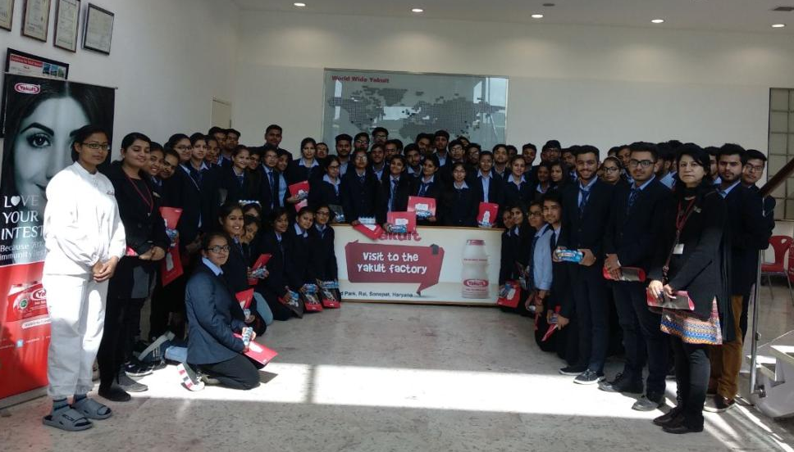
Ms. Samriti & Ms. Monica (PIET faculty) along with students of BBA and Ms. Yamini at Yakult

Slide 14
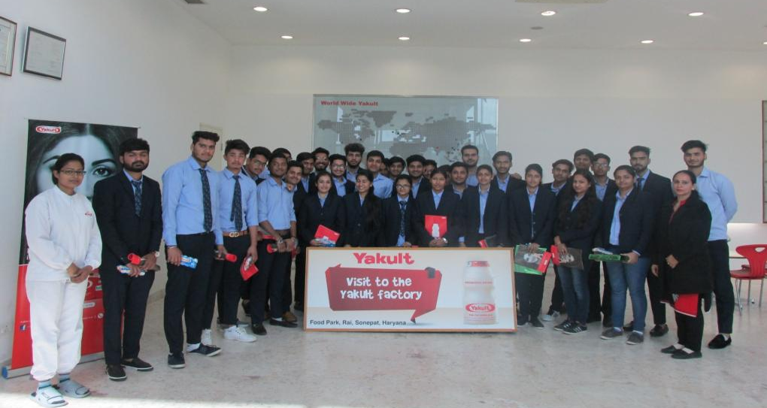
Group Photograph of Students at Yakult

Slide 15
9-February-2018

Slide 16
“DONATE A DROP OF LIFE FOR UNKNOWNS”
A ‘Blood Donation Camp’ was organized by PIET in collaboration with the Lion’s Club, Panipat on 9th Feb. which was coordinated by Ms. Preeti Dahiya of BBA.
141 Units of blood were donated by the students of PIET out of which many were from BBA.

Slide 17
“If you’re a blood donor, you’re a hero to someone, somewhere, who received your gracious gift of life” – Nikhil, BBA-2nd Year

Slide 18
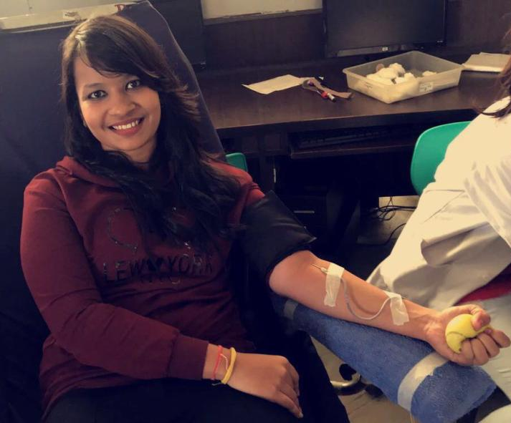
“To the young and healthy it’s no loss. To sick it’s hope of life. Donate Blood to give back life.” -Kunjal Garg, BBA-2nd Year

Slide 19
9-February-2018

Slide 20
National Conference at
Guru Jambheshwar University (GJU)
Like previous years, a National Conference was attended by three students of BBA final year Mr. Akant Bhola, Mr. Tarun Anand and Mr. Sagar Sharma under the guardianship of Dr. Ankur, AP, BBA, PIET.
Dr. Himani Sharma was the organizer And Dr. Promila Suhag was the resource person of the conference.
It is a matter of proud for BBA Department that these students were specially invited for the conference because of their previous presentation.

Slide 22
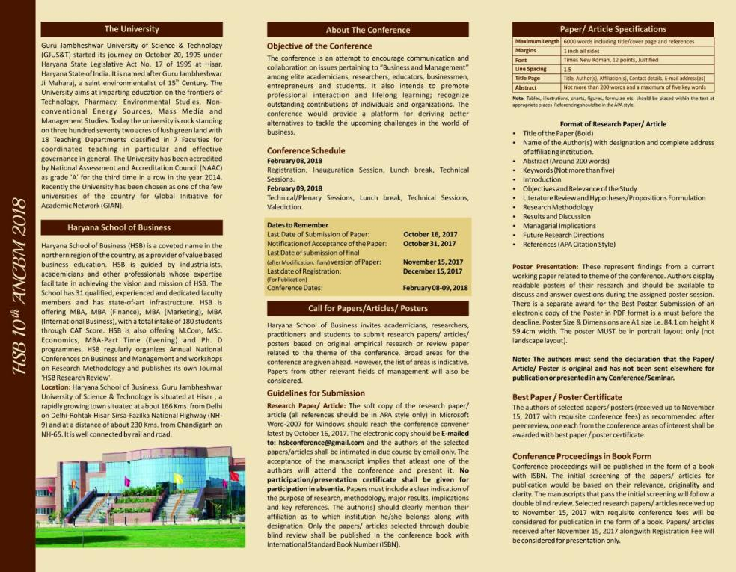

Slide 23
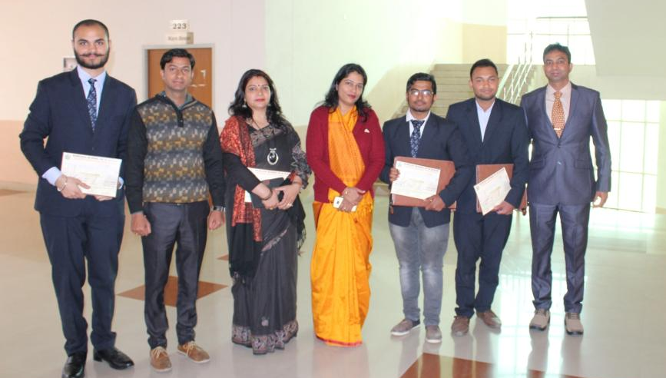
Dr. Ankur with BBA students Mr. Akant Bhola, Mr. Tarun Anand & Mr. Sagar Sharma at Haryana School of Business (GJU) along with Dr. Himani Sharma & Dr. Suresh Kumar Bhaker

Slide 24
16-Feb-2018

Slide 25
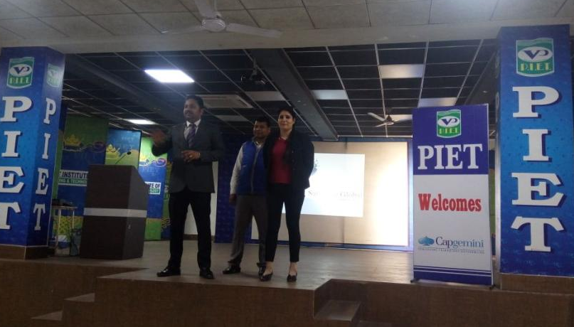
16th Feb was another important day for BBA 2nd year aspirants coordinated by Dr. Annu Dahiya. An interactive Session was organized on the theme International training with Dr. C S Yadav.
This would be help to the students for internship abroad in countries like the USA, Spain and Mexico

Slide 26
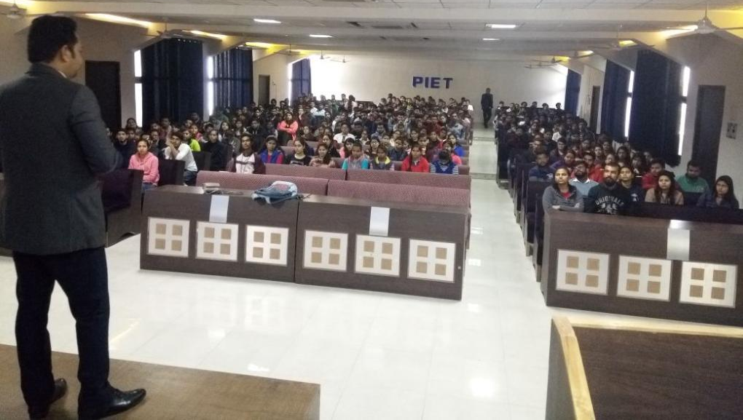
International Internship Programme
During the interaction, many queries were asked by students regarding international internship which were on the spot solved.

Slide 27
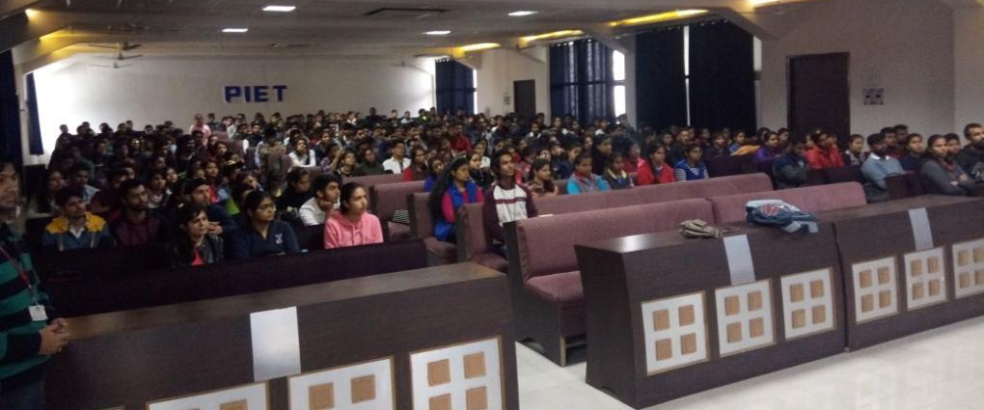
BBA 2nd year attending International Internship Programme , Many students gave positive feedback for the programme as they were willing to know the opportunities which are available abroad. And no doubt this program helped them a lot in this.

Slide 28
19-February-2018

Slide 29
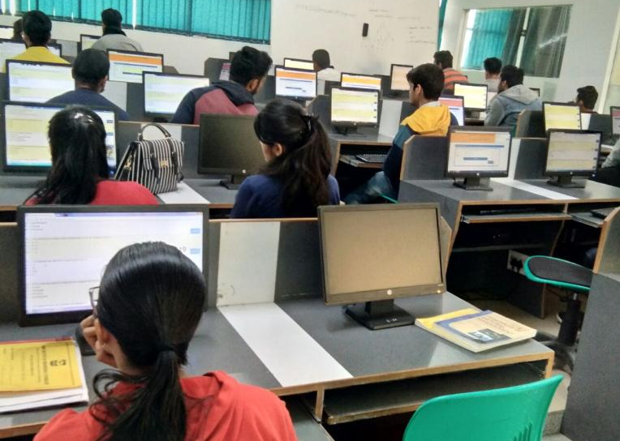
And it was the time for SOT-1 Which was held on 19-February-2018 for all the three years. In one semester SOT’s are taken thrice in order to check the understanding of students regarding subjects. And its like test of their own knowledge and memory .

Slide 30
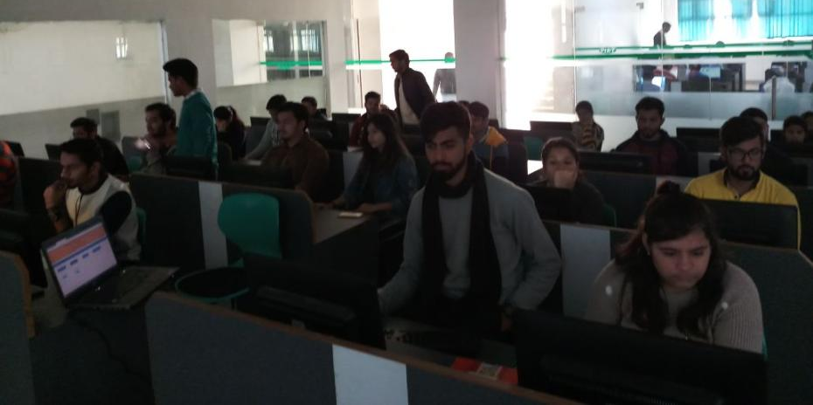
BBA Students giving SOT-1 in Computer Labs

Slide 31
20-Feb-2k18

Slide 32
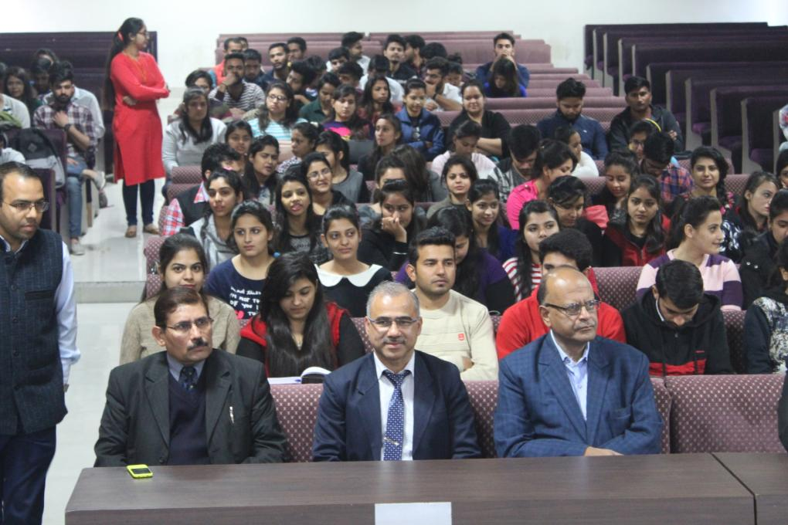
Dr. Sanjiv Mittal, Professor, GGSIPU along with Director Sir (Prof.(Dr.) K.K Paliwal and HOD Sir (Dr. Yoginder Singh Kataria)

Slide 33
Dr. Sanjiv Mittal, Professor, GGSIPU, Delhi presenting lecture to BBA Students.

Slide 34
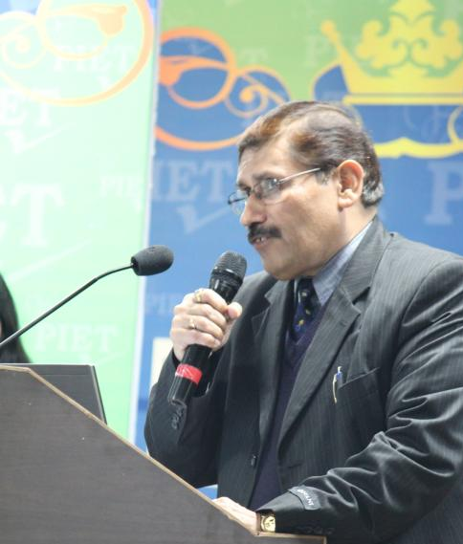
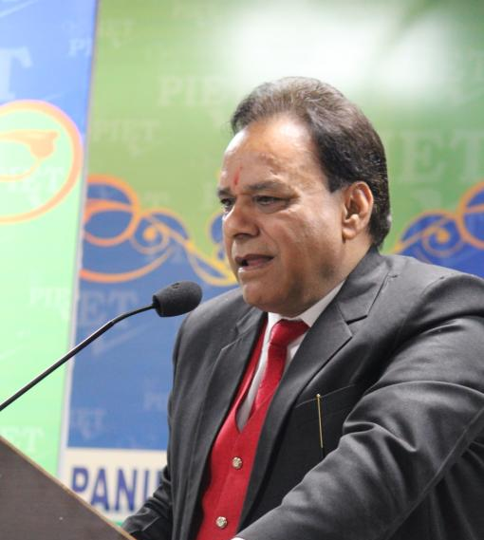
Address by Dr. Yoginder Singh Kataria, HOD, BBA, PIET
Address by Dr. BB Sharma, Dean, Student Welfare, PIET

Slide 35
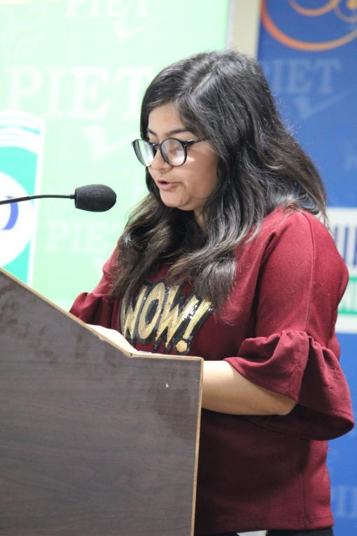
Ms. Vidhi Arora, BBA-2nd Year, Formal anchor of the day.

Slide 36
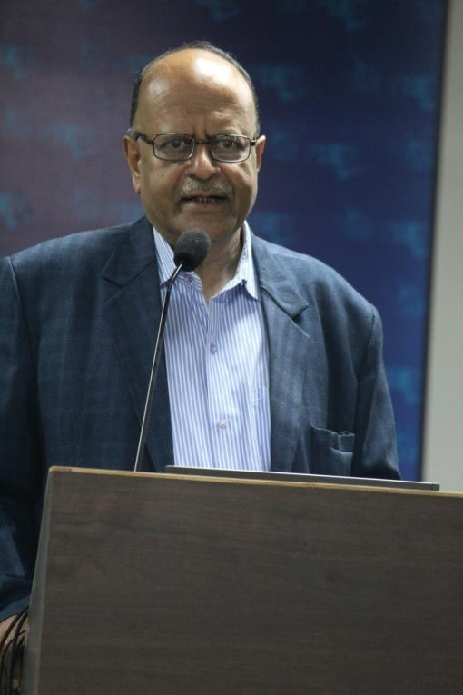
Dr. Sanjiv Mittal interacting with BBA students.
Students were really happy to know things about entrepreneurship which they never knew and were always keen to know.

Slide 37
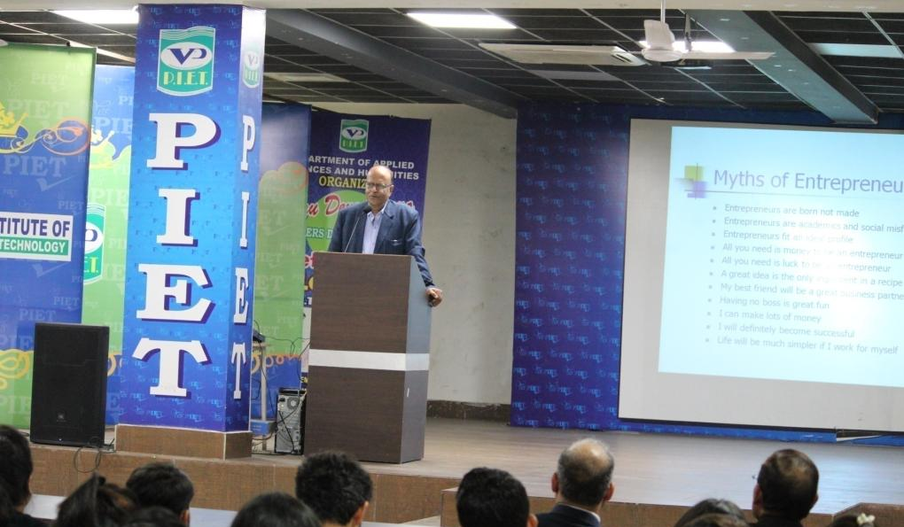
Dr. Sanjiv Mittal during presentation in Seminar

Slide 38
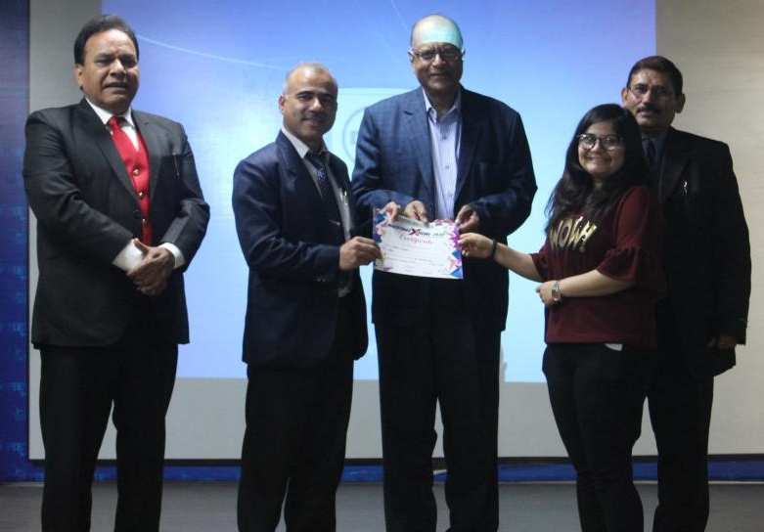
Ms. Vidhi Arora, BBA-2nd Year, Receiving certificate for Formal Anchoring of the day by Dr. Sanjiv Mittal, Dr. BB Sharma and Dr. Yoginder Kataria

Slide 40
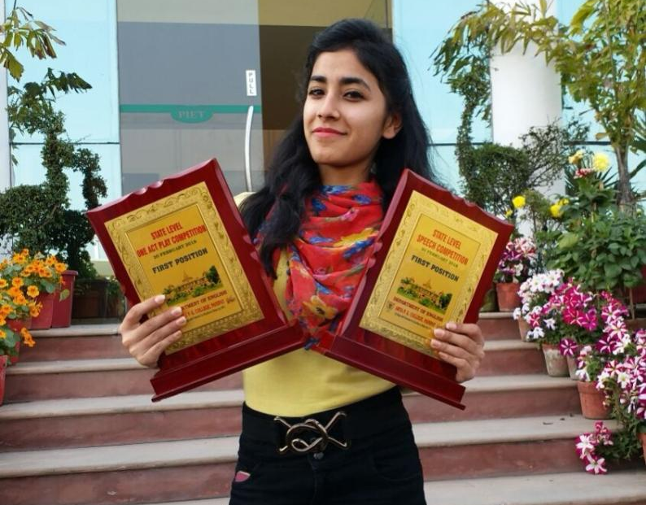
Ms. Mamta Gandhi, BBA-2nd Year, Secured 1st Position in Speech and One Act Play Competition in state level competition held at Arya PG College, Panipat

Slide 41
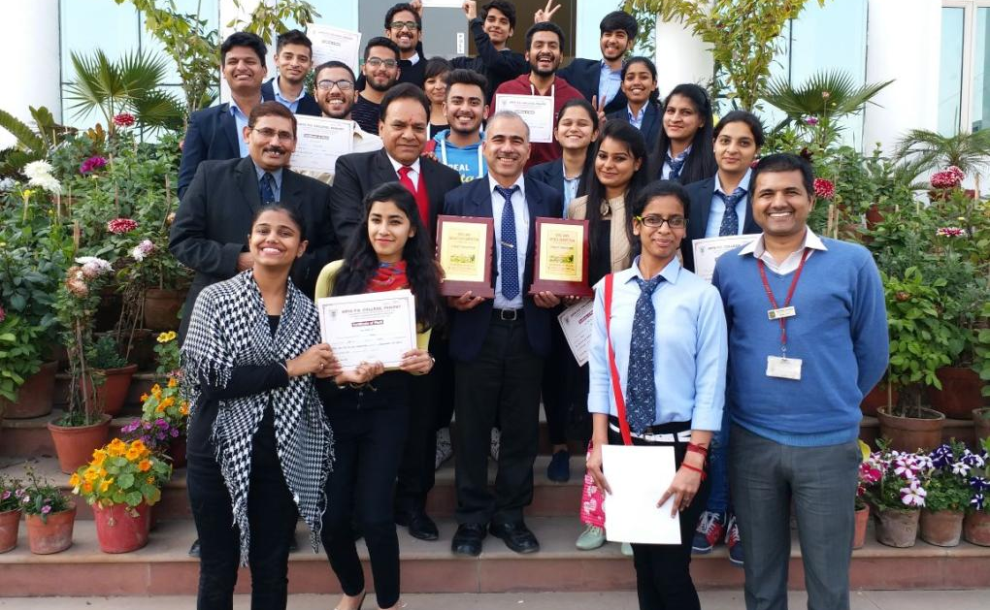
BBA Students who participated in Arya PG College’s State Level Competition taking pictures along with Director Sir, BB Sharma Sir and HOD Sir showing their awards and certificates received. Again a proud moment for BBA Department.

Slide 42
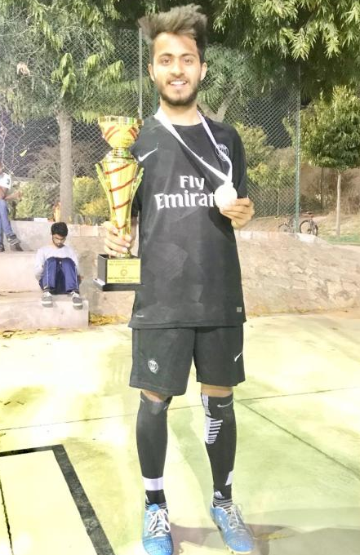
Malaviya National Institute Of Technology , Jaipur (MNIT) Sports Tournament 2018 (Malaviya National Institute Of Technology , Jaipur) organized a National Level Football Competition in Sports Tournament which was from 23rd Feb to 25th Feb 2018. PIET’S Team secured 2nd Position Shivam Digani, BBA-2nd Year got title of 2nd runner up for the tournament.
Shivam Digani, BBA-2nd Year

Slide 43
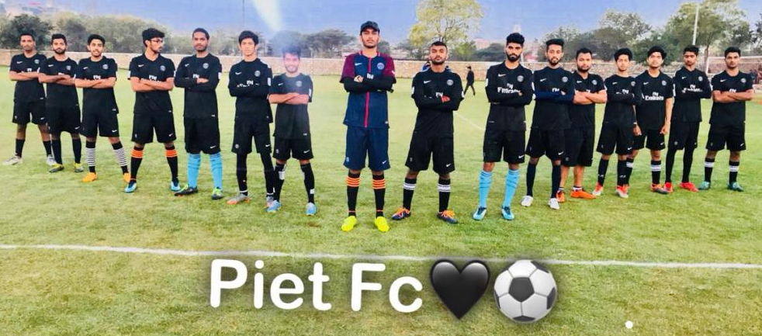
PIET’s Team Participated in that and results were as follows.
First Match Quarter Final Semi Final Final Bikaner v/s PIET PIET v/s NIT Delhi PIET v/s MNIT Jaipur PIET v/s Manipal Uni, Jaipur Score 2-0 Score 1-0 Score 3-1 Score 1-0 (Qualified) (Qualified) (Qualified) SECOND POSITION

Slide 44
Sessional-1 was successfully organized from 24th to 27th Feb

Slide 45
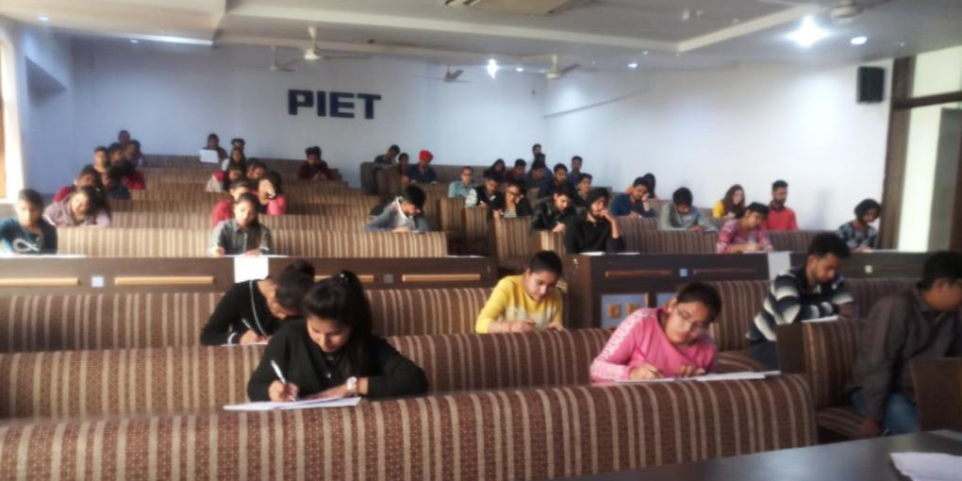
BBA Students giving Sessional exam. In 1st Sessional exams minimum 50 percent syllabus is given for each subject.

Slide 47
Don’t Quit
When things go wrong, as they sometimes will When the road you're trudging seems all uphill When the funds are low and the debts are high And you want to smile, but you have to sigh When care is pressing you down a bit Rest if you must, but don't you quit. Life is queer with its twists and turns As every one of us sometimes learns And many a fellow turns about When he might have won, had he stuck it out.
Don't give up though the pace seems slow You may succeed with another blow. Often the goal is nearer than It seems to a faint and faltering man;
Sakshi Garg, Assistant Professor, BBA, PIET

Slide 48
Often the struggler has given up When he might have captured the victor's cup. And he learned too late when the night came down.
How close he was to the golden crown.
Success is failure turned inside out The silver tint of the clouds of doubt And you never can tell how close you are It may be near when it seems afar;
So stick to the fight when you're hardest hit It's when things seem worst that you must not quit.
Sakshi Garg, Assistant Professor, BBA, PIET

Slide 49
BBA, HOD
(Dr. Yoginder Singh Kataria)
BBA, E-Committee
(Mr. Jagmohan Malhotra)
(Ms. Sakshi Garg)
(Ms. Simranjeet Kaur)
(Ms. Simran Verma)

