Slide 2
Issue 5

Slide 3
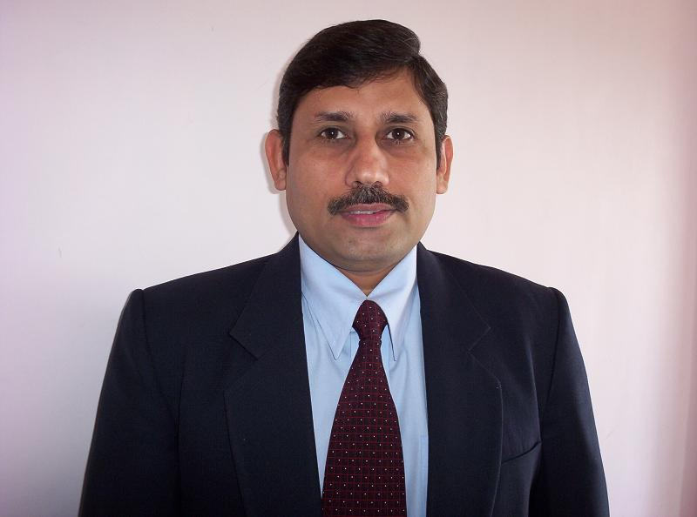
Dr. Yoginder Kataria
BBA – HOD
Message

Slide 4
You are indeed blessed to find an opportunity to get education at one of the best colleges of Haryana, Delhi NCR and North India, which has been nurtured and benefitted by a great management with a celestial vision. The college has the privilege of having a healthy, harmonious ambience and rich values which play pivotal role in shaping the future of innumerable students. Our mission is to transform students into rational thinkers, competent professionals, law abiding citizens and spiritually enlightened individuals. This is my firm belief that the rich values and traditions imbibed here would carry you to greater heights.

Slide 5
With proud legacy of a decade now, PIET has excelled in every field. Many students have registered their presence in the merit list of Kurukshetra University and others have brought laurels in cultural activities in zonal and inter-zonal sports. We are university champions in sports while some students educated from the college have carved a niche for themselves in various fields at national and international levels.
Dear students, in this era of cut throat competition, it is of paramount importance to be equipped with appropriate knowledge, habits, attitudes and values leading to holistic development. Co-curricular and extra-curricular activities organised by various clubs and societies facilitate the process of creative and critical thinking. They not only inculcate social and moral values, compassion for nature, pride for Indian culture and tradition and awareness for one’s rights and duties but also make students good human beings and confident leaders. I intently believe that you would develop versatile personality during your stay in this temple of learning.

Slide 6
While bidding adieu to the seniors in a very friendly, harmonious and joyous moods i would like to say that to be successful in life, have ambitions and define your goals clearly. Discipline and hard work is the key to success. Be regular in your classes and focus on your goals. Your concerted efforts with the able guidance of your teachers would definitely provide you a blissful and successful life.
I wish you all the best for achieving greater success and scaling new heights in the coming session.
With blessings and warm wishes
Dr. Yoginder Kataria
HOD, BBA

Slide 7
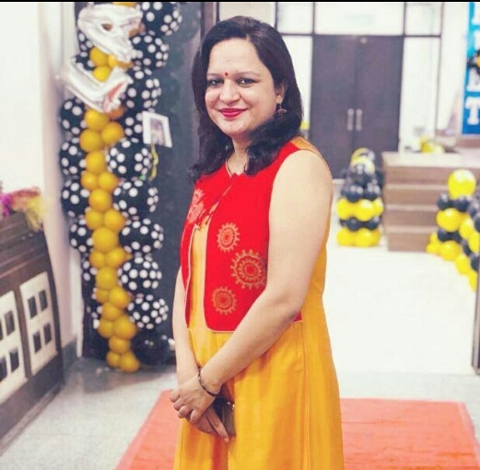
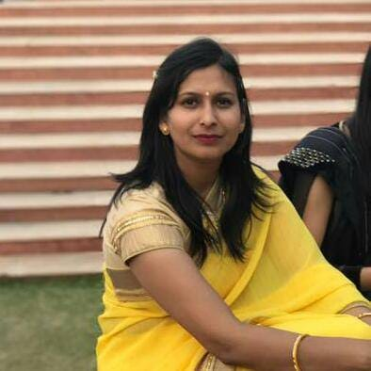
Editorial Team’s View
This is the first magazine release of the new semester and it brings you NEWS about happenings at PIET so as to update your information about the institute and BBA department.
We at PIET prepare students to live lives of leadership and good for the common and to meet challenges of professional world. These days people question the value of a college degree. I can’t say about all colleges in the vicinity, but at PIET you get value for money which comes in the form of personality transformation and campus placement. We teach you to think critically and communicate cogently.
This issue focuses on 16 University Positions.
Wishing you the best of times academically and forthcoming annual events, a blend of education and entertainment for a balanced personality.

Slide 8
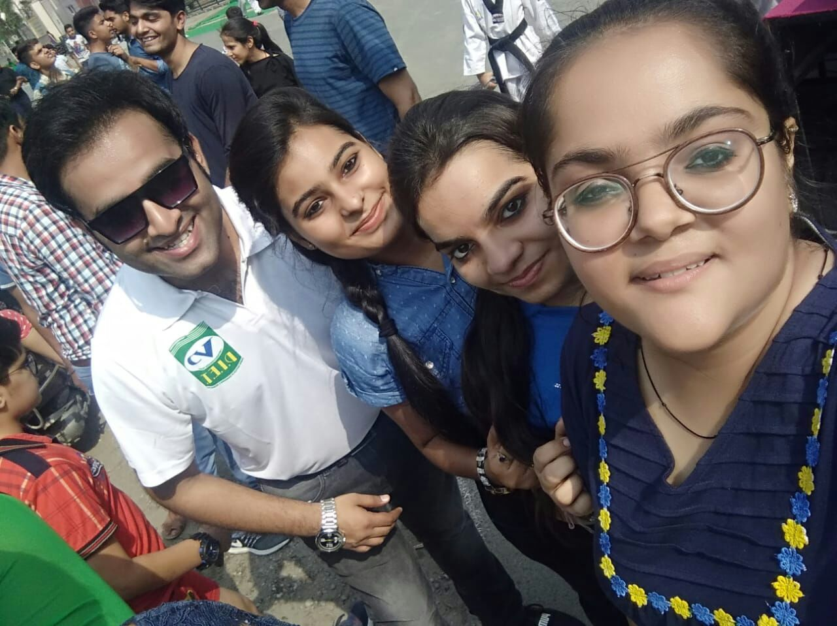
Raahgiri June 17, 2018
‘RAAHGIRI’ is an excellent mission of the Deputy Commissioner of Panipat. It is a common platform for the people at large, students, adults, schools, colleges and business men. It is a ‘go back’ passage to pre-technology phase whereby communities mix, play and enjoy physical games.

Slide 9
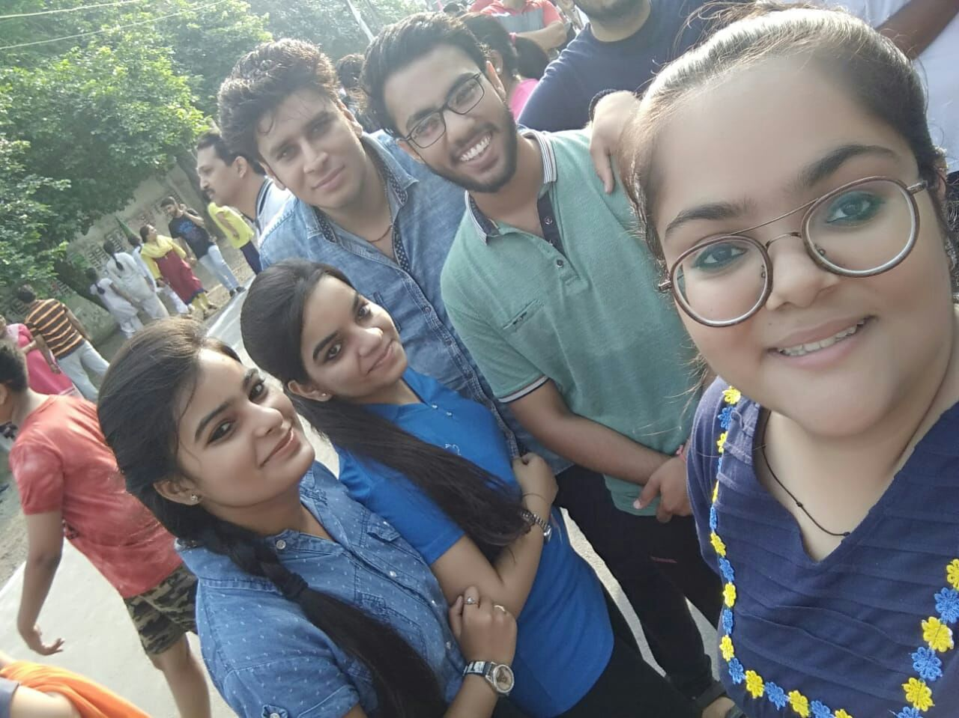
As PIET also plays a very vital role the above three students impressed the spectators with their mind blowing performances. Not only this, but on one or two occasions two more first year students Kritika and Nishant handled the stage successfully.

Slide 10
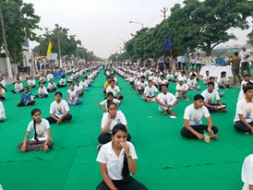
21st June, 2018 World Yoga Day
World Yoga Day is a mission adopted universally under the recommendations of United Nations General Assembly since 2015. Yoga is regarded as one of the most effective methods of establishing a connection between the body and the mind. It is a unique exercise which includes dietary discipline, breathing and physical postures which help the body and mind to relax. This ancient exercise is from Indian origin and widely acclaimed in the modern times.

Slide 11
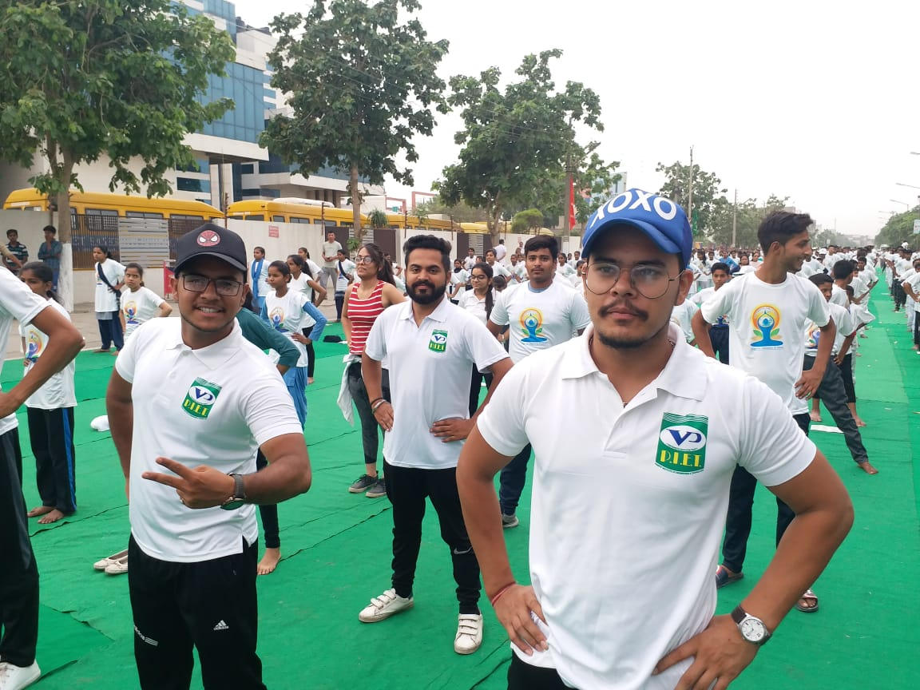
PIET students and faculty formed a part of this day celebration on 21st June in a mass ceremony held in Panipat city wherein many more dignitaries too participated.

Slide 12
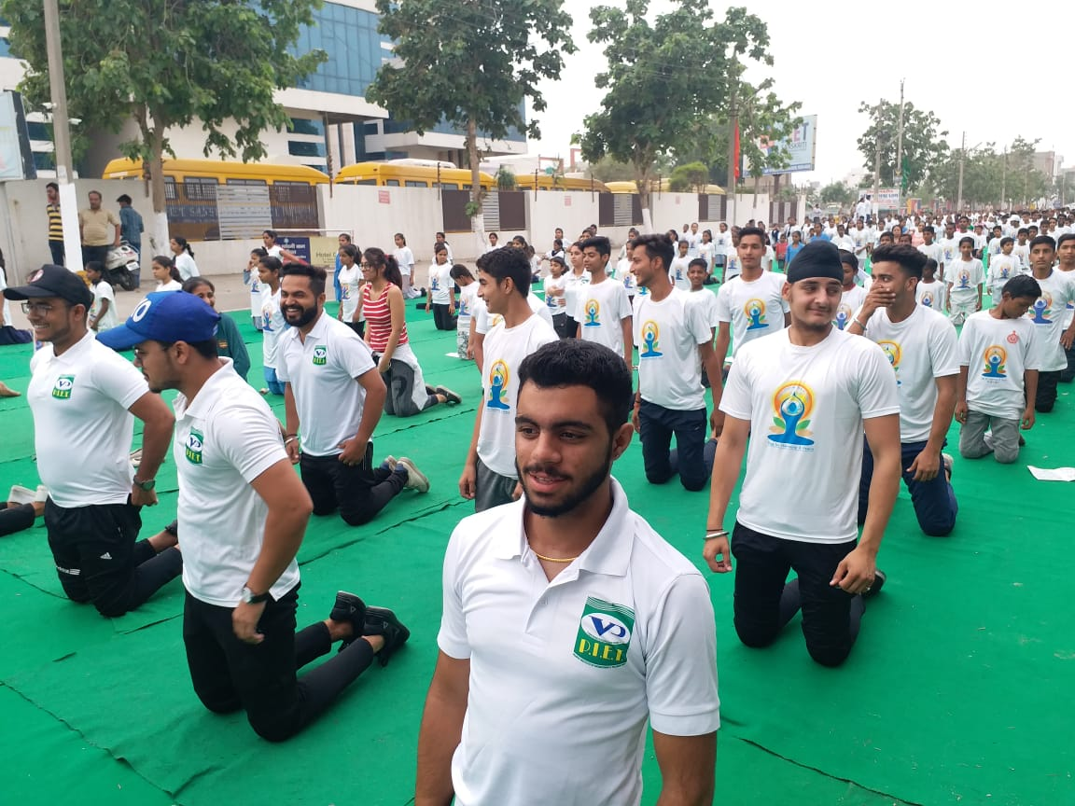
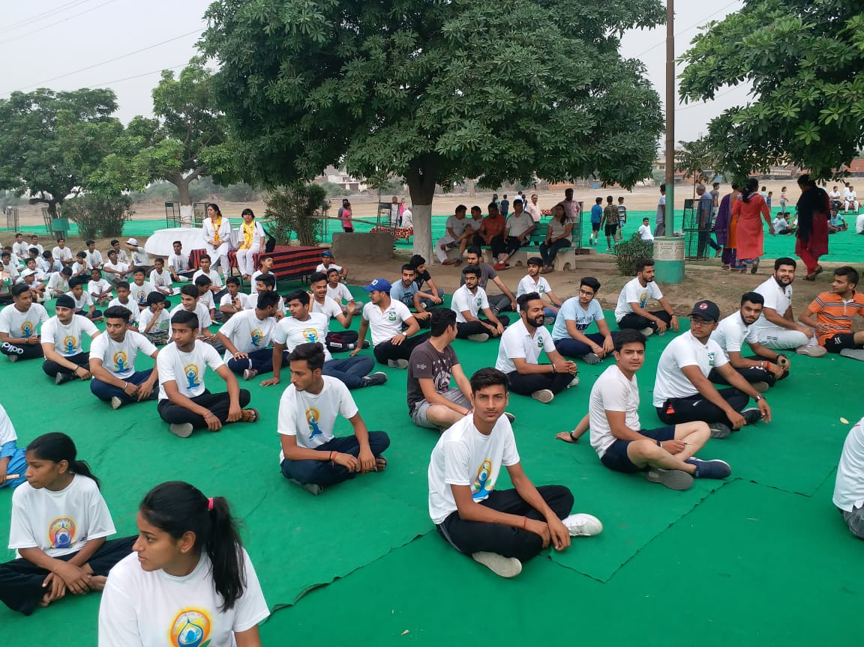
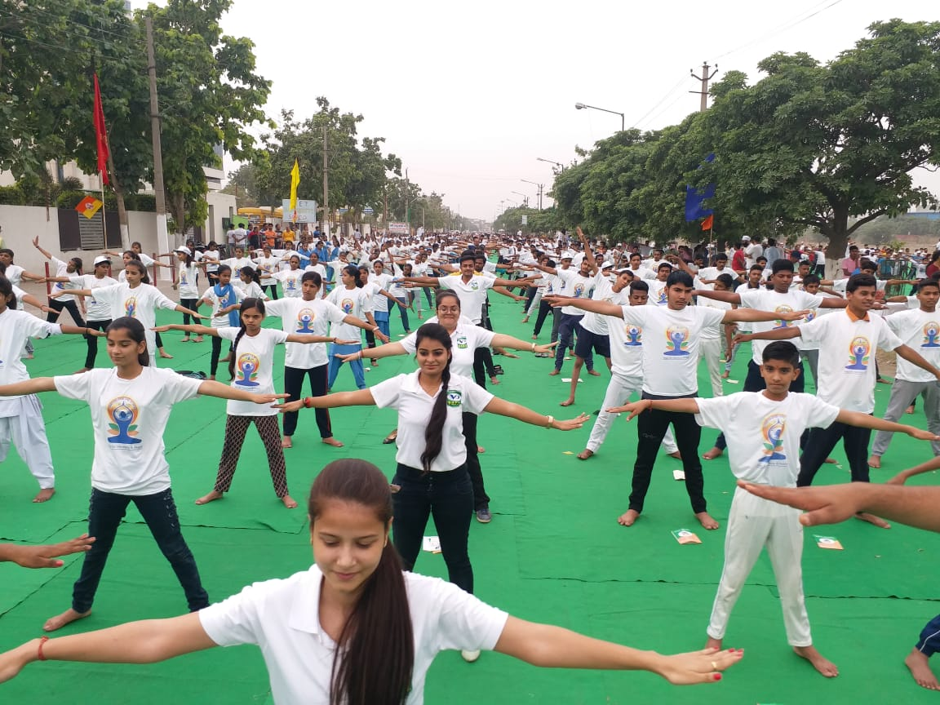
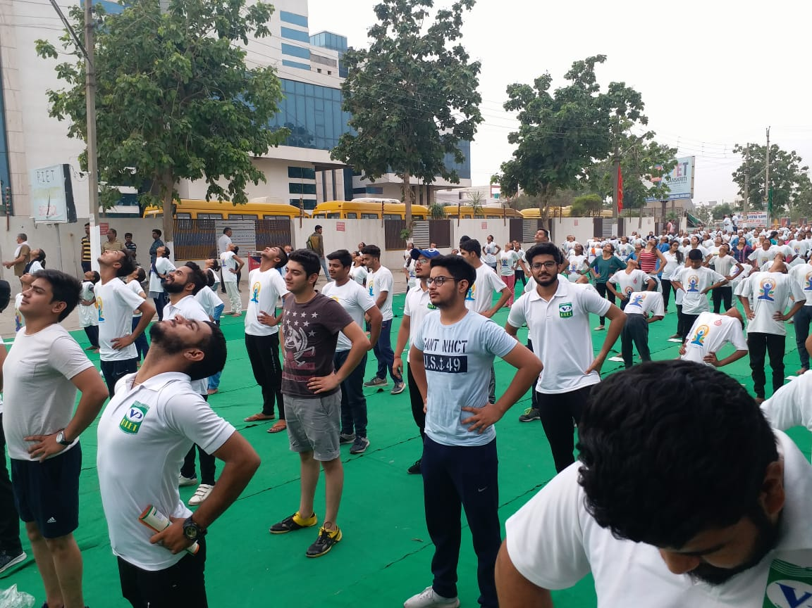

Slide 13
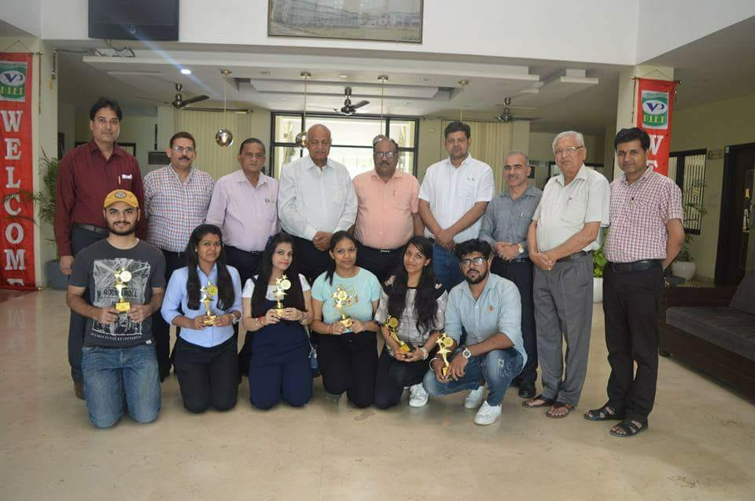
University toppers 6th sem
12 POSITIONS BAGGED BY PIETIANS

Slide 14
SR.NO | ROLL NUMBER | NAME | MARKS | UNIV. POSITION
1 | 0005874426 | VAISHALI | 3178 | 1
2 | 0005874382 | SHRISHTI JAIN | 3137 | 2
3 | 0005874207 | AKANT BHOLA | 3104 | 5
4 | 0005874171 | VANDANA BAJAJ | 3067 | 6
5 | 0005874205 | GOURAV | 3056 | 7
6 | 0005874189 | ADITI BAJAJ | 3054 | 8
7 | 0005874253 | GUNJAN | 3039 | 11
8 | 0005874239 | BHARTI GARG | 3021 | 12
9 | 0005874254 | DIMPLE RAHEJA | 3010 | 14
10 | 0005874186 | KARUNA MITTAL | 2995 | 16
11 | 0005874328 | NISHA JAIN | 2984 | 17
12 | 0005874320 | TANYA SHARMA | 2972 | 19

Slide 15
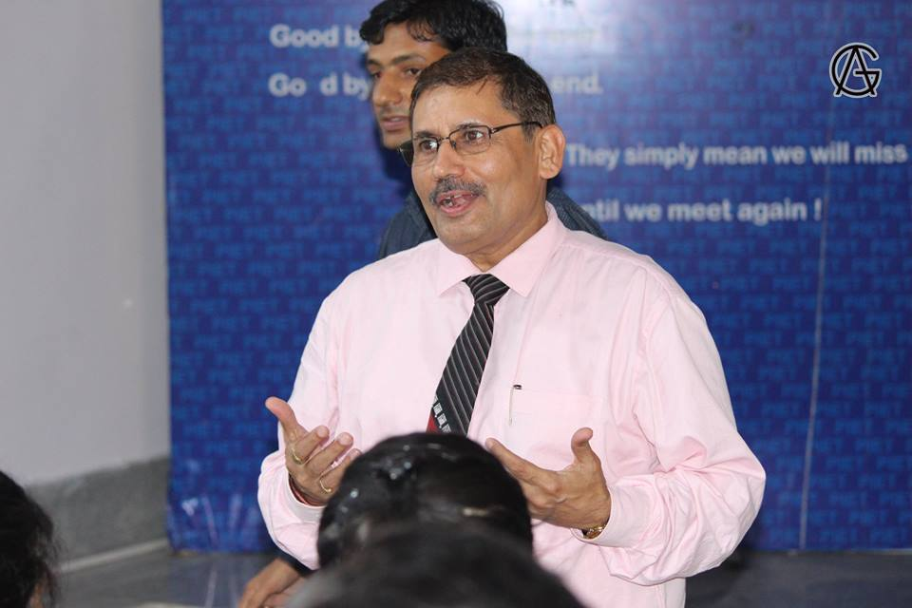
Pratibha Samaan Samaroh
Pratibha Samaan Samaroh is a vey prestigious joint venture of The Dainik Bhaskar and PIET. It is an important platform where the two giants come together to honour the meritorious students of all Haryana and NCR schools of HBSE and CBSE.
Organiser : Dr. Yoginder Singh Kataria
(HOD BBA)

Slide 16
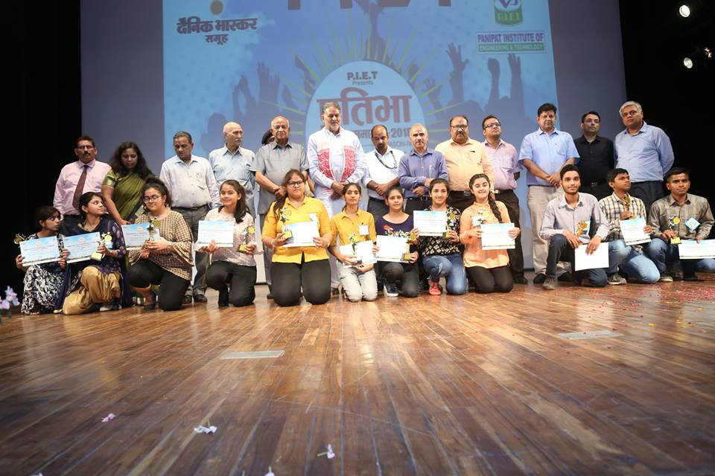
The Bhaskar management has come forward to join hands with our institute and these award ceremonies are held primarily in our college premises.

Slide 17
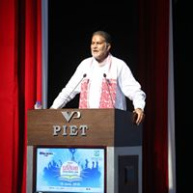
Chief Guest
Ram Bilas Sharma
Born: 25/07/1951
Area: Mahendergargh
Education: B.A, M.A, B.Ed., LL.B.

Slide 18
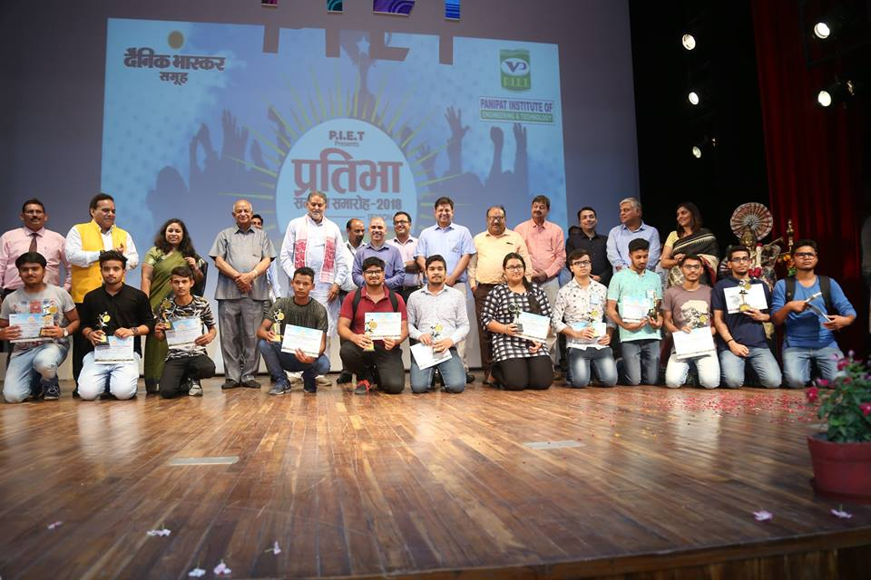
Of late, the event has been given a new shape by holding these functions in various Haryana cities for the convenience of travelling of the students and teachers. PIET also goes a step further and honours their teachers as well for excellence in education.

Slide 19
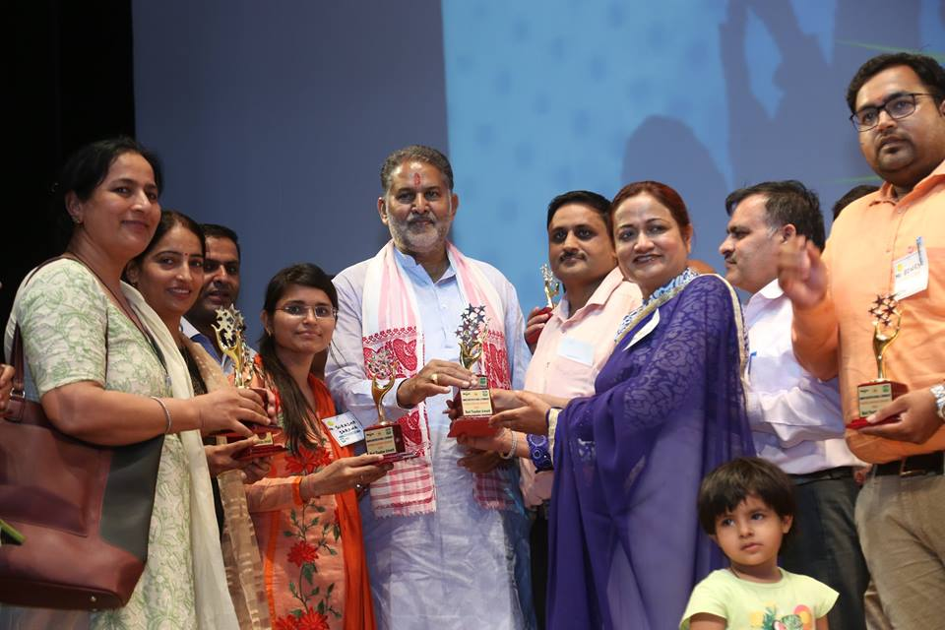
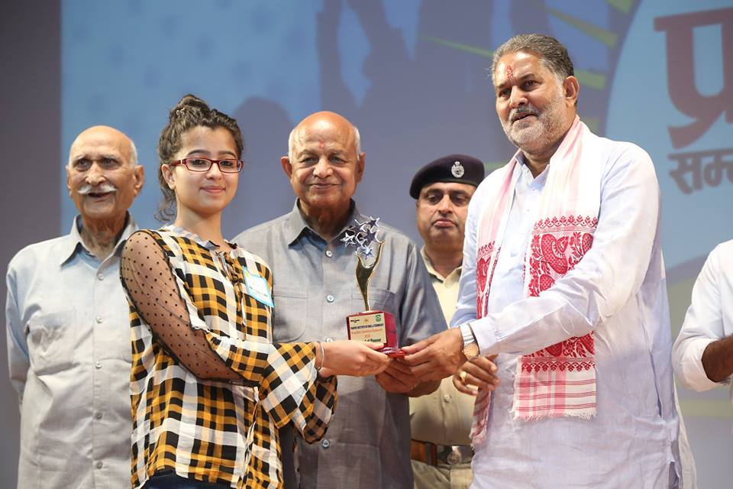

Slide 21
Himanshu

Slide 22
PIET gives the equal opportunity to all students to achieve their milestones and relentless efforts of college faculty to make their students dexterous in every field of life .
Yes PIET the right choice for you
Himanshu

Slide 23
Nikhil Goel

Slide 24
Nikhil
I love infrastructure of my collage. Also i has learn so many things which will help me in my life .. staff is supporting and caring..
I miss my college days in PIET
Nikhil Goel

Slide 26
Dr. Sangeeta

Slide 27
Work together Grow Together
“Coming together is a beginning; keeping together is progress;
working together is success.”
Henry Ford

Slide 28
Work together Grow Together
“Esprit de corps” a French expression has describe Team work as a sense of unity for common objective and responsibilities with a great jeal of enthusiasm.
Team work is leads towards the common goal and helps to identify new opportunities with Greater productivity. In many organizations, day to day working of employees is largely done on individual basis which is unfortunate and reduce the profitability and growth of organization as well as individual.
To reduce the size of workforce, many organizations perform right sizing, downsizing, reorganizing. Working cooperatively by putting aside turf issues and politics is the only way to cope with these situations.

Slide 29
Work together Grow Together
Why TeamWork Matters?
Learning opportunities
Synergy at Workplace
Problem Solving
Task Accomplishment
High Morale
Increase Efficiency
Enhanced sense of Unity

Slide 30
Work together Grow Together
Team work is not “ too many cooks spoil the soup” but rather it is the combination of skills, capabilities, ideas and job enrichment.
Team work is very encouraging while achieving some goal in a team boost the morale and motivate the sense of helpfulness. It bond the employees with one another. Various job assignments have create a situation where contribution of team members is the only way to get success which in return enhance their respect with one another.
Working together is the key to success
By Dr. Sangeeta

Slide 32
BBA,HOD
(Mr. Yoginder Kataria)
BBA, E- Committee
(Mr. Jagmohan Malhotra)
(Dr. Sangeeta)
(Ms. Pooja Gupta)

