Slide 1
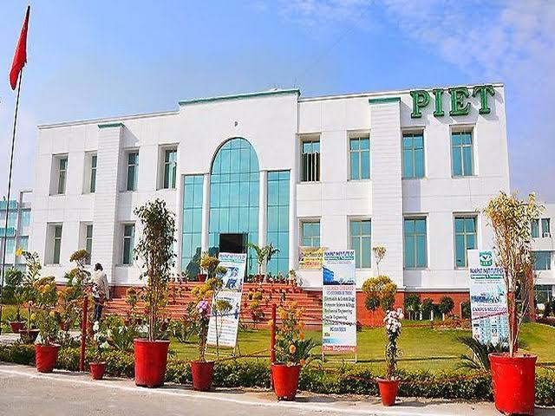

Slide 2
VISION
To provide business and administration knowledge to individuals so as they learn to handle and manage the operations of business in competitive environment.
MISSION
: To teach basic knowledge, skills and aptitude regarding business activities for running the business.
: To provide an opportunity of higher education in the field of business administration.
: To sharpen their operational skills by workshops.

Slide 3
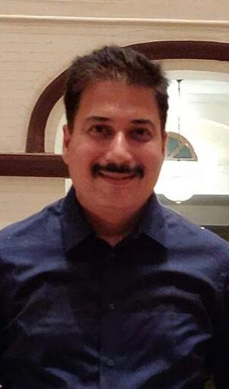
HOD’s MESSAGE
The purpose of education is to teach budding managers to think and develop a capacity to reason our facts. Learners should keep in mind the importance of planning and prioritizing their time and the effective use of it which are essential to achieve success. Learner’s should always think and review, discover the cause and effect of every event, in which they are involved. Do not surrender or become a salve to youthful fancies and indulgences. Be steady in your studies.
Learn to enjoy hard work particularly your studies.
MR. ATUL GAUTAM
“ WE CANNOT ALWAYS BUILD THE FUTURE FOR OUR YOUTH, BUT WE CAN BUILD OUR YOUTH FOR THE FUTURE”. REMEMBER
“ THE REWARD OF EVERY GOOD ACTION WILL BE GOOD ONLY”.

Slide 4
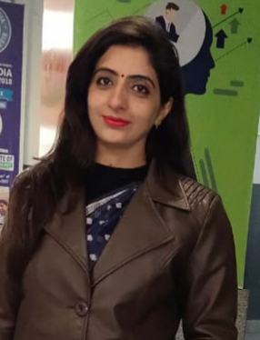
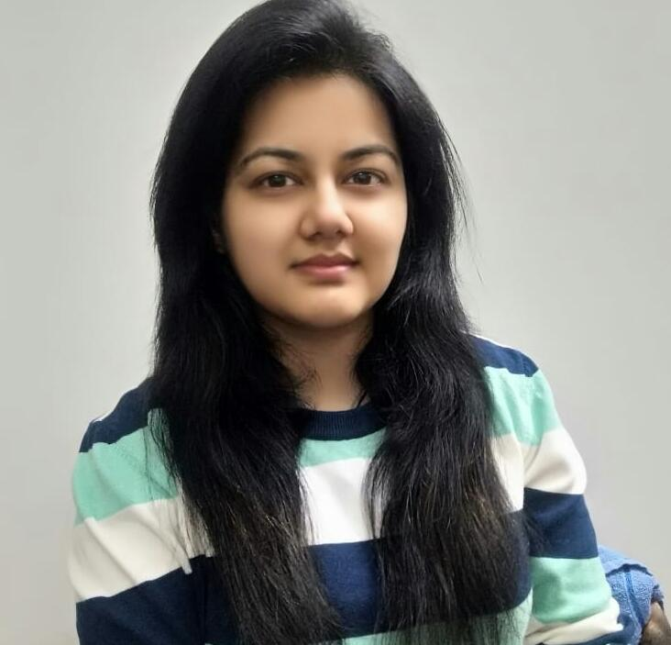
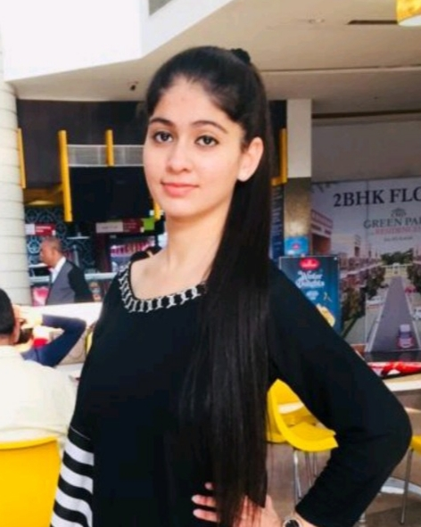
From Editor’s
Desk
DR. NANCY ARORA
MS. SAHIBA SHARMA
AARUSHI
BBA 2ND YEAR

Slide 5
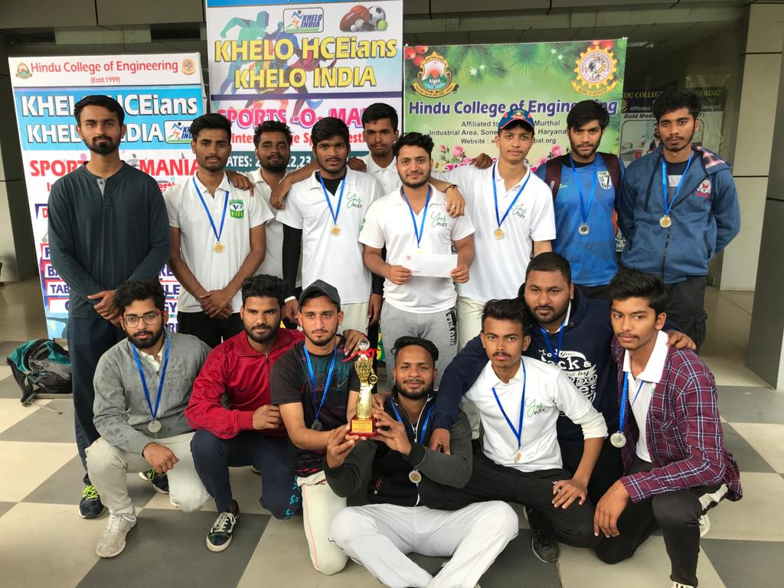
INTER COLLEGE CRICKET COMPETITION
2ND POSITION secured by Aman Tyagi BBA, PIET
THE TEAM ALWAYS
PLAY TO WIN

Slide 6
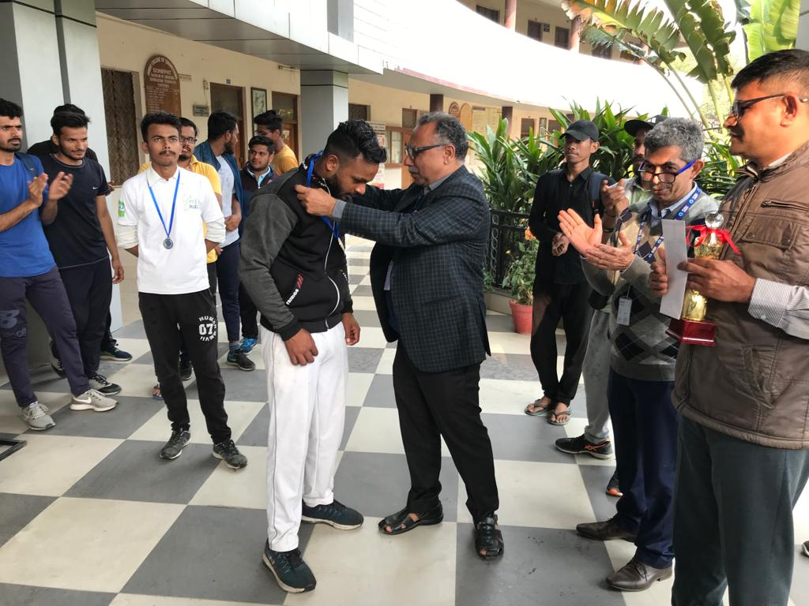
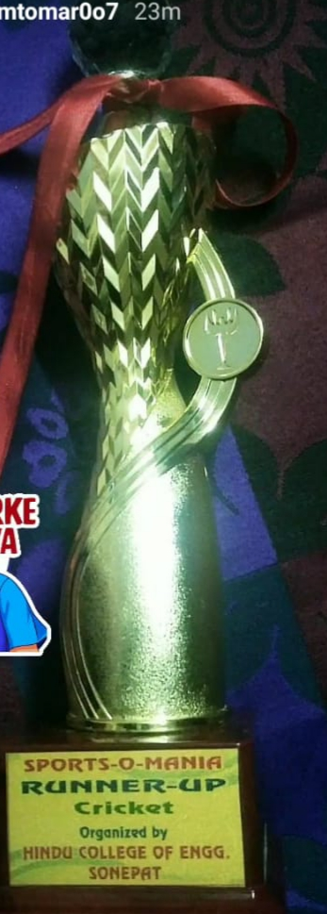
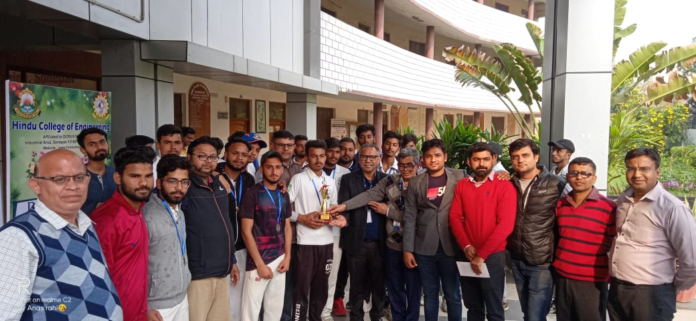
Proud moment

Slide 7
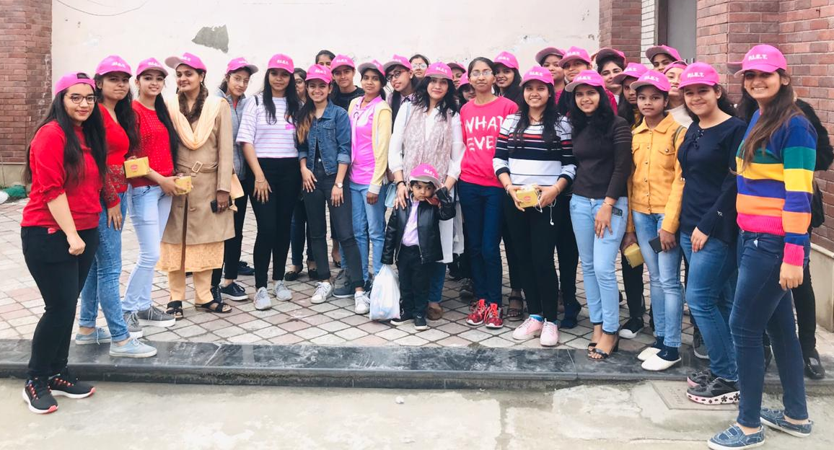
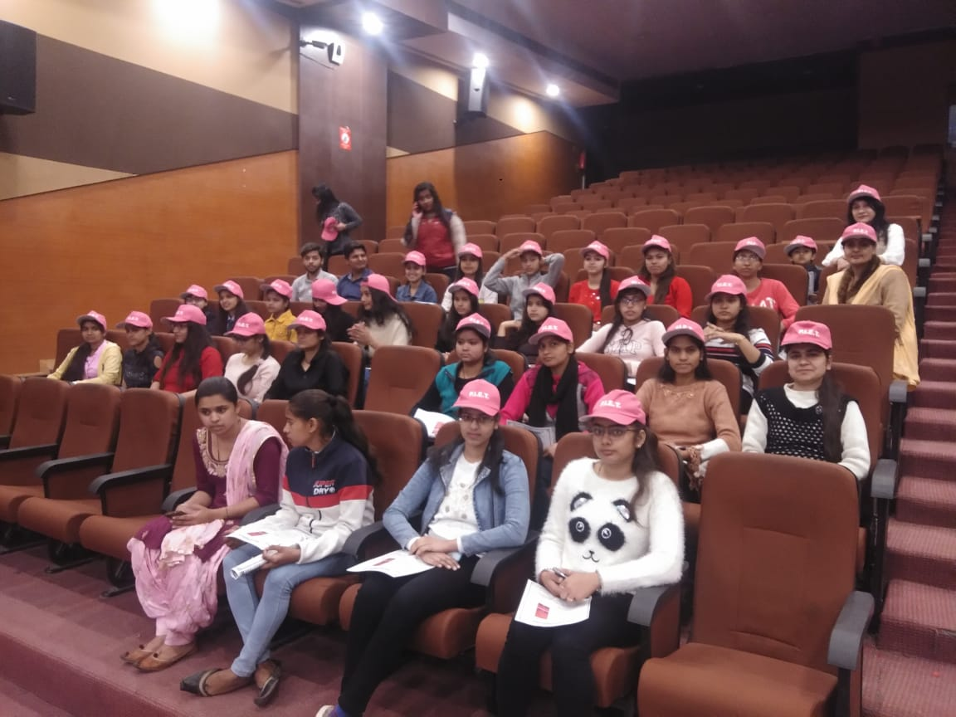
Celebrated Women’s Day at ARYA COLLEGE, Panipat

Slide 8
UNIVERSITY POSITIONS
CHINMEY JAIN 7th position
ISHA MITTAL 9th
position
1st SEMESTER
“Education is
power.”
KIRTI GULATI 10th position
TANIYA 19th position
SHIVAM 20th position

Slide 9
AARUSHI
2nd position
SONAM DOON
7th position
GAURAV
9th position
3RD S
E
M
E
S
T
E
R
TANYA
12th position
SAKSHI GOEL
14th position
DEEPALI GARG
18th position
SMILY BANSAL
19th position
SHIVI GUPTA
19th position
RIYA CHANANA
20th position

Slide 10
5th SEMESTER
DHRITI BHUTRA 3rd position
JASIKA ARORA 4th position
CHARU ANEJA 5th position
SUMAN YADAV 8th position
JYOTIKA BAJAJ 8th position
ANJALI LAKHINA 12th position
TAPSI KATYAL 12th position
CHHAVI JAIN 14th position
NIDHI 14th position
AYUSHI PAHWA 15th position
PALLAVI JUNEJA 16th position
NANCY BANSAL 16th position
SHEFALI JUNEJA 16th position
PRIYA BHARDWAJ
17th position
KRITIKA ARORA 19th position

Slide 11
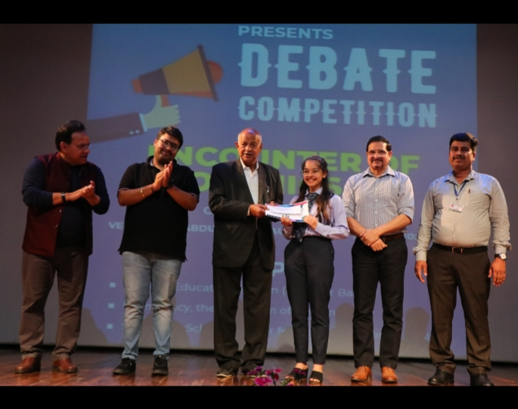
INTER DEPARTMENT DEBATE
COMPETITION
3RD POSITION
SIMRAN CHHABRA
2ND YEAR A

Slide 12
Grand HOLI FUNCTION WAS ORGANIZED

Slide 13
Online classes
“Online Classes Ki
Taiyari digitally with us”. Stay Home Stay Safe
Online Classes
“No Academic Loss”
#PIET #StudentSafety
Because of coronavirus all colleges are closed down. We cannot take the risk of students life by gathering them at one place. But education is must so PIET is providing online classes to students.

Slide 14
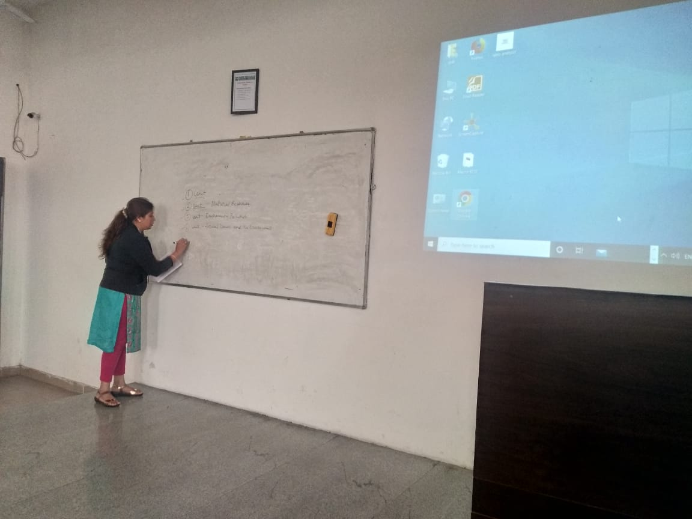
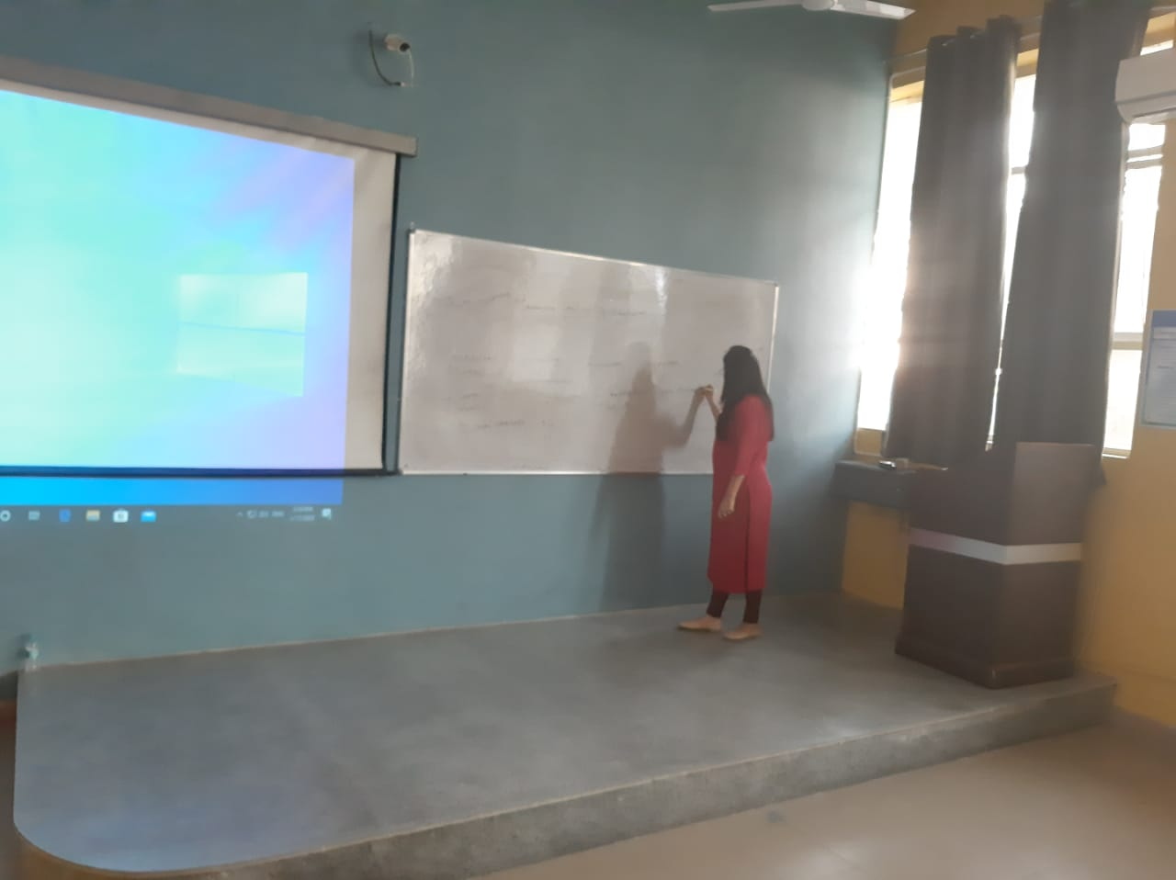
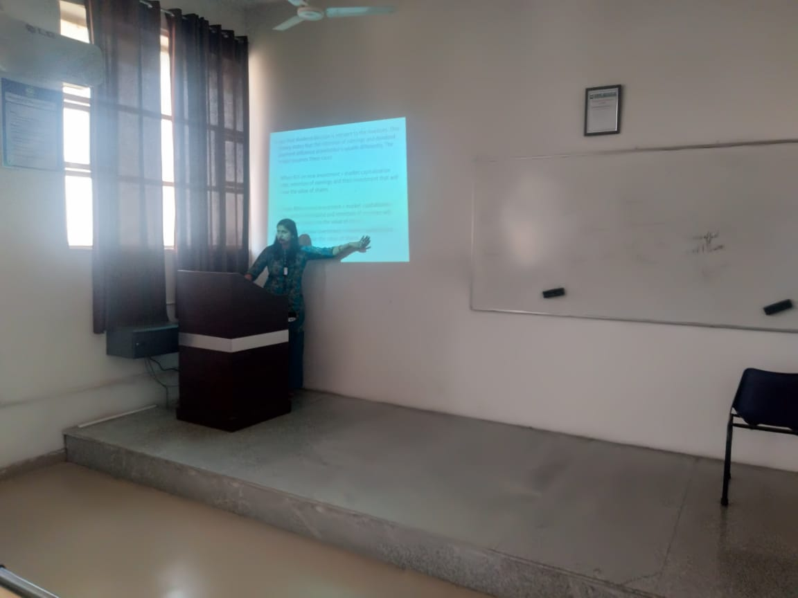
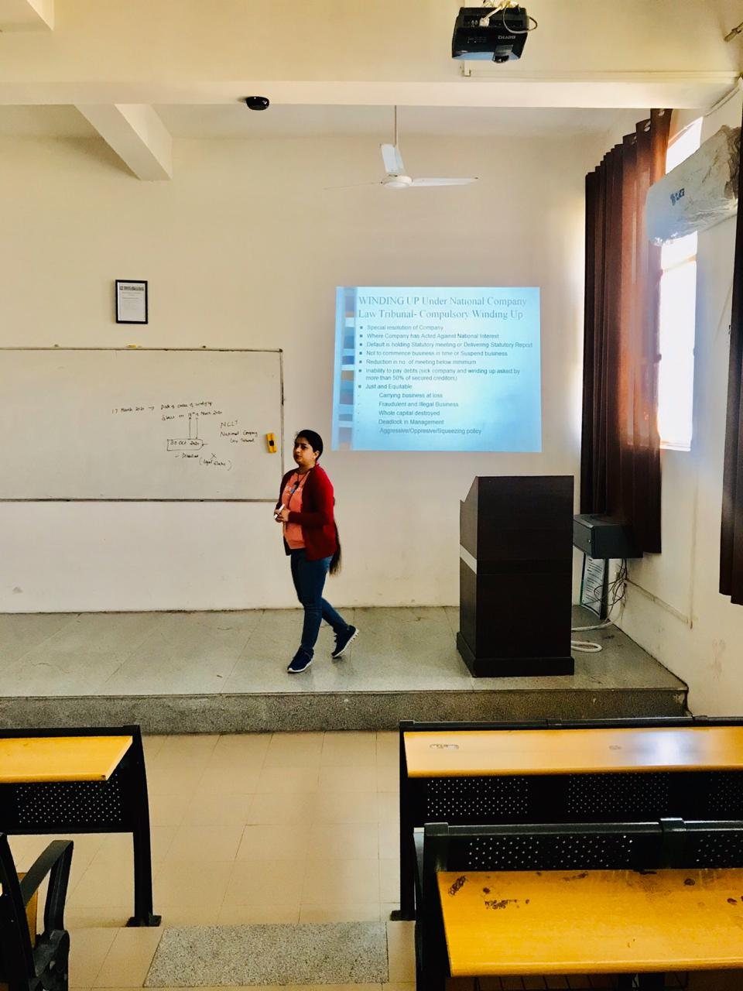
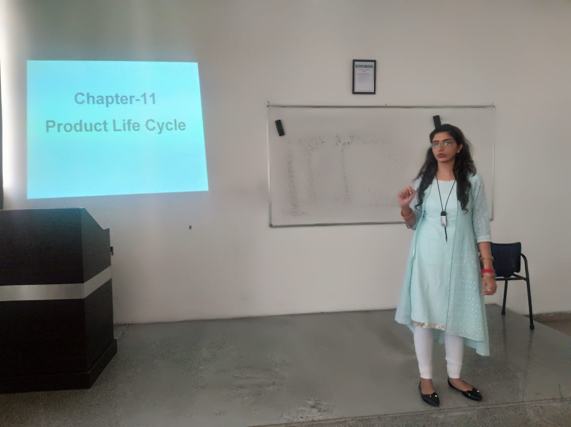
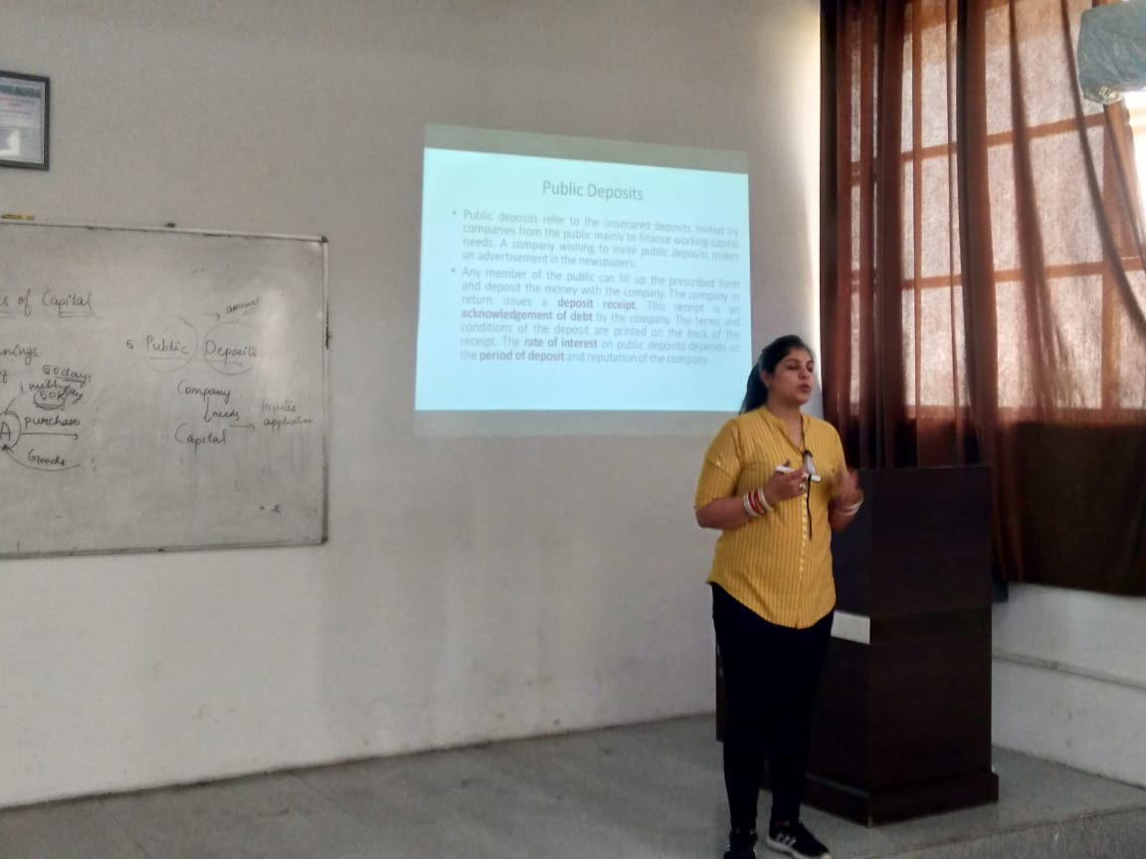
Connected Virtually with Students

Slide 15
MARCH 2020

