Slide 1
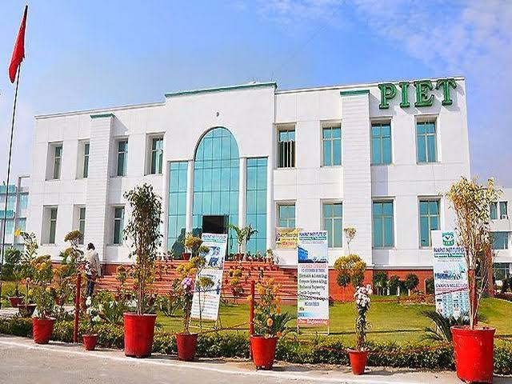
DEPARTMENT OF BUSINESS STUDIES
NEWSLETTER NOVEMBER 2020

Slide 2
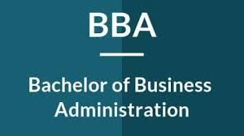
“To be a world leader in business education, research and engagement, helping to create a better knowledge society.”
To teach basic knowledge, skills and aptitude regarding business activities for running the business. and to provide an opportunity of higher education in the field of business administration.
:Systematic academic support and mentoring
: Inter department collaborations
:Start up ecosystem

Slide 3
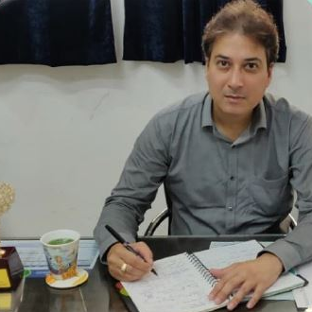
HOD’S MESSAGE
The purpose of education is to teach budding managers to think and develop a capacity to reason our facts. Learners should keep in mind the importance of planning and prioritizing their time and the effective use of it which are essential to achieve success. Learner’s should always think and review, discover the cause and effect of every event, in which they are involved. Do not surrender or become a salve to youthful fancies and indulgences. Be steady in your studies.
MR. ATUL GAUTAM
“ WE CANNOT ALWAYS BUILD THE FUTURE FOR OUR YOUTH, BUT WE CAN
BUILD OUR YOUTH FOR THE FUTURE”. REMEMBER“ THE REWARD OF
EVERY GOOD ACTION WILL BE GOOD ONLY”.
“Learn to enjoy hard work particularly your studies”.

Slide 4
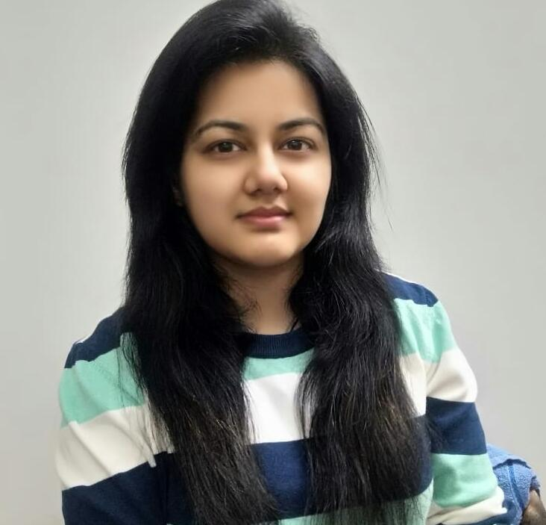
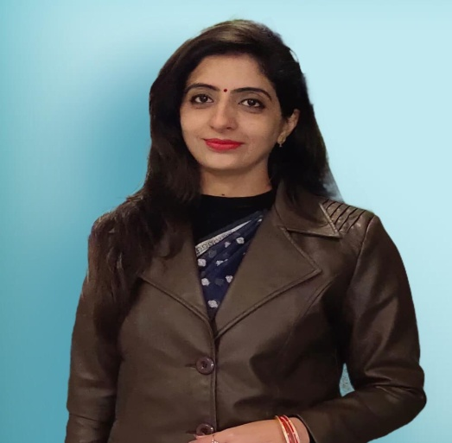
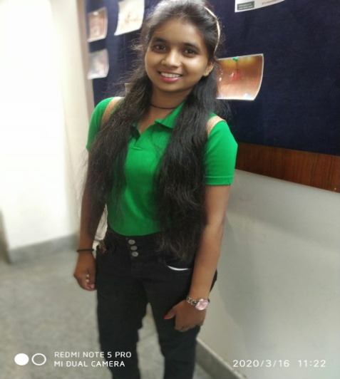
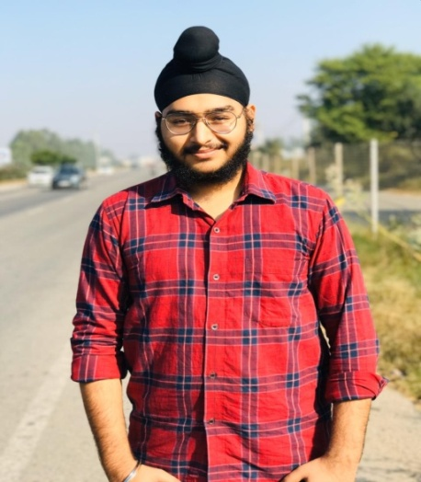
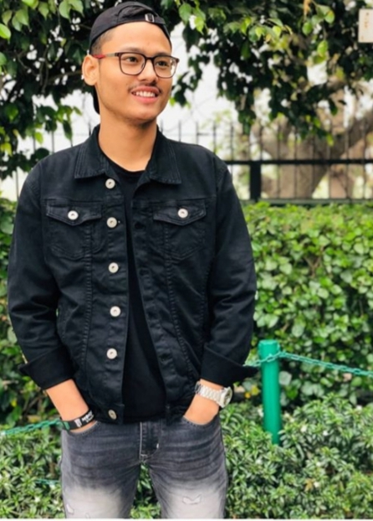
From Editor’s Desk
BBA DEPARTMENT
MS. SAHIBA SHARMA
DR. NANCY ARORA
Radha
BBA 2nd year
Jasjeet
BBA 2nd year
Sanjul
BBA 3rd year
Aarushi
BBA 3rd year

Slide 5
VIRTUAL CULTURAL WEEK
BBA department organized
“VIRTUAL CULTURAL WEEK”
(6 Nov – 11 Nov)
Under the esteemed guidance of Prof. (Dr.) B. B. Sharma (DSW), the Cultural Society of Panipat Institute of Engineering and Technology & PIET NCR College organized “Virtual Cultural Week”.
Organizing Committee:
Ms. Samriti

Slide 6
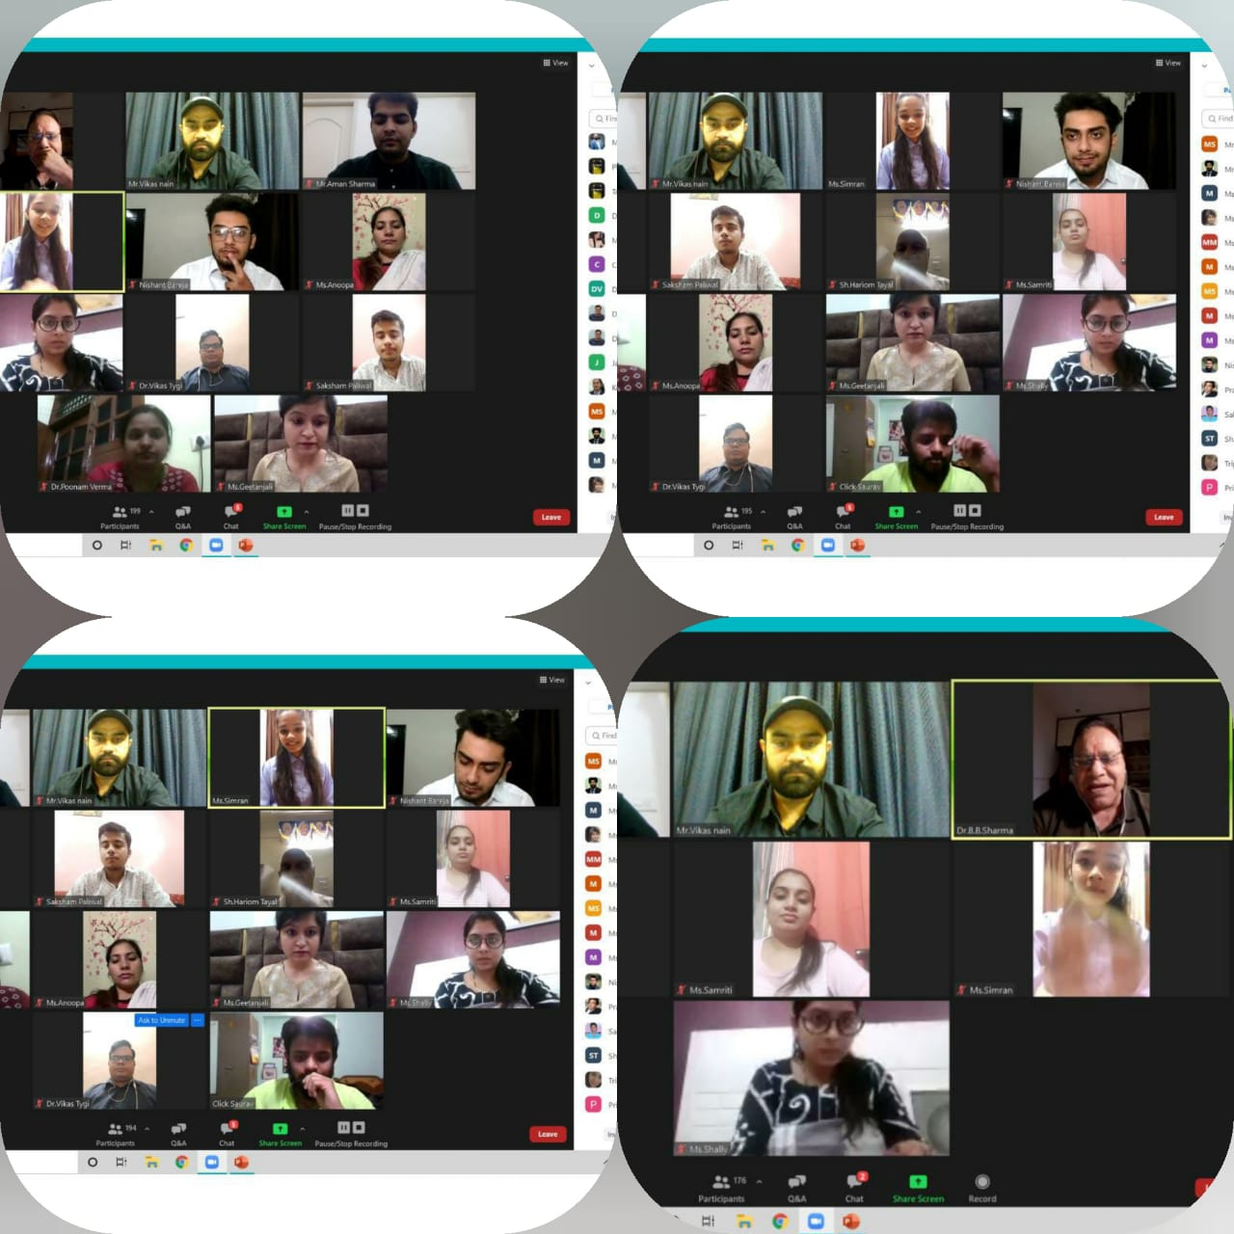
GLIMPSE OF CULTURAL WEEK

Slide 7
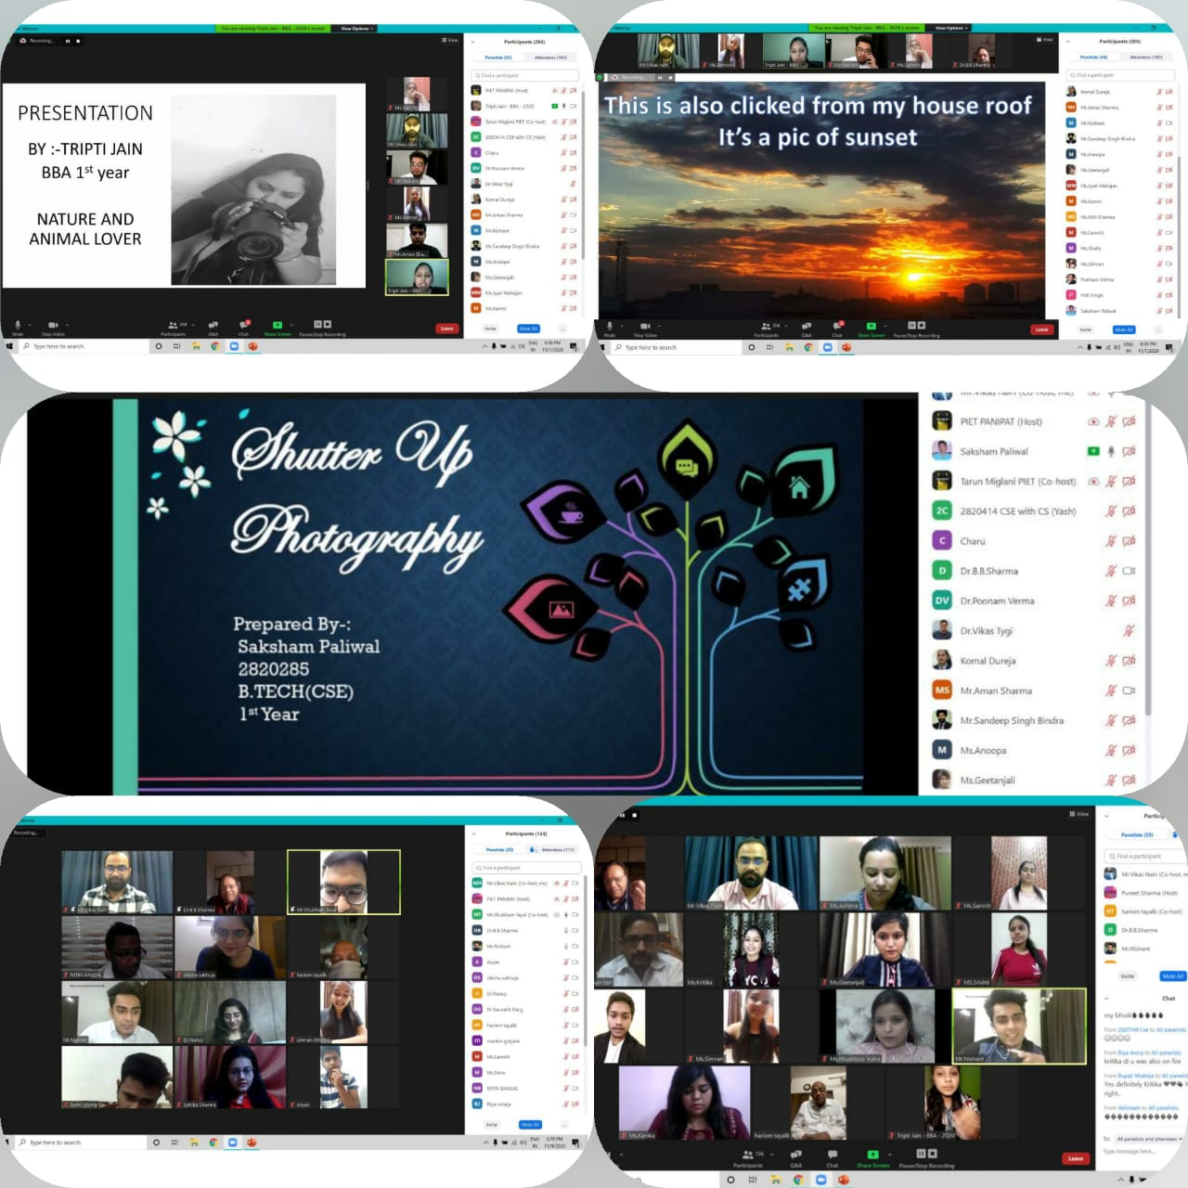

Slide 8
BEYOND THE PLATE AND QUIZ

Slide 10
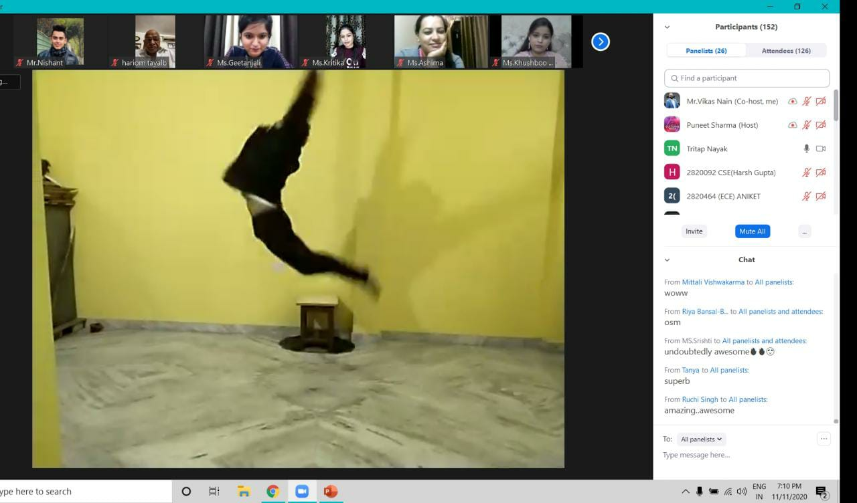
STUDENTS participated with great enthusiasm

Slide 11
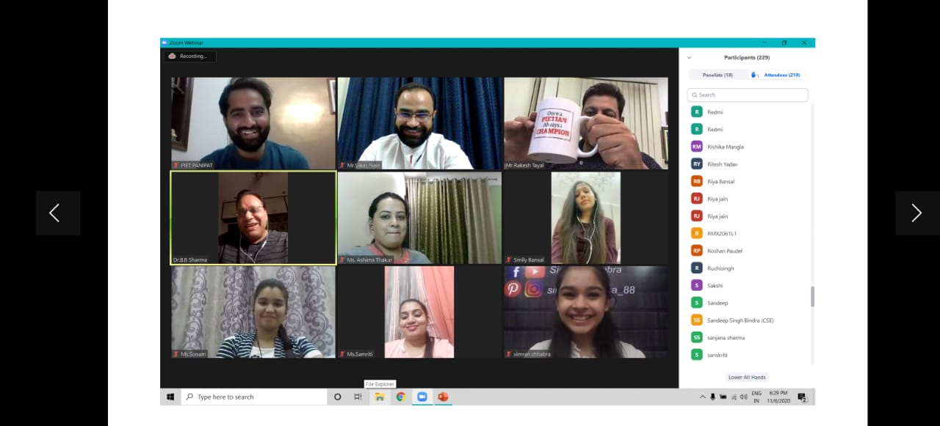
WELL PLANNED AND COORDINATED ONLINE EVENTS WERE ORGANIZED AND STUDENTS ACTIVE PARTICIPATION MADE THIS CULTURAL WEEK A SUCCESS

Slide 12
VIRTUAL CULTURAL WEEK

Slide 13
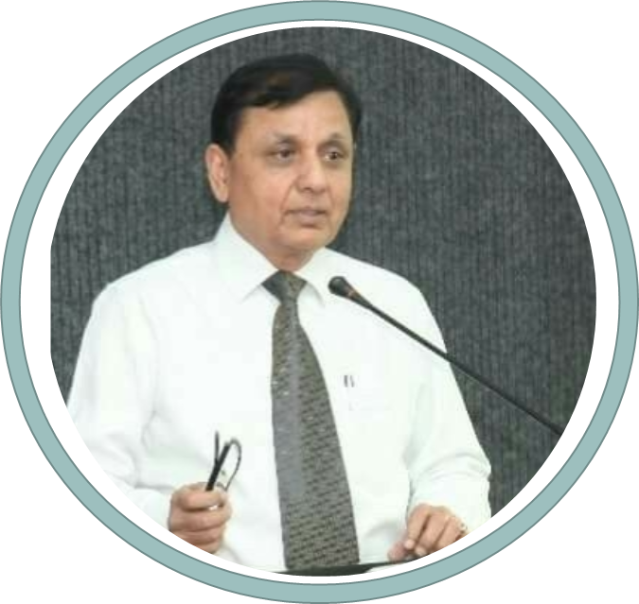
Education
EXPERT LECTURE
M.A. (Economics),
Ph.D. in International Business
Previous Experience
Dean, Faculty of Management Studies, Manav Rachna International University, Faridabad.
Dean of Faculty, Apeejay School of Management.
Professor (Economic Environment & Strategy), & Dean (Administration), IMT, Ghaziabad.
Director, Institute of Management Studies & Research , Maharishi Dayanand University, Rohtak.
Guided more than 30 Ph.D. thesis
Research Publications
Prof. Dr. Suresh Bedi
Chief Academic Mentor

Slide 14
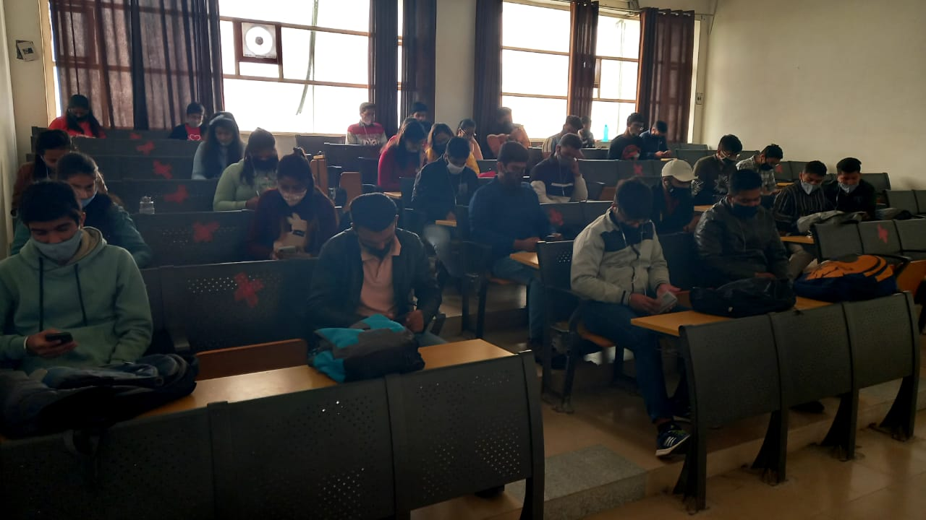
Students attended online lecture by Prof. S. K. Bedi following social distancing rules.

Slide 15
ONLINE DIGITAL MARKETING WORKSHOP

Slide 18
WEBINAR

Slide 19
WEBINAR ON PASSPORT TO A GLOBAL CAREER WITH CMA(US)
Mr. Daya Murthy heads the Institutional Partnership at international skill development corporation.
Mr. Vikas Khosla, with overall experience of 13 years has worked with some of prestigious companies like American express.
In various Guest Lectures/ Workshops/ Webinars/ Expert lectures students actively participated and interacted with the speakers.

