Slide 2
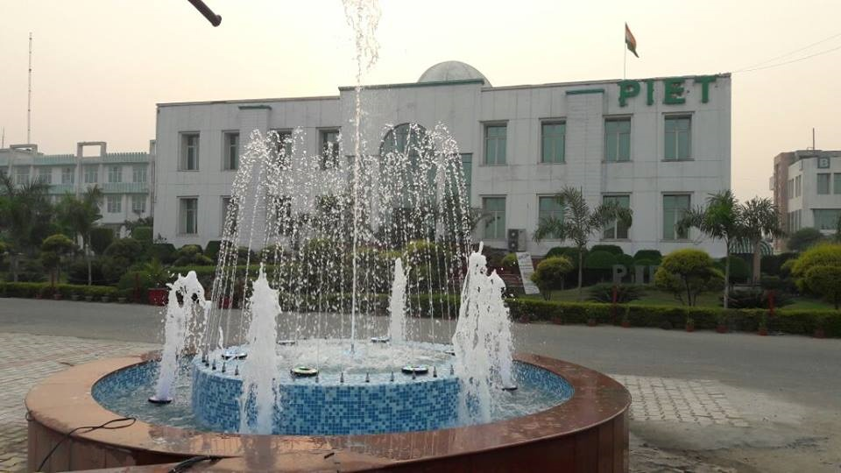
VOLUME 5 ISSUE 8
February Issue

Slide 3
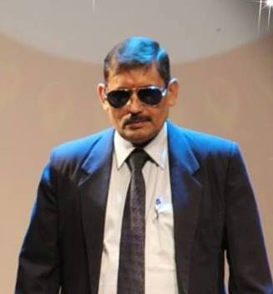
Dr. Yoginder Singh Kataria
BBA – HOD
Message

Slide 4
Dear Students,
As a part of this milestone institute of academic excellence and extracurricular performances which has enlarged and enriched educational map of Haryana and NCR region over the past one decade. As we proceed to the end of this even semester, our commitment at PIET is to provide a safe and intellectually challenging environment that will empower students to become innovative thinkers, creative problem solvers and inspired learners prepared to thrive in the 21st century.
In 12 years of its reign, PIET has imparted quality education, strong & dynamic entrepreneurs have evolved out of this institute and we feel fortunate enough to be a part of PIET which is one of the leading institute in Haryana and which has reached its highest pinnacle in the education sector.

Slide 5
High standards and expectations for each student in regard to academic performance, co-curricular participation and responsible citizenship are the foundation of our institute. It is with pride that we hold these high standards and ask each of our students to commit to maintaining the extra ordinary record of achievement and contribution to create a rich legacy for the coming generations.

Slide 6
The college has a distinguished reputation in the field of sports and cultural activities too. Our sports and cultural students are winning accolades at the state, national and international level. Moreover discipline, which is a non-negotiable factor of a students’ life on our campus inculcates the value of time management and punctuality; ensure your attendance in the classes. Endeavour to be better human being while foraying in the competitive life, realizing your dreams. Honesty and integrity should be your second names.
And with this you would definitely turn out to be the best citizens endowed with humanistic values after getting formally instructed from this institution and would open new horizons of development and bliss for your country.
With Best Wishes and Blessings for the upcoming session!
Dr. Yoginder S Kataria
HOD, BBA

Slide 7
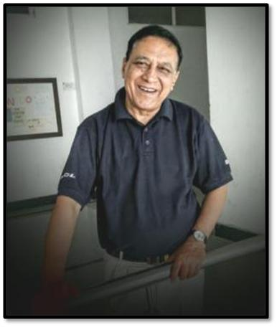
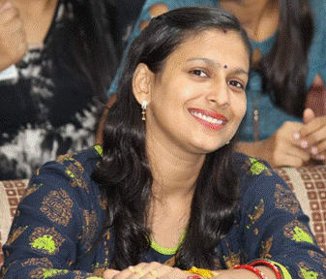
Editorial Team’s View
Mr. Jagmohan
Ms. Pooja Gupta

Slide 8
Foot Fall of New Year is one of the most exciting periods at a college because
it’s the start of something new for so many students. With the change of weather the campus is filled with smart, inspired students ready to take advantage of fresh offerings of the season – both in the classroom and in the many extracurricular options of student life. PIET is our community’s college and we share our community’s values. Most residents can identify with the eager anticipation our students feel, when they see the opportunities of innovation, diversity and educational excellence that this institute offers.
In this issue we recapitulate the celebrations we had on our campus, the sports meet and Maestros, the annual function which provide enormous opportunities to the aspirants to show case their inherent and acquired talents.
Since our college supports and promotes our international presence, feature the innovative learning opportunities on campus, as well as calling attention to our upcoming university examination, it is time to girdle up your waists to register in the merit list to keep the winning tradition alive.
Jag Mohan Malhotra
Chief Editor

Slide 9
Industrial Visit
Feb 1, 2019
Classes visited-BBA 1st year sec D and E

Slide 10
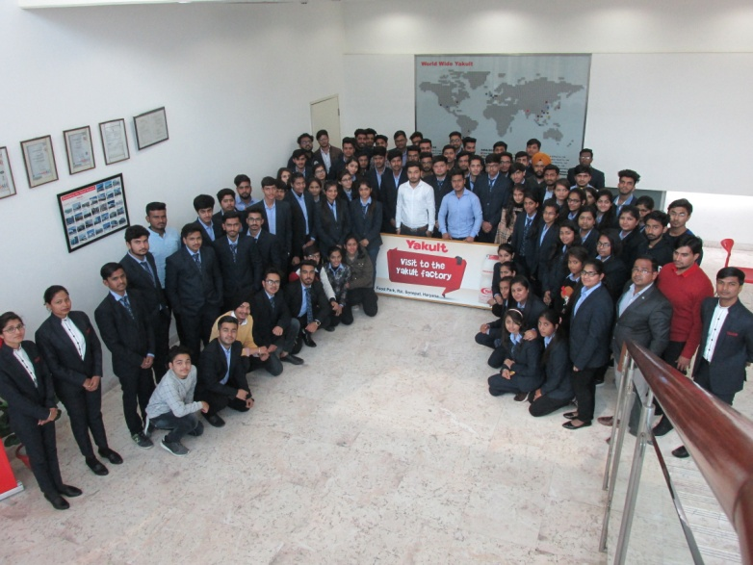
Yakult, the favorite destination of BBA aspirants. And yes, it is the right place to learn PLC, the new industrial concept with minimized man power.

Slide 11
Inter Department Football Match
4 & 5 Feb, 2019

Slide 12
Supporting the Sports is the PIET slogan to create an atmosphere of work life balance. This is what resulted into inter-departmental foot ball match.
Watch the jury sitting on judgment.

Slide 13
Second Semi-finals Between BBA vs. ASH
HODs, Faculty members and other players posing for a photograph before action.

Slide 14
Dr. Yoginder Kataria delivering final instructions before the first kick.

Slide 15
Maestros 2K19
The most exciting annual function of PIET was organised from 8th to 10th Feb.
As usual there were so many events ending with ‘Star Night’.

Slide 16
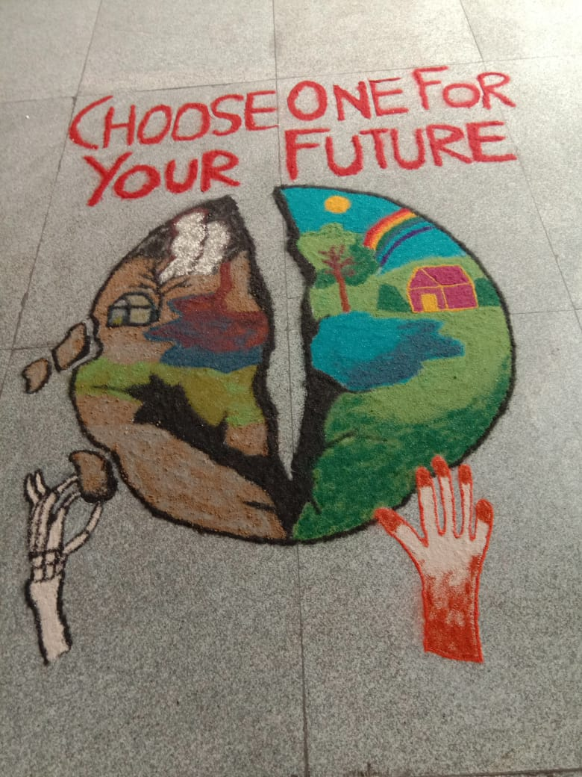
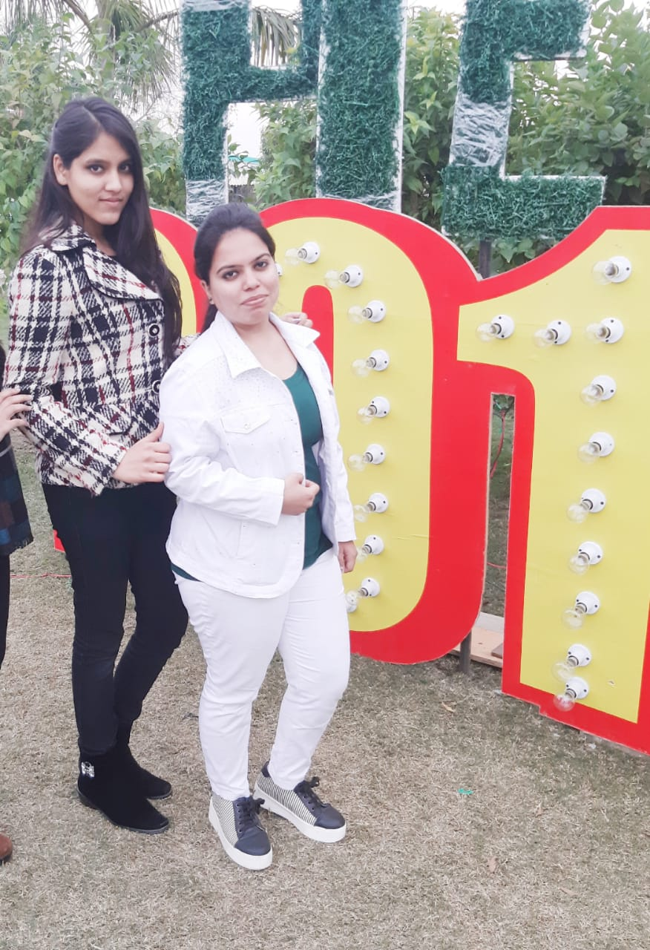
Navrang - Naye Saal ki shuruat rango ke sath | 2nd Position | Ashima and Radhika

Slide 17
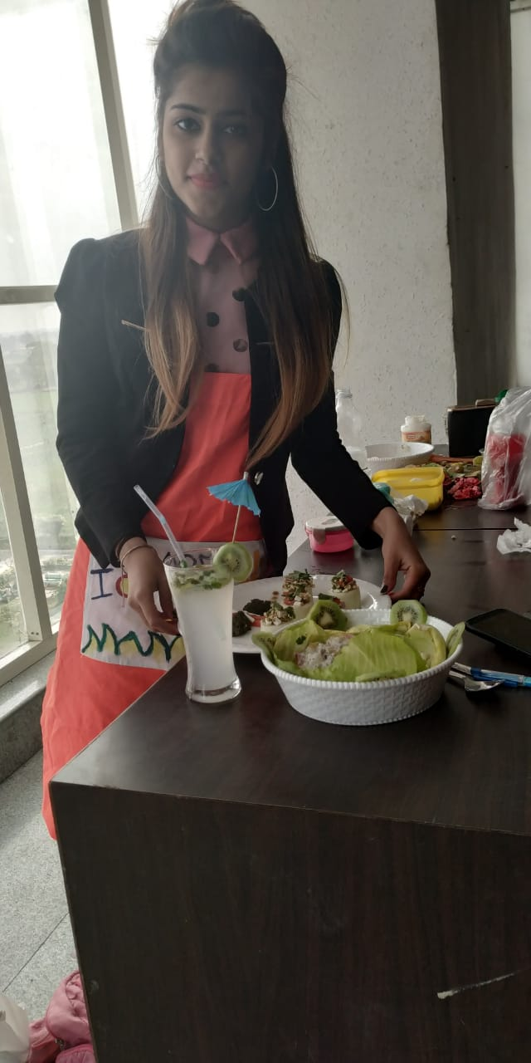
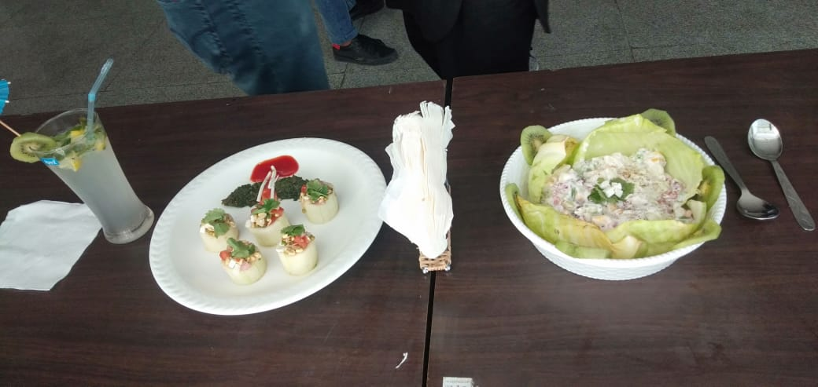
Food Carnival | 2nd Position | Tanya Goel
 | 3rd Position | Urvashi and Himani

Slide 18
Ramp walk
Lavisha
Shine
Vanshika
Diksha
Arvind
Anchal
Aman
Hardik

Slide 19
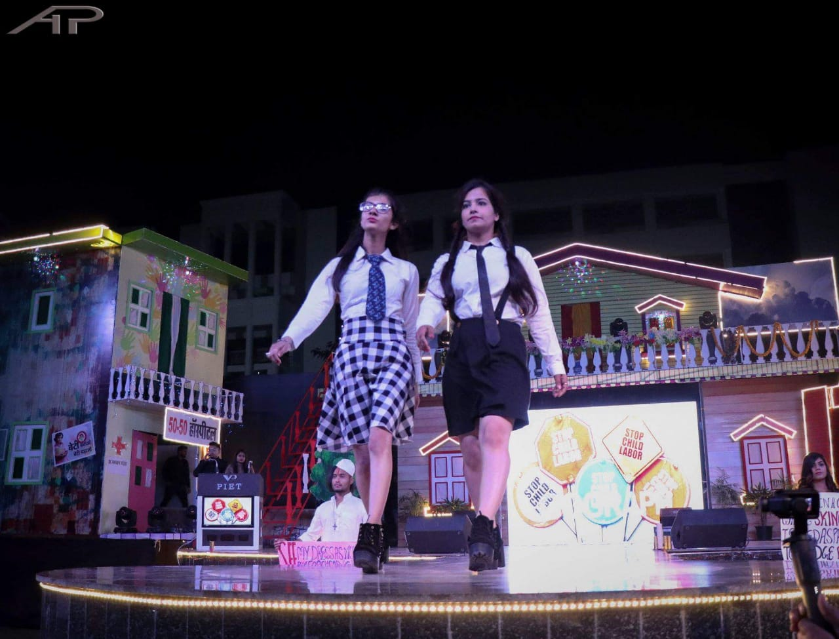
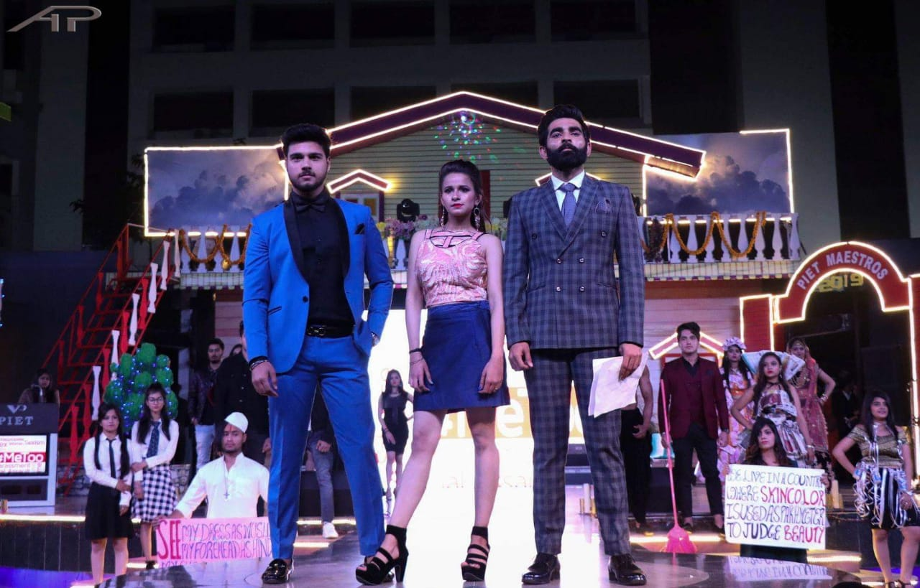

Slide 20
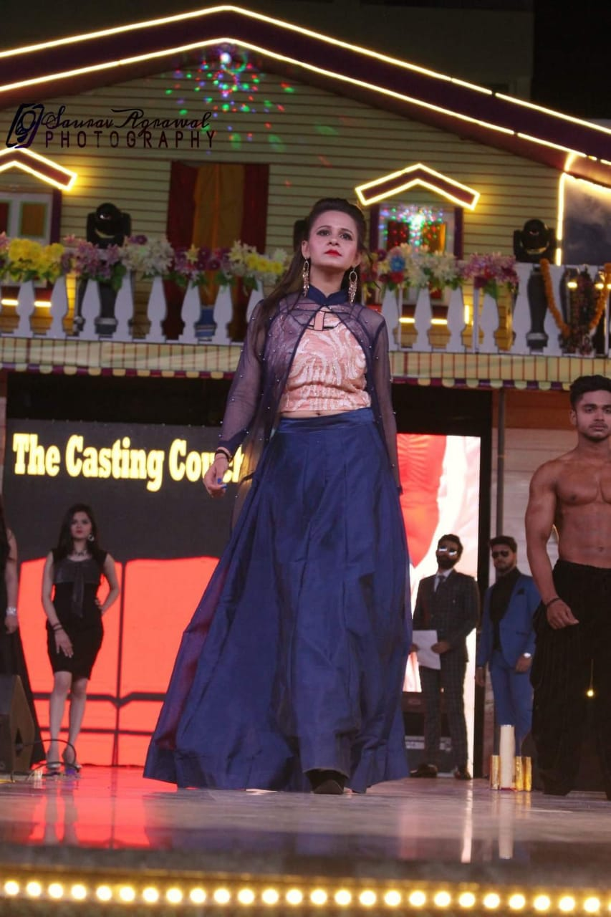
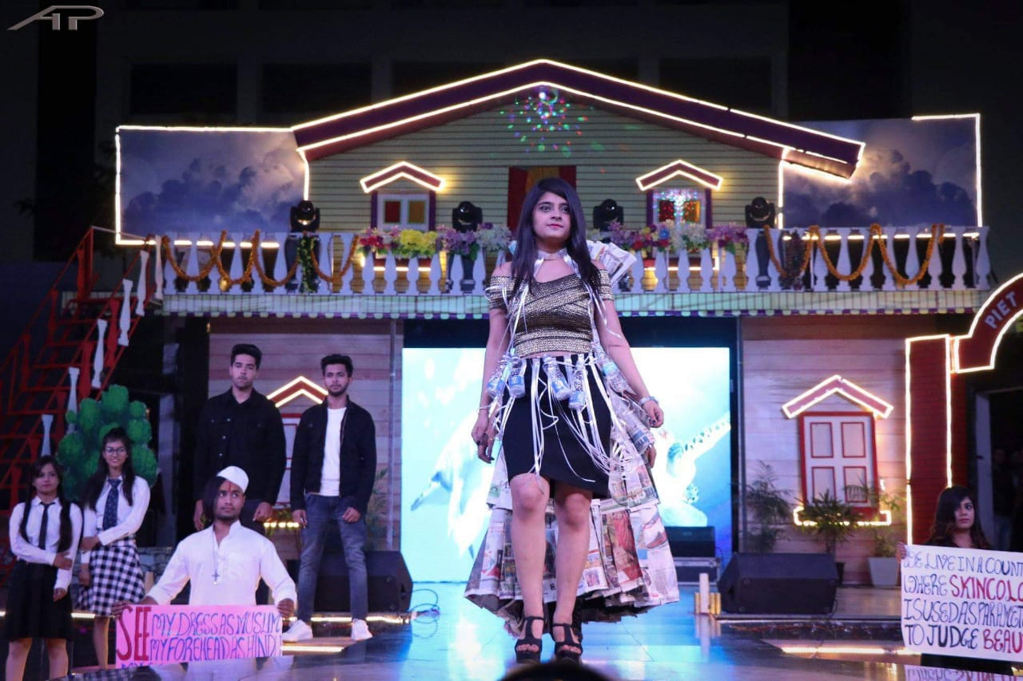

Slide 21
Industrial Visit
Feb 13, 2019
NDRI, KARNAL
Classes visited BBA 3rd year Sec A, B and E
BBA 2nd year Sec C and D

Slide 22
Faculty Visited: Dr. Y.S Kataria, Dr. Sangeeta, Mr. Rajesh and Ms. Namita
Industrial visit was carried out at NDRI ( National Diary Research Institute) on 13th Feb. The main objective behind the visit was to make student aware about how various activities related to marketing, financing and human resource are carried out in company and give them feel of managers. As soon as we reached company we were guided by Marketing Head about history ; how company was established and other information. We also got the information of various dairy products and how they are manufactured.
The Industry visit of NDRI gives student an indeed experience and see how a company manages its quality along with quantity.

Slide 23
Students got to know about lots of products of the company like- flavoured milk, cheese, ice-cream and other dairy products etc. Students got to know how the formulation how to manufacture it by keeping quality in mind. Students learnt about the manufacturing process and various other information for the same.
The whole Visit was Energetic and knowledgeable. Students were delighted by seeing everything lively. It is rightly said that “See & know’ is better than ‘read & learn’. Students have got real feel of company’s working after this visit.
They got a chance to transfer their theoretical knowledge to practical implication. This will even help students to understand subject matter clearly in future also.
Me along with student would like to extend our gratitude to company for permission and support they gave to make our visit a success with accomplishment of objective and our director Dr. Shakti Singh sir for arranging this visit for our student.
Thanks
Bhumika Khurana
BBA 2nd year Sec C

Slide 24
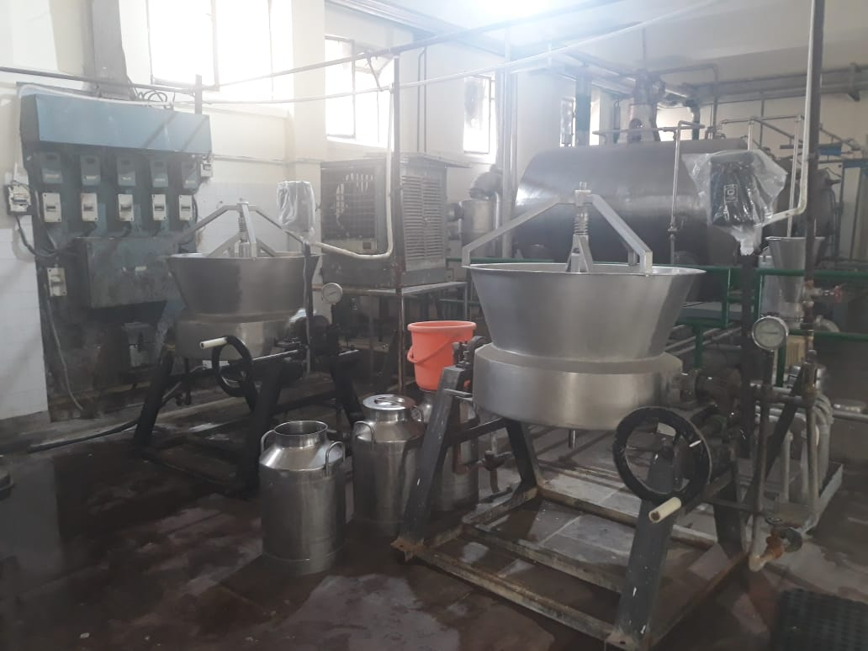
Plant Visited by BBA Students

Slide 25
Industrial Visit
Feb 14, 2019
NDRI, KARNAL
Classes visited-BBA 3rd year Sec C, D and E
BBA 2nd year sec C and D

Slide 26
Faculty Visited: Dr. Saurabh Garg , Ms. Preeti and Ms. Shilpa.

Slide 27
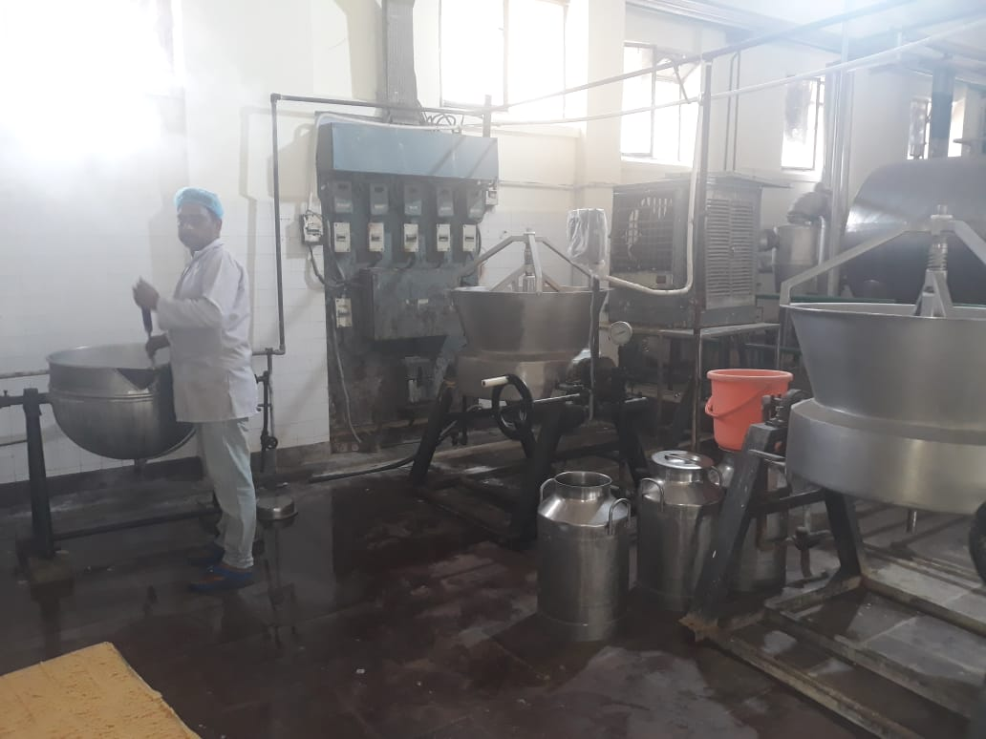
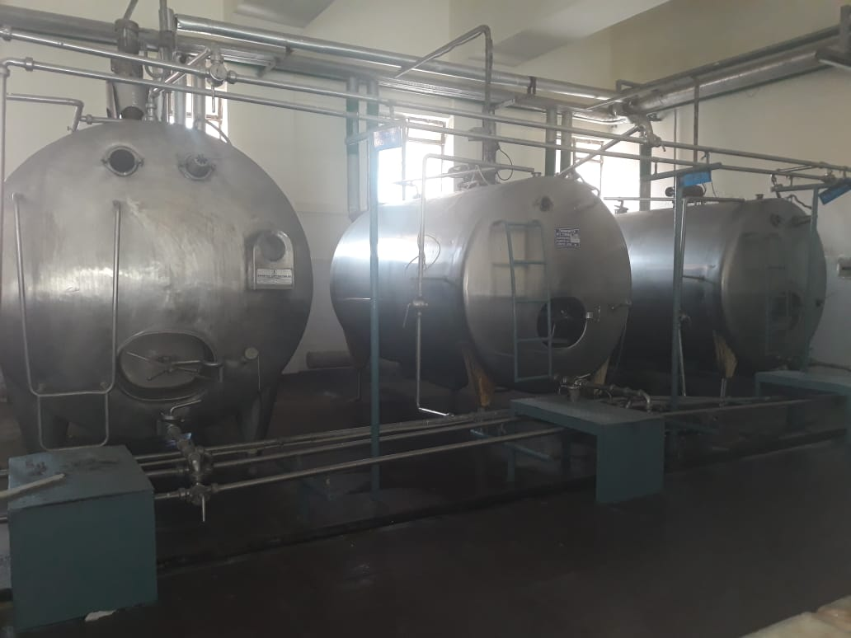
Glimpse of NDRI Plant

Slide 28
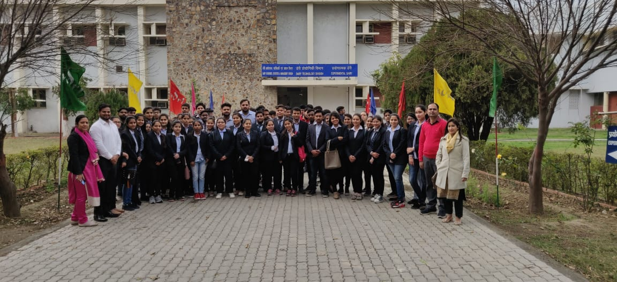
NDRI, the most premium institute of Haryana known for quality education. They have contributed largely in development of dairy industry and white revolution.

Slide 29
19/02/2019
Guest Lecture
On
Entrepreneurship Development

Slide 30
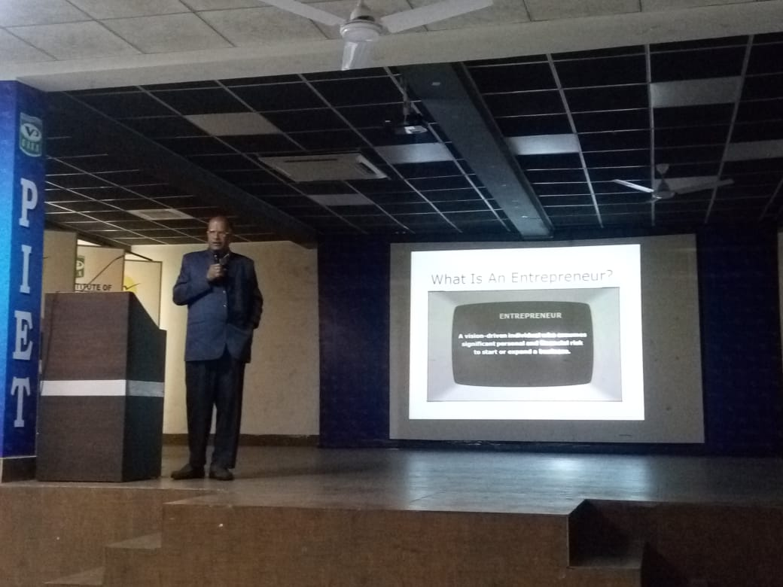
Prof. Sanjiv Mittal
Professor and Dean & Programme Coordinator Entrepreneurship Development Centre (EDC)
University School of Management Studies Guru Gobind Singh Indraprastha University Sector-16-C, Dwarka New Delhi , 110075

Slide 31
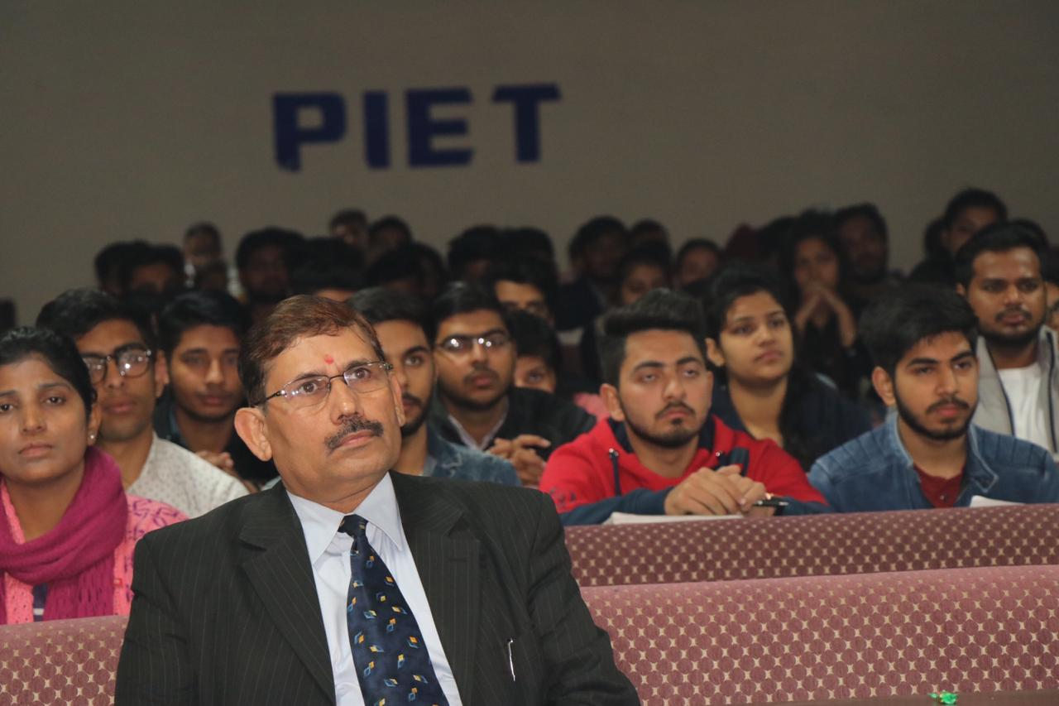
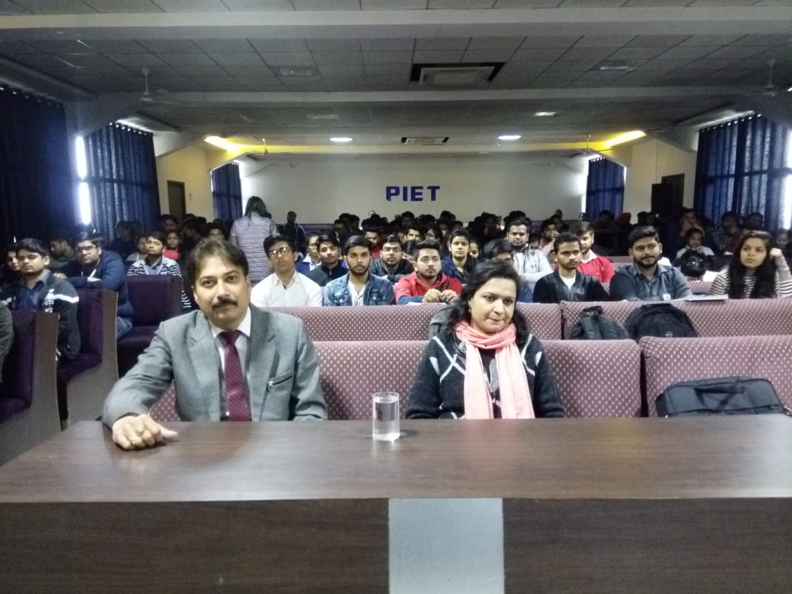
A Guest Speaker can be a great tool for the improvement of a class, because it offers a new perspective and variety in the way it is taught, while it provides important specific subjects that are often omitted from a regular class. That in turn brings a better learning experience to the students, the teacher and even the guest speaker. Because of the way this technique is used, a better one-on-one approach is achieved, as well as a better understanding of a topic that otherwise would be very dull or unclear. Students have a chance to learn about said specific topic in a way that helps them get fully involved in the class and actively engage in a more approachable way of teaching.

Slide 32
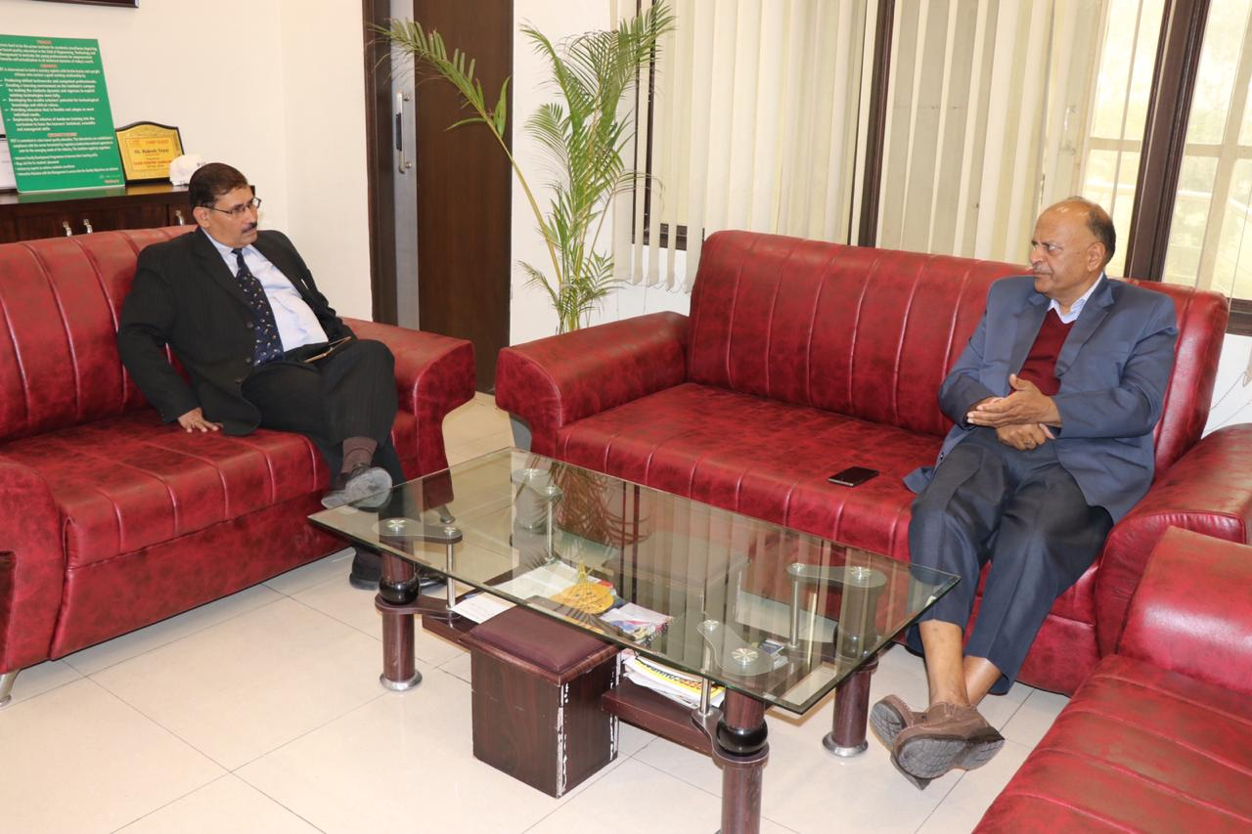
Interaction session of Prof. Sanjiv Mittal and Dr. Y.S Kataria.

Slide 33
BBA Sessionals
Feb 25- 28 2018

Slide 34
BBA 1st Sessionals recorded good attendance of around 70%, which is an optimistic figure for the department.
The role of faculty team in contacting the parents over telephones for spreading awareness for the same has played a vital role in this attendance

Slide 36
Ms. SAMRITI

Slide 38
How To Inspire Your Employees
An inspired employee gives his or her all to their employer, and is constantly striving to be and do their best; to use their skills and talents to their full potential.
Simply recognizing employees for a job well done can do a lot more than you'd expect.
Leaders who understand the power of their own viewpoint do not become victims of circumstance. Rather, they identify the challenges and the opportunities which are presented to them at the moment - whatever the adversity.

Slide 39
motivate your employees is by investing in them. Offering things like tuition reimbursement, a mentoring program, one-on-one coaching, and job shadowing with people in higher positions sends a clear message: you care about their career and their future.
Show your employees why they matter to the company, and what the results of their work are, and they’ll feel rewarded and motivated to keep at it.
By :Ms.Samriti

Slide 40
Mr. Charan

Slide 42
LEADERSHIP QUALITIES
1. Self-motivated:
Motivated leaders desire to achieve above and beyond expectations.This comes from their passion, pride and desire to become better and the motivation to do things better than everyone else.
Standards:
Leaders hold them selves and the people around them to a higher standard than most, both on a personal and professional level.

Slide 43
3. Confidence:
Unfortunately, confidence can be one of those things you either have or don’t have, but I believe that it can be practiced and learned. Confidence has to do with your inner perception of your ability to fulfill a particular role and is built through your experiences and dealings during your life.
4. Optimism & Positivity:
Where others might think a project or task is too difficult, leaders face those challenges with energy and positivity.

Slide 44
5. Accountable:
Being accountable means that you accept responsibility for the outcomes expected of you, both good and bad. You don’t blame others. And you don’t blame things that were out of your control.
6. Courage:
Aristotle called courage the first virtue, because it makes all of the other virtues possible.
Leadership sometimes involves making unpopular decisions which requires a certain level of bravery.

Slide 45
7. Engaged:
Great leaders are able to focus their attention on the problem at hand without being distracted.Even when your extremely busy, you need to make sure that you’re participating in the process with team members and not giving orders from the sideline.
By:
Mr. Charan

Slide 47
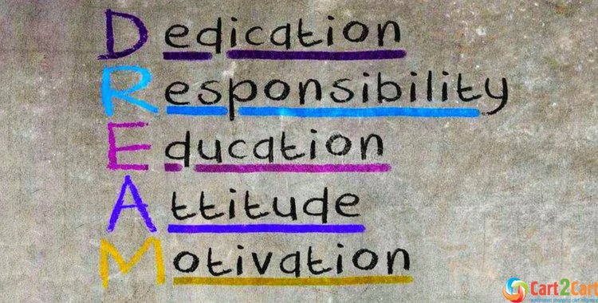

Slide 48
Thank you
BBA, HOD
(Prof. (Dr.) Yoginder Kataria)
BBA, E- Committee
(Mr. Jagmohan Malhotra)
(Ms. Pooja Gupta)

